Slide 1
Understanding and paying my TE Invoices
New TE System Snippet
The heading on the following slides details where you find the information for Billings and Invoices

Slide 2
Billing Invoices
Be sure to click the 2024-2025 Academic year
You can leave the Fee Type as All Fee Types
You can change the Fee Type to Membership Fees or Participation Fees

Slide 3
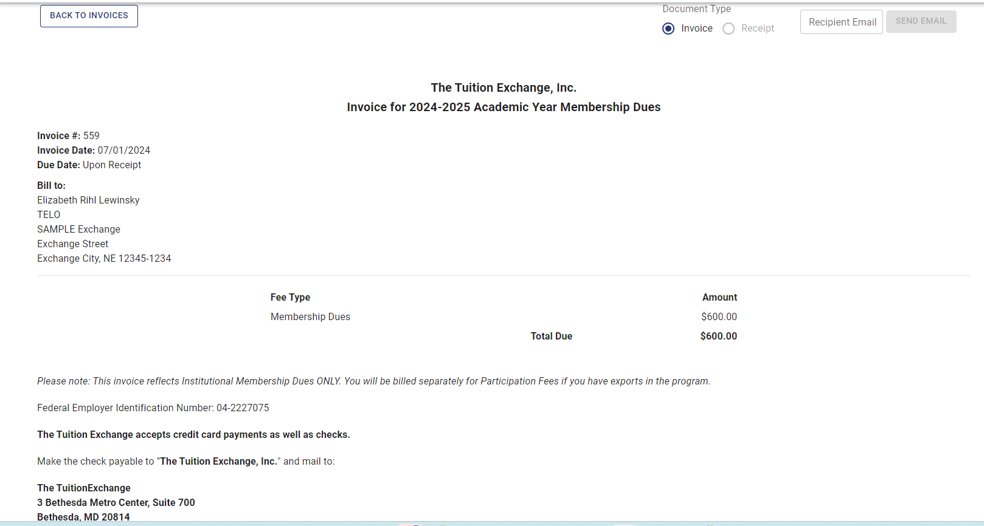
To Pay By Check
To open the Invoice by check – click on the Invoice Number
A new screen appears complete with an INVOICE number
You can choose to email the invoice to others for payment

Slide 5
Pay by Credit card – TE Central does not charge member cc fees to use

Slide 6
Paid Receipts
The individual listed on the Bill to: receives an email receipt
Should you need a duplicate receive see below

