Slide 1
School Profile specific questions
The heading on the following slides details where you find the information for responding to School specific questions

Slide 2
School – School Profile
If any of the required information is missing, the school will be greyed out and not available for student selection
General biographical information was imported into the system
If any general information is incorrect – the Primary TELO can update all information EXCEPT the school’s name
Contact TE Central @ info@tuitionexchange.org, sharing the name currently listed in the TE system and the new name
Please allow 24 business hours for changes to be made
It is the responsibility of the Primary TELO to maintain, add, or delete the contact information listed
TE Central will not contact any listed contact without sharing the information with the Primary and Secondary TELO
Confirm the Users listed are correct
If incorrect, refer to the snippet: Creating and Modifying…
If a secondary TELO is missing, refer to the snippet: Creating and Modifying…

Slide 3
School School Profile
Program Settings
Accepting New Students?
The answer should be YES for all active schools
If the answer is NO, the school is not available for student selection
Academic Term
If unknown, contact your Registrar asking if the school’s academic term is:
Semester
Quarter
Trimester
Non-EDU Email Accepted
Yes, this means only applications with eligible employee email addresses ending in .edu are allowed
No means any application with the eligible employee email address entered is allowed
For more information, refer to the snippet Eligible Employee Email Options

Slide 4
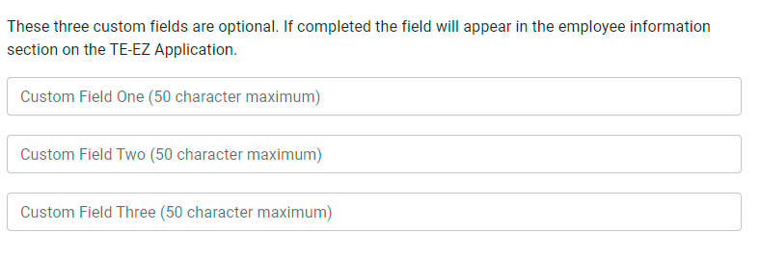
School – School Profile
Program Settings: Three custom fields – optional for EXPORT schools only
Export schools only
Optional
Can be open-ended or YES/No
Once determined, do not modify during the Annual Aid Year
Are not searchable

Slide 5
School – School Profile
Required. The information should be upbeat. Ask the marketing department for assistance if you are unsure what to share. This is a text-only feature.
If you still have questions after reviewing the information, refer to your school guidelines, Registrar, or Marketing Department before contacting TE Central. Thank you!

