Slide 1
TE New System Walk-Through
Liz Rihl Lewinsky, FAAC®, M.A., M.Ed.
Associate Vice President for Member Engagement

Slide 2
Reminders Before We Begin
Bookmark the new TELO system: te.tuitionexchange.org
Bookmark the new TELO System FAQ’s: www.tuitionexchange.org/TELO-FAQ
You must have completed a live mandatory training session or have watched the mandatory training webinar to be able to access the system. View webinar at: www.tuitionexchange.org/TELO-FAQ
*NEW* TE EZ-Application: https://te.tuitionexchange.org/applicantsignin
TE EZ-Application Podcast Link: https://register.gotowebinar.com/recording/2511780877935218094
Janet Hanson is retired-direct email inquiries to: info@tuitionexchange.org.
Please be sure to list full name of your institution, clarify import/export.

Slide 3
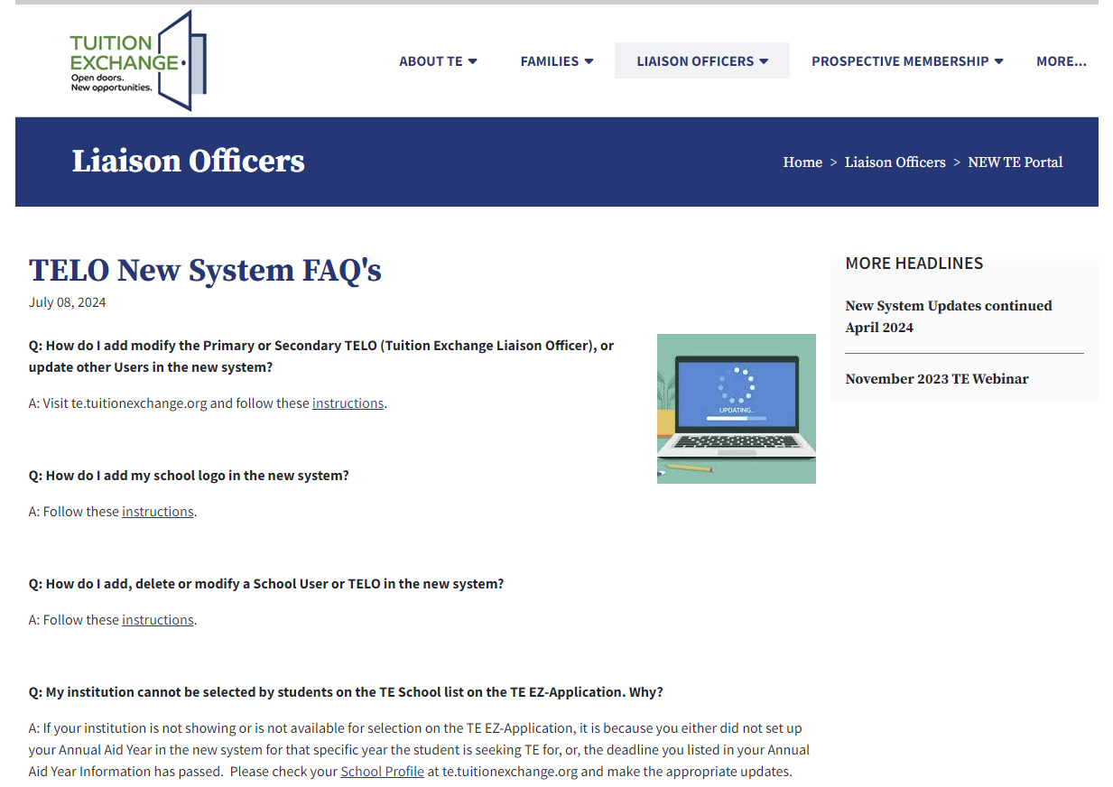
TELO New System FAQs & Instructions (Liaison Officers – New TE Portal)

Slide 4
Reminders Before We Begin
Every member school must have a Primary and Secondary Tuition Exchange Liaison Officer (TELO)
The names and email addresses must be different and be a .Edu address
Primary TELO is responsible for system maintenance including:
Ensuring the School Profile, including all institutional contacts, is accurate
Adding, maintaining, and removing system Users (note—for the Invoice Billing Contact to be able to pay the bill in the system, he/she must be set up as a User, can have Billing only role).
Adding and maintaining Annual Aid Year School Information for 2024-2025 and 2025-2026 years
If not populated or if deadlines for Import and Export application consideration are past, your institution will not be available in Employer list for selection or for prospective import students to select in school list on TE EZ-Application
ALL Continuing students that were recertified moved into the new system with a cohort year of 2023-2024, regardless of their entry year. They will show up on your 2024-2025 Enrollment Report once the Import School enrolls them (after August 15th). They do NOT need to do a new application b/c they do not show up with 2024-2025 as their year.
All New 2024-2025 students with a status of approved or decision pending in the old system moved into the new system. Waitlist students did not move.
PLEASE, PLEASE be sure you check off ALL AID YEARS (not “Active Aid Years”) when viewing your Imports and Export Applications.
If you have a Continuing student who no longer wants TE or will not be enrolled, the IMPORT school withdraws the student. There is no longer that type of action for the EXPORT school.

Slide 5
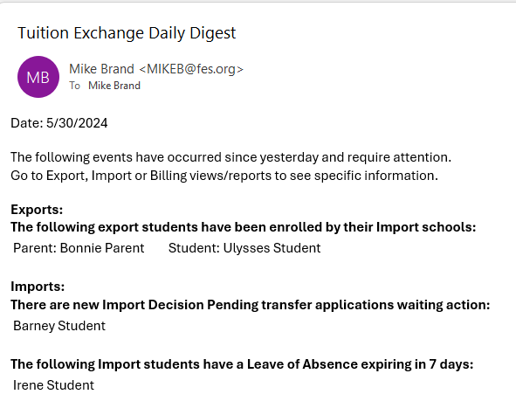
Daily Digest Emails
No more individual student emails. Students review their account activity inside their TE EZ-Application account
Primary and Secondary TELOs receive a Data Digest nightly-reflects prior day activity
Comments provide you with the required action
As Import School, you will not get notification of new applications until the Export School approves them for TE consideration.
As Export School, if Import School denies one of your Imports, you will get a status update. There is no action required, however.

Slide 6
Daily Digest Emails
What you’ll be notified of:
Exports:
There are new export applications Awaiting Export Decision action
The following export students have been enrolled by their Import schools
The following export students have been put on Leave of Absence by their Import schools
The following export students have been denied by their Import schools
The following export students have been withdrawn from their Import schools
Imports:
There are new Import Decision Pending applications waiting action
There are new Import Decision Pending transfer applications waiting action
The following Import students have a Leave of Absence expiring in 7 days
The following Import students have been denied by their export school
The following student applications have been closed due to reaching maximum eligibility usage
Pending Invoices

Slide 7
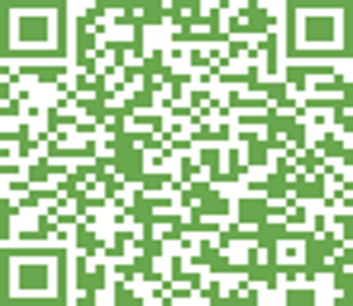
Thank you for your time and attention We want to hear from you! Scan to take the short survey

