Slide 1
Daily Digest
New TE System Snippet
The following slides provide you with information about the Daily Digest

Slide 2
Daily Digest
The Primary and Secondary TELO receive a Daily Digest when events happened in the past 24 hours
Emailed early morning when events occur impacting your Exports and Imports
Emailed early morning when NEW outstanding invoices are available
An example of the Daily Digest is available on the following slides
If no action occurred impacting your Exports, Imports, or financials, you will NOT receive a Daily Digest email

Slide 3
Examples of System Generated Emails
No more individual student emails!
  Students review their account activity inside their TE account
No more emails clogging TELO email accounts!
  Primary and Secondary TELOs receive a Data Digest nightly
    Provided activity occurred yesterday impacting your students or a new Invoice was generated
Comments provide you with the required action
  Review the following slides for details

Slide 4
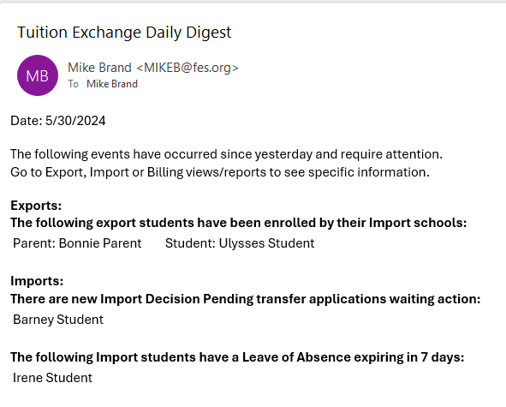
Example of the Daily Digest – be sure to read all comments

Slide 5
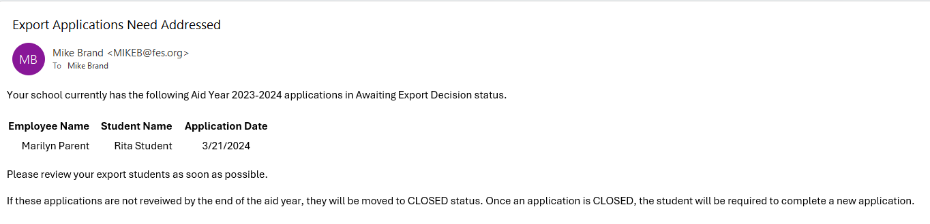
Daily Digest – be sure to read all comments

Slide 6
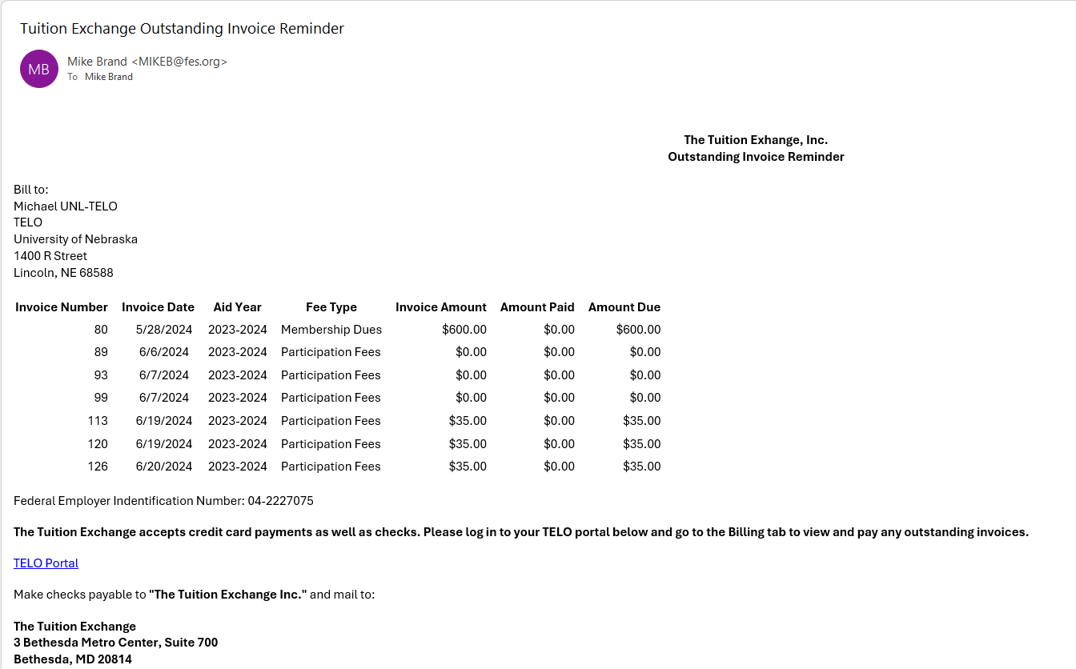
Daily Digest – click the TELO Portal for quick access to the Invoice

