Slide 1
Creating, modifying, or deleting TE users
The heading on the following slides details where you find the information on Creating, modifying or deleting TE system users
If you still have questions after reviewing the information, contact TE Central. Thank you!

Slide 2
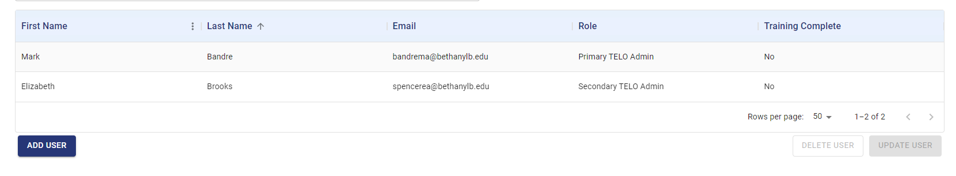
School
Users
Each member school is required to have in place, at a minimum, a PRIMARY and
SECONDARY TELO
TE Central added the initial PRIMARY TELO
The PRIMARY TELO is responsible for all user maintenance, updates, and deletion
The PRIMARY TELO has the authority to add any other user to the system.
Should the PRIMARY TELO leave, contact TE Central for replacement assistance of the PRIMARY TELO

Slide 3
School
Users – ADD USERS
Requires a first name, last name, and email address*
If the Secondary User is in place, the option to add a Secondary User is not available
Other users can be added to one of two categories
  Active user – allows the user to see and modify student records
    Requires participation in Mandatory Training
  Read-only user – provides the user to see student records
    Does not require participation in Mandatory Training
User options
  Export
  Import
  Billing
  Reports

Slide 4
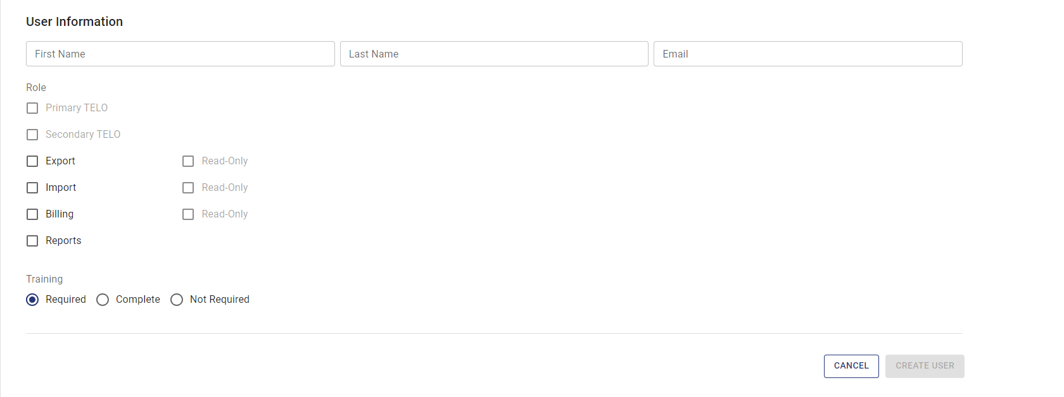
School
Users – ADD USER
To add users not listed, click ADD USERS

Slide 5

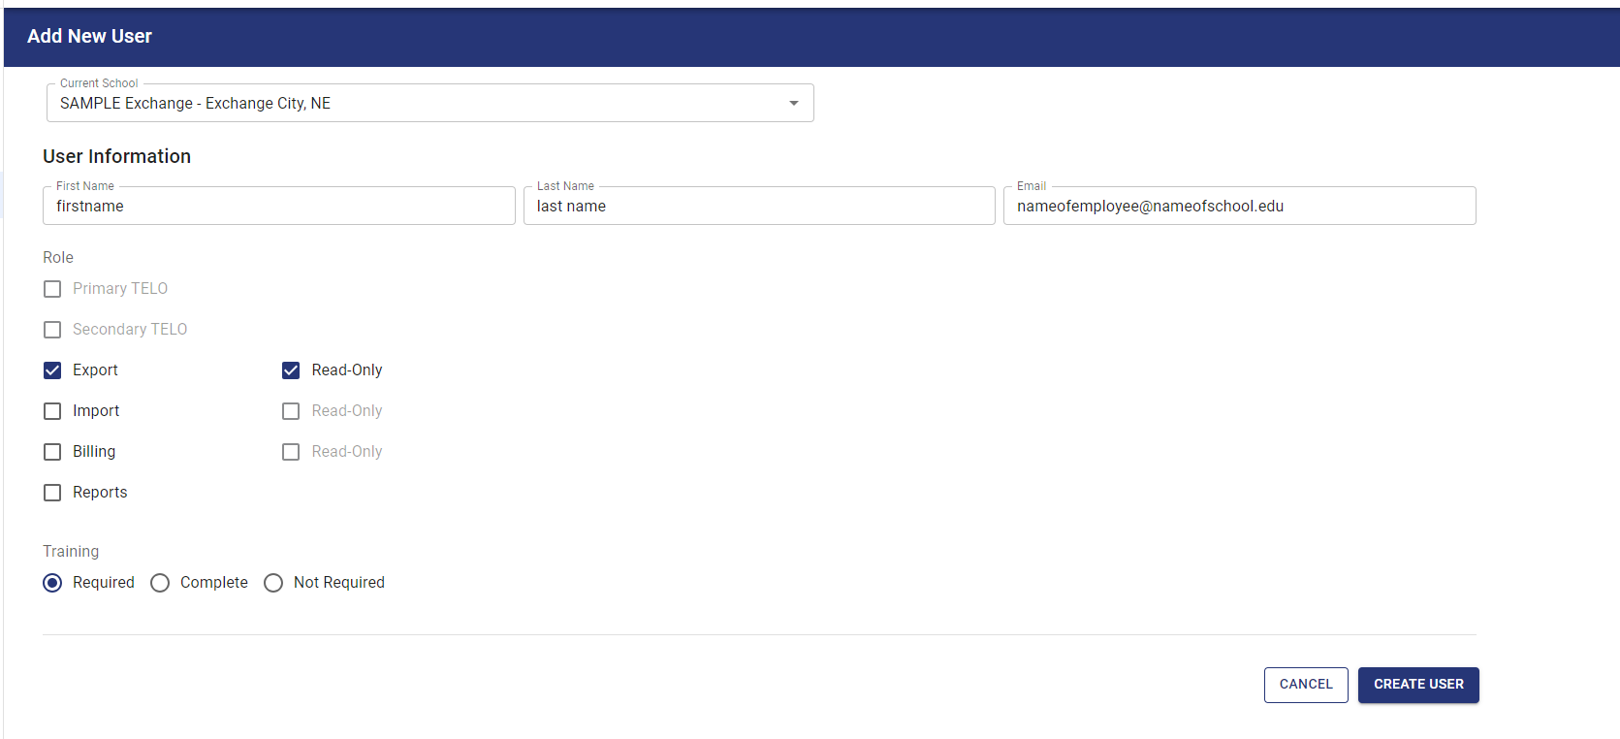
School
Users – ADD USER
Click ADD USER
Be sure to click Create User

Slide 6
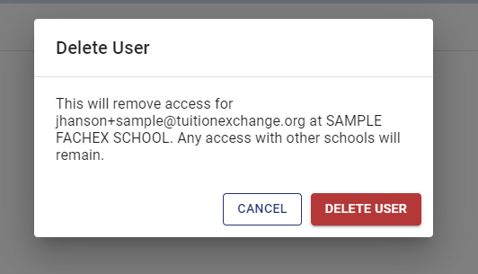
School
Users – How to delete/remove a user
The PRIMARY TELO is responsible for maintaining all active users
To remove a user – click on the name of the user which requires removal
The option DELETE USER appears clear to the right (beside UPDATE USER)
Click DELETE USER
The following Delete User message appears
Click DELETE USER one more time

