Slide 1
TE EZ-APP online process
Tuition Exchange has a new student application process

Slide 2
What you need to know!
The TE EZ- APP is all about the student.
The student should have an email account besides their high school email address.
Consider creating a Gmail, Yahoo!!, Hotmail or other commercial email account option.
Be sure the student email address is professional, considering something like firstname.lastname2024@name of email provider.com.
Do not use the eligible parent’s employee email address unless the eligible parent is also the student.
The student is creating a Tuition Exchange account, which stays with the student throughout their educational journey as a TE scholar.
Should the student wish to transfer, take a leave of absence, or stop out, the application follows, and no new application should ever be created.

Slide 3
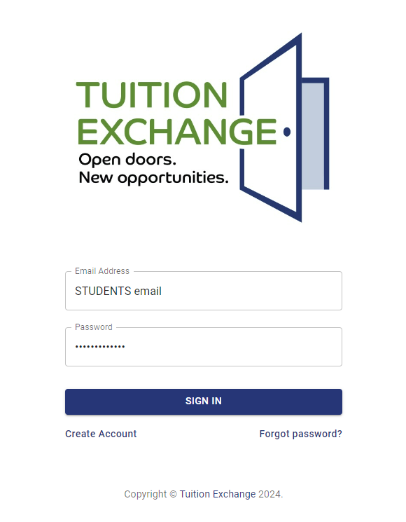
Creating the students TE EZ-App online account
The application is available at:
www.abc.org/applicationsignin
Enter the STUDENT email address.
See slide two (2) for suggested email address options.
Create a 12-character password that includes alpha, numeric, and special characters.
Click Create Account.

Slide 4
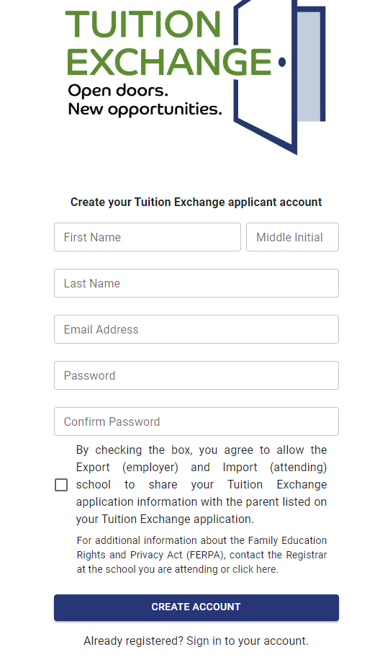
The nine steps for adding the student’s biographical details
Enter the student’s legal first name.
Middle Initial is optional.
Enter the student’s legal last name.
Enter the same student email address used to create the TE EZ-App account.
Re-enter the same 12-character password that includes alpha, numeric, and special characters used to create the TE EZ-App account.
Confirm the password entered in step 5.
Once the student graduates from high school or turns 18, whichever is first, the student is the owner of all academic records. By checking the box, the student agrees that the eligible employee listed on the TE EZ-App can ask questions and receive information regarding the student’s Tuition Exchange account.
For additional information about FERPA, go to https://studentprivacy.ed.gov/resources/eligible-student-guide-family-educational-rights-and-privacy-act-ferpa
The last but most important step is to click CREATE ACCOUNT.

Slide 5
EZ Application
Take three minutes to review the information.
The academic year is when the student seeks their initial Tuition Exchange scholarship.
For the 2025 high school graduating senior, the Application Year is 2025-2026.
Any student receiving a Tuition Exchange scholarship should NOT complete a new TE Application unless the student plans to transfer to another Tuition Exchange member school.

Slide 6
Student information
Use the student address provided on all admission applications.
Enter only numbers for the student’s phone number.
Enter the student’s birthdate and correct birth year.
Student birth year is the most common app error.

Slide 7
Eligible employee information
The information in this section is all about the eligible employee.
Click on the carrot (triangle) to the far right inside the Employer box and click on the name of the eligible employee’s employer.
If the employer’s name is greyed out, review the member school information for the school Export deadline and the student’s selected Application Year.

Slide 8
Eligible employee information, continued
First and Last name must be that of the eligible employee.
The email must be the eligible employee’s employer .edu* email address.
i.e. john.doe@Doecollege.edu
* if the eligible employee does not have a .edu email address, check directly with the employee’s Tuition Exchange Liaison Officer (TELO) for options.

Slide 9
Eligible employee information, continued
The eligible employee’s exact title or position must be provided.
In whole numbers, provide the years the eligible employee has been employed at the school.
For any questions about years of employment, the employee connects with Human Resources or their TELO.
Employee ID – this is a series of numbers assigned to the employee by the employer.
DO NOT PROVIDE the eligible employee’s social security number!

Slide 10
Eligible employee information, continued
Each school may ask up to three additional school-specific questions.
Each school-specific question must be answered to submit the application successfully.
Questions regarding the school-specific questions must be directed to the eligible employee’s TELO.

Slide 11
Application Information
The information in this section is all about the student.
Student Classification
The first 5 options are for the undergraduate student.
If the Free Application for Federal Student Aid (FASFAA) is completed, use the same student classification.
The final option is for the eligible employee, spouse, or registered domestic partner if the eligible employee’s employer offers graduate school as a TE scholarship option.
Check with the eligible employee’s TELO for additional information and program clarification.
Generally, once the student graduates, they are no longer considered an eligible dependent of an eligible employee.

Slide 12
Application information, continued
Applying to is where the student selects up to ten (10) schools to which the student will apply or has applied for admission.
The maximum number of schools is ten (10).
The student can modify the list until one school enrolls the student. (See slide 13).

Slide 13
Student application status matters
The student’s Application Status is important. If open, the student can modify the application.
The student can click on OPEN to review the individual statuses of each student’s applications.
Students always contact their admission counselor at the import school for information.

Slide 14
Student application status matters, continued
The student’s Application Status is important. If closed, the student cannot modify the application.
The student can click on CLOSED to review the individual statuses of each student’s applications.
The student contacts the Import school for additional information.

Slide 15
Finalizing the student TE EZ-APP
Each time the student reviews or changes their TE EZ-APP the student must check the box and click SUBMIT.

Slide 16
Final Reminders
The TE-EZ Online App is all about the student!
For employer-eligible questions, the employee contacts their Human Resource Office or Tuition Exchange Liaison Officer.
If the eligible employee leaves their employment, the TE scholarship is canceled.
For Import eligibility questions, the student contacts their Admission Counselor.
Tuition Exchange is not an employee benefit!
Tuition Exchange is a scholarship opportunity.
Not all students will qualify for a Tuition Exchange scholarship.
The student is responsible for reading, understanding, and asking questions about the TE scholarship offered.
What is the scholarship amount?
Can I receive an additional institutional scholarship, too?
What about federal Pell Grant or State Tuition Grants?
What are the scholarship renewal requirements?
Are there on-campus housing requirements?
How many semesters are covered?
Can I be a part-time student and receive Tuition Exchange?
Does the TE scholarship cover summer school and study abroad?

