Slide 1
Introducing the new TE user portals
Janet Hanson, EdD
Director of Communications
IT Project Manager

Slide 2
Today’s Focus
Scholar Portal
TE Liaison Officer Portal
TE Central Portal

Slide 3
Scholar Portal
It is all about the student.
A simple nine-step process, start to finish.
A one-time FERPA option is available.
To update the FERPA choice, the student connects with the school(s).
The parent detail is all about the eligible employee.
Can have up to a maximum of ten (10) individual schools.
Student can modify their choices throughout the process.

Slide 4
What the student sees
Student logs into the system with the student’s personal email address.
Student can review the status of individual applications.
The Application date is recorded, and each change date is recorded separately.
Students can manage their application by removing or adding schools up to a max of 10.

Slide 5
Student Application Status

Slide 6
TE Liaison Portal
Member requirements:
Maintain Primary and Secondary TELO and all other users.
Keep Up-to-date school profile.
Provide Annual Aid year details.
Oversee Export and Import deadlines.

Slide 7
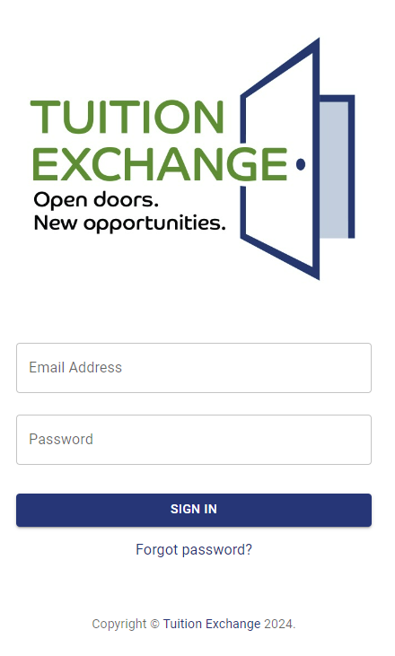
TE Liaison Portal Enhancements
Individual and secure sign-in
Option to offer READ-ONLY
Employee ID question (not required)
School type – semester, trimester, quarters
Summer school, study abroad, and leave of absence simplified
Up to three (3) optional fields for data collection
Data is collected but cannot be sorted by these fields
Bulk update status options
Tuition Exchange Tickler – Daily Email Digest
Reports
Static
CSV download to Excel

Slide 8
What the TELO sees
The option to view the School information.
The option to add, modify, update, or remove Annual Aid Year School Information.
The ability to add users outside of the Primary TELO.
Export details reflective of the employee.
Import information focused on the students.
Billing statements.
Reports.

Slide 9
TE Liaison Officer Portal

Slide 10
Information – Tuition Exchange Tickler (TET)
The daily digest email will:
Remind TELOs of tasks to complete.
Determined by actions that happened in the system the previous day.
For example:
Application changes that occurred;
Detail reminders such as there are exports to work;
There are still outstanding Imports to work;
A student is no longer eligible;
And so on.
Best of all – if you don’t receive a TET email, you are up to date

Slide 11
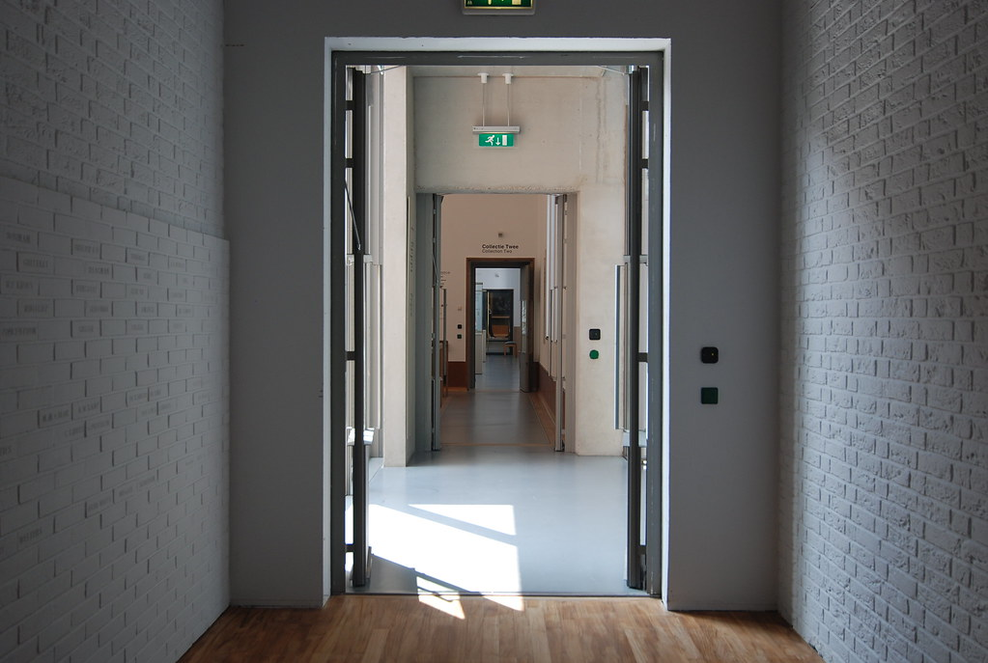
TE Central Portal
Individual user sign-in
Modern, clean, secure
SQL Database construction
Needed information in one orderly space
Specific TE Admin Settings for individual
member institutions
Data filtering and CSV export option
Reports
Static
Crystal

Slide 12
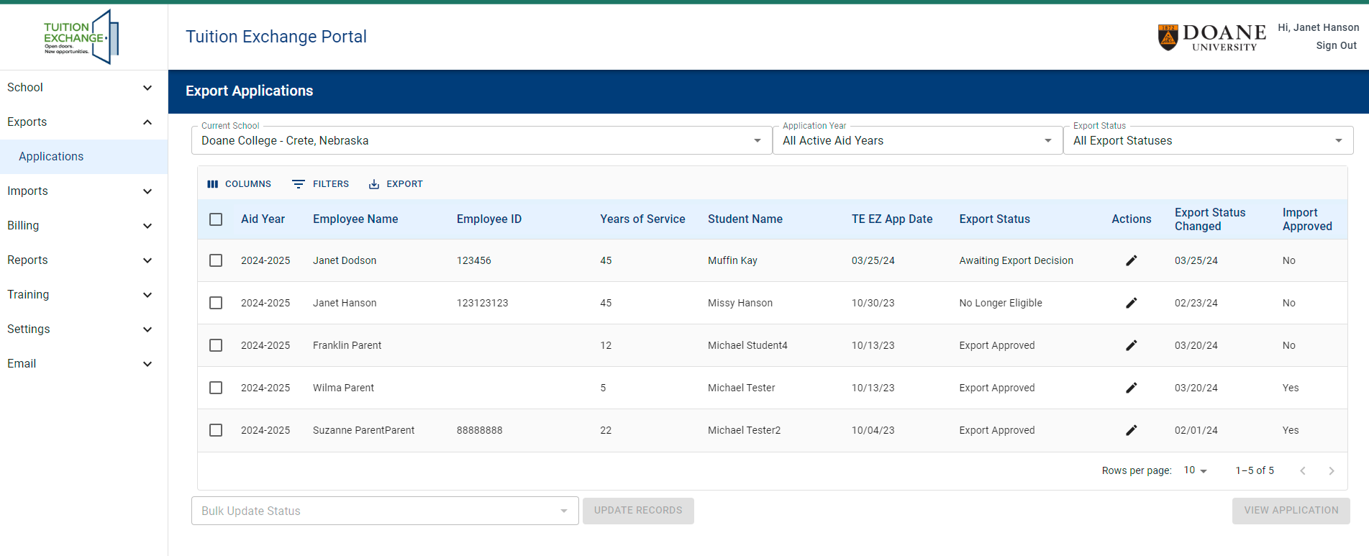
TE Central Portal
Export – application report option for one school, regionally or globally.
Status-specific and year-specific

Slide 13
TE Central Portal
Import Reports – just like the Export Report option – multi-faceted and flexible!

Slide 14
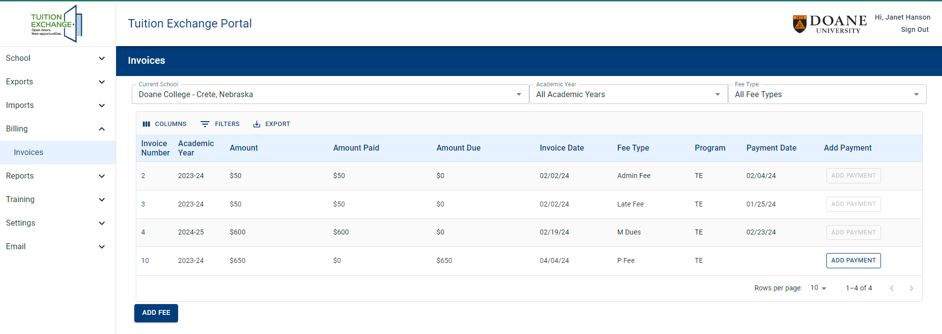
TE Central Portal
Billing options are cleaner, more precise, yet flexible.
Invoice numbers allow TE Central and members better payment tracking options.
Pay by credit card continues to flourish and is greatly appreciated by our members and TE Staff.

Slide 15
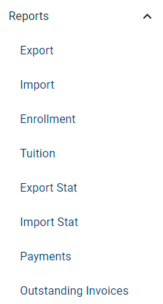
TE Central Portal
Static Report options
These reports are push-button fast.
Can be downloaded to EXCEL.

Slide 16
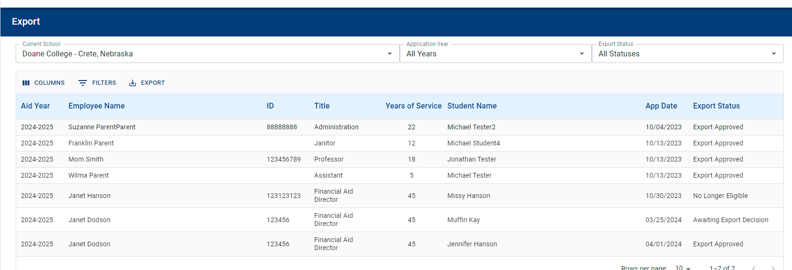
Reports at a glance
Export
Import

Slide 17
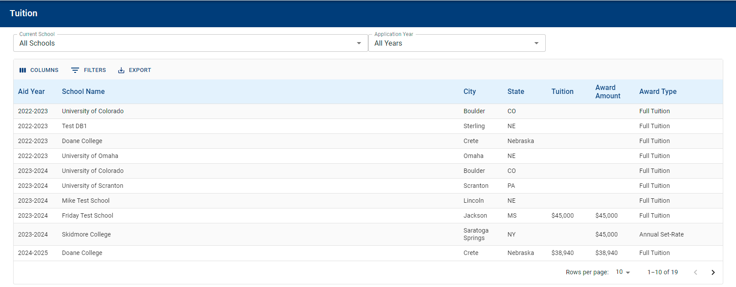
Reports at a glance continued
Enrollment Summary (fka Enrollment Report
Tuition and TE scholarship

Slide 18
Time for Your Questions
This Photo by Unknown Author is licensed under CC BY-SA

Slide 19
Answers!

Slide 20
Calendar
Daily – approve or deny 2024-2025 new students.
By May 15 – all re-certifications must be completed.
By June 1 – all continuing students must be funded, or the expiration date must be updated.
June 14 – every school must print one final and clean Enrollment Report and Balance Sheet for your records.
June 17 – 21(or June 24 – 28) the Tuition Exchange Liaison Portal and TE-EZ Online app process will be unavailable.
Depending on the date above, the new Tuition Exchange System will be launched.
Throughout July and August – new system mandatory training will be provided.
Every Primary and Secondary TELO must attend at least one live session.

Slide 21
Great things are happening in …
New System and Updated ways to manage Tuition Exchange
New Application Process for students and a
New Contact at Tuition Exchange – thanks for the memories! J

Slide 22
Happy Spring
Take a walk!
Complain about the weather!
Enjoy all the spring flowers.
Know that TE Central appreciates all your hard work.
Thanks! Janet
This Photo by Unknown Author is licensed under CC BY

