Slide 1
Tuition Exchange TE Portal
Janet Hanson, Fall 2023

Slide 2
Today’s focus
TE Liaison Officer (TELO)
Portal login
School Profile
Annual Aid Year information
User set-up
TE-EZ Online (Student) application portal
Portal login
Export TELO Review
Training Schedule
Reporting

Slide 3
New system TELO messages shared to date
New TELO system coming July 2024
Requires all member schools to use the TE-EZ Online application
Requires all member schools to have two TELOs
Export TELOs will have the option to approve all Export applications rather than one at a time
The Export school will approve the first set of TE-EZ Online applications only
Additional new applications in the same academic year will automatically be approved
Enrolled students no longer require re-certification in subsequent years
Unless parent changes jobs or student transfers
A Daily Digest emailed nightly
Keeping TELOs informed

Slide 4
TELO Portal
Fall 2023

Slide 5
Accessing the system
Resetting a forgotten password
Enter your user email and system password
First-time users receive an email from info@tuitionexchange.org with a temporary password after the user is set up
.
The user enters the
email address used to access the system to
receive via email a temp
password
The email comes
from Info@tuitionexchange.org
This area will eventually include announcements and reminders.
If the user forgets the
password, clicking forgot password prompts the user to a new screen

Slide 6
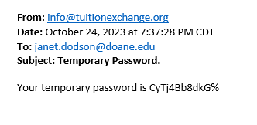
Logging in
Password Requirements
A minimum of 12 characters, including at least one capital letter, one number, and one of the following special characters !, %, &, *, ?, #, @, or $
The prompt will be emailed from Info@tuitionexchange.org

Slide 7
What you see when logging in
The Welcome page will include reminders and messages
School name and logo will be displayed in the upper right corner
The TELO navigation area is on the left
Click on the carrot to expand the options
The system automatically logs the user out after four hours, requiring logging in again

Slide 8
School details
TE Central sets up the initial school profile
TE Central sets up the Primary TELO
Should the primary TELO leave, the school’s secondary TELO or TE Central can set up the new Primary TELO
The Primary TELO is responsible for maintaining all member information
The Primary TELO must populate the Annual Aid Year school information
If not populated, the school does not appear on any lists
The Primary TELO adds and deletes all other users

Slide 9
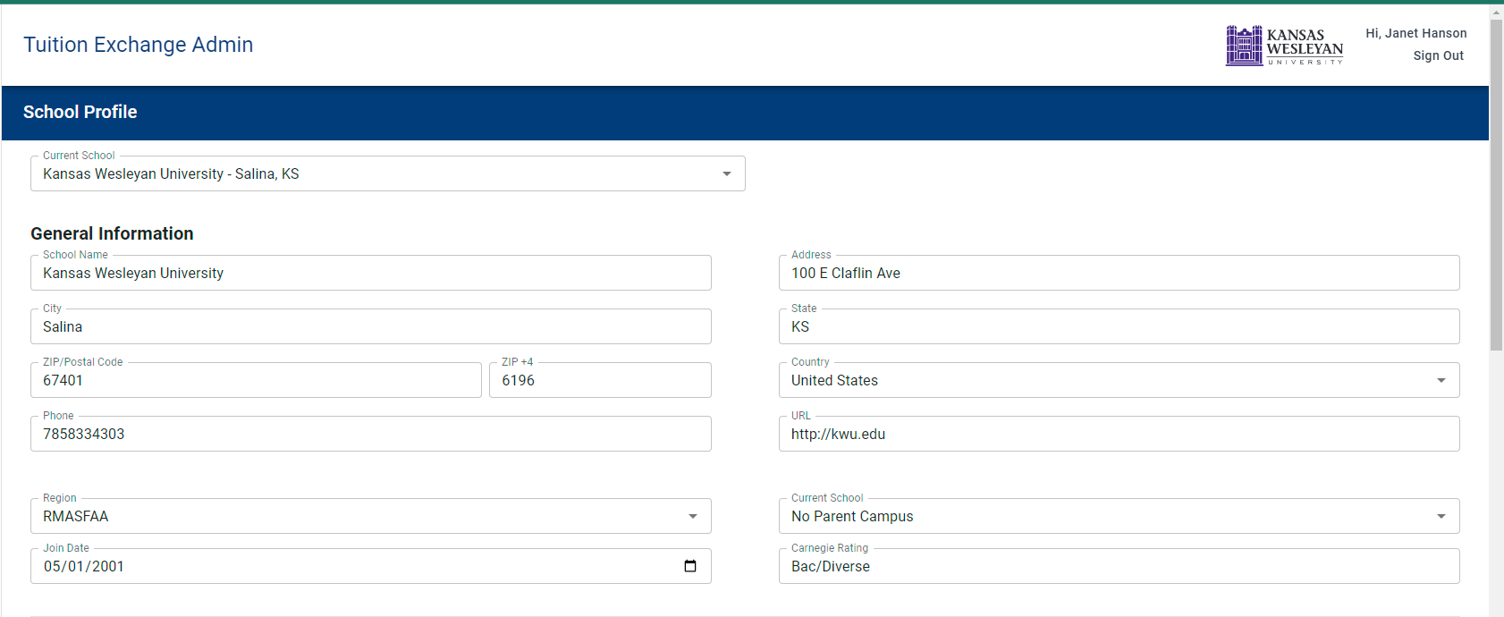
School Profile
Notice the logo, username, and sign-out option Member name, region, join date, and Carnegie ranking are static fields modifiable by TE Central only

Slide 10
Contact information
Every contact requires a name and a valid email

Slide 11
User Details
As users are added, the name and user type is provided
The primary TELO is responsible for keeping users up-to-date
The primary TELO can add, modify, and delete users

Slide 12
Program Settings & Details
Primary TELO is responsible for keeping program settings current
The Percentage of Award Offer field is moving to the School profile section for annual updating
Each member school has up to three optional TE-EZ Online application fields
The fields are not sortable
The Overview requires at least 100 characters of valid text

Slide 13
Annual Aid Year details
No more over-writing – each year’s information is saved
The information gathered powers the school search information used by families for the upcoming academic year
The information can be updated as needed
The Primary and Secondary TELO will have a read-only option to toggle between years
We plan to have five years of information
Next year, current year, and the most recent three previous years*
* details will be held beginning with 2025

Slide 14
Annual Aid Year School Information
New questions
Student categories mirror the FAFSA

Slide 15
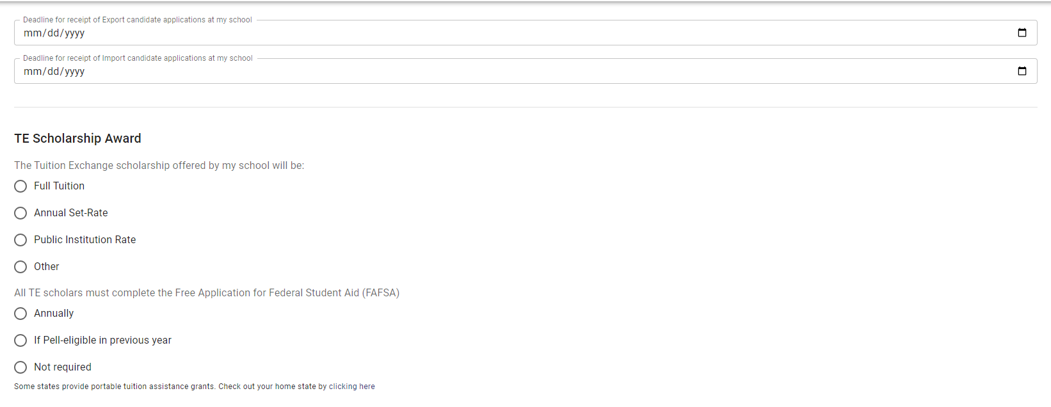
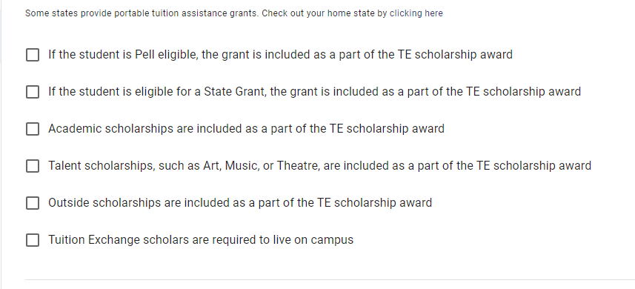
Annual Aid Year School Information - continued
Export and Import application deadlines
TE scholarship award amount options
Questions focused on FAFSA are clearer
Additional questions to emphasize attention on other financial aid issues and campus requirements

Slide 16
Annual Aid Year School Information - continued
Eligible Import applicant academic programs
When selecting options with EXCEPT – a text box opens for the TELO to complete with a limit of 250 characters.

Slide 17
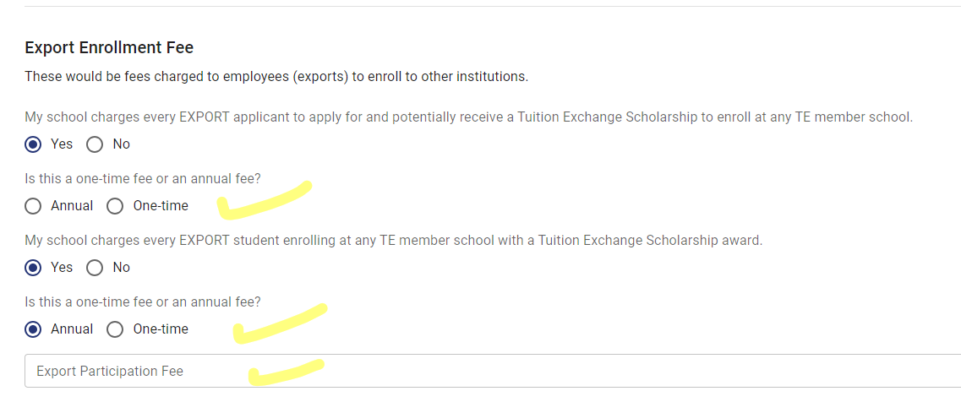
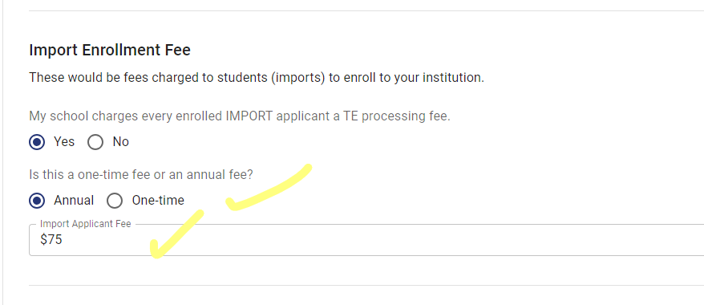
Annual Aid Year School Information - continued
Schools can charge families a reasonable access or user fee
The questions have been re-worded, making the options clearer
Allows for better consumer information

Slide 18
Defining Users
TE Central enters the primary TELO
All other users are defined, added, or deleted as necessary by the primary TELO
Some members use a third-party payment service – i.e., PayMeRang
The primary TELO provides user access
The primary TELO makes all biographical updates
Only one primary and secondary TELO are allowed
Additional users can be provided full access to the EXPORT, Import, Billing, or Report option
Users can be limited to read-only
All primary and secondary TELOs are required to participate in Mandatory Training
Training attendance will be managed via the system

Slide 19
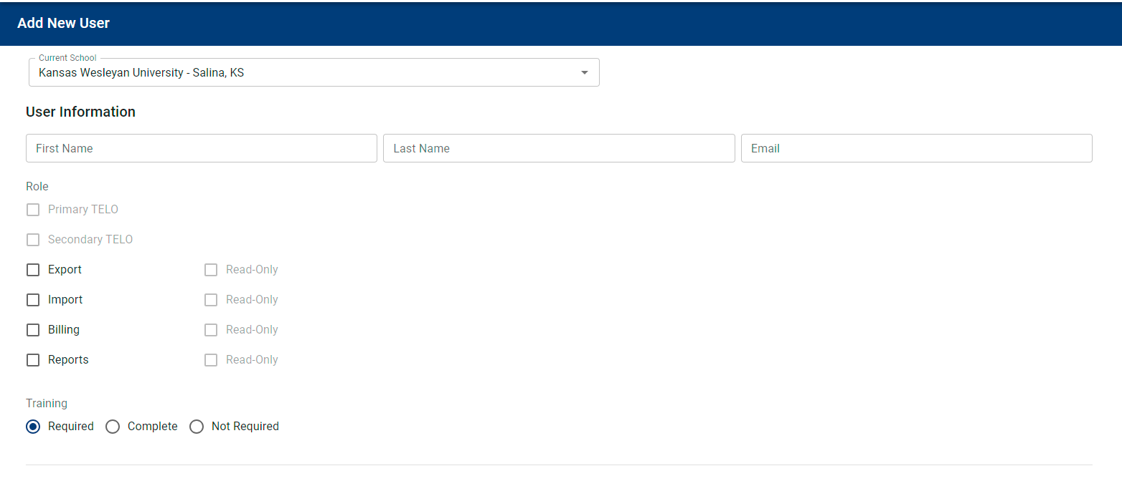
TE Central or the Secondary TELO enters the primary TELO in the case that the Primary TELO leaves their position sans a replacement
All other users are defined, added, or deleted as necessary by the primary or secondary TELO
Some members use a third-party payment service – i.e., PayMeRang
The primary or secondary TELO provides user access
The primary or secondary TELO makes all biographical updates
Only one primary and secondary TELO are allowed
Additional users can be provided full access to the EXPORT, Import, Billing, or Report option
Users can be limited to read-only
All primary and secondary TELOs are required to participate in Mandatory Training
Training attendance will be managed via the system

Slide 20
TE Student Portal
Fall 2023

Slide 21
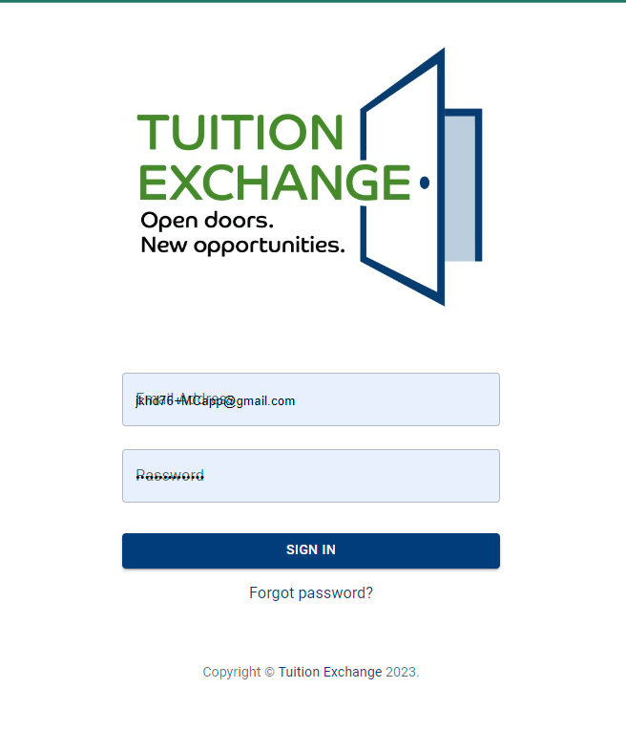
The TE-EZ Online application process
The information is student-focused
It is required that the application be created with the student’s email address
The password must be at least 12 characters, including at least one CAPITAL letter, one lowercase letter, and one special character
There are no options to recapture or share the email address used by the applicant
If the password is not remembered, the applicant can request a new one

Slide 22
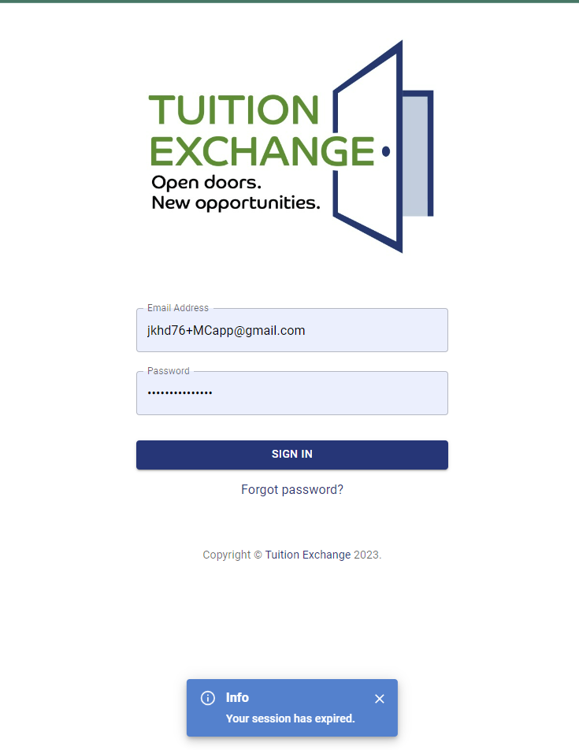
The TE-EZ Online application process
After four hours the user is automagically logged out
This should prevent multiple applications

Slide 23
The TE-EZ Online application process
The information entered is all about the student. Their name, email address, and password
Notice the new addition of FERPA permissions
This information is captured and shared as a part of the TE-EZ Online application detail
The applicant can choose not to click the agreement form
There is no option to go back later and click yes
The Create Account button moves the new student to the TE-EZ Online application

Slide 24
The TE-EZ Online application process
The first-time applicant starts here!
Reading the Instructions and listening to the podcast will prove beneficial to all
The system has a variety of bold statements and warnings!

Slide 25
The Instructions
Additional information will be added here
The podcast and the PowerPoint will be available inside the application
Stay tuned for more on the issue of instructions

Slide 26
TE-EZ Online application details - STUDENT
Current year and next year available
The only option information is the ZIP+4

Slide 27
TE-EZ Online application details - EMPLOYEE
Employee is a drop-down box listing all active member schools
The employee is the individual eligible for TE – no one else!
The email must be the employee’s school email address*
The Employee ID is not a required field
* The TELO may select the option in School Set-Up to accept non-school email addresses

Slide 28
The TE-EZ Online application final steps
Student classification mirrors the FAFSA
The student can select up to 10 schools
If the student wants to add more, the applicant must remove currently selected schools where the student is no longer interested in attending in order to add new schools
The Submit button goes blank after being clicked

Slide 29
Application Status for the applicant

Slide 30
Application Status Options
The system posts the applicant’s submission date
The system retains and posts dates the Export and Import TELO takes action
The Application Status of OPEN is crucial to the system’s operations

Slide 31
EXPORT TELO Review
Fall 2023

Slide 32
Export School Applications
The system will provide the primary and secondary TELO a daily digest
TELOs should continue to review Exports – Applications weekly to confirm all applicants are approved or denied
Student/employee communication is still in flux
The concept of an account means the student should be checking

Slide 33
Export School Applications
Click on the bo to View Application

Slide 34
Employee Details
The EXPORT TELO can modify any of the information inside the Employee Information
The three boxes with Test 1, Test 2, and Test 3 are the school-individualized TE-EZ Online application fields
CAUTION – do not change your boxes mid-processing year
- the fields can be printed within a report but are not the reason for the report

Slide 35
Export View of the Application
You can see the student information BUT
If the applicant does not complete the information correctly or entirely, IT’S NOT YOUR ISSUE!
You act on the Employee details only
Status Options
Awaiting Export Approval
Export Approved
Denied – not an employee
Denied – minimum requirements not met
Denied – other

Slide 36
Application Status Denied Other View
For the option Denied – other
the TELO will be required to provide a why with a maximum of 250 characters

Slide 37
Deleting applications
EXPORT TELOs have the power to DELETE an application
You will receive an “Are you sure” message, which you must confirm
There is no going back
A new function that you may never use but is excellent to have

Slide 38
Training Schedule
TE Central will load and confirm that all member school data is correct
Before live training, the Primary and Secondary TELO will receive system login credentials
April through mid-May
TE Central will provide live webinars
EVERY primary and secondary TELO must attend at least one live webinar on each topic
This Photo by Unknown Author is licensed under CC BY-NC-ND

Slide 39
Training Topics
TELO Primary
TELO Secondary
TE-EZ Online application
TELO EXPORT
TELO IMPORT
Enrollment Report
Membership dues and Participation Fee payment
Reports

Slide 40
Training Schedule
Live sessions will be no longer than 90 minutes and offered at least five times each
Live sessions will be recorded
The TELO must attend a minimum of 75% of the session(s) offered
TELOs not attending will experience login suspension

Slide 41
REPORTS
Fall 2023

Slide 42
Reports
Reporting is still in the development stage, BUT with the dashboard approach, you can get the information you want when you want it and, most importantly, how you want it!
Much more to come as the system develops

Slide 43
Current System Reminders & Important Reminders
Fall 2023

Slide 44
Current System Reminders
All outstanding membership dues and participation fees are now overdue
Late fees are assessed
Encourage your employees to watch and listen to the TE-EZ Online app PODCAST before completing the TE-EZ Online application
TE Central does not respond to family phone calls – we forward them to you!
If the caller does not share their employer’s name – the call does not receive a response
No one should be completing the 2025-26 TE-EZ Online application
The system is changing
Those applications will not move to the new system

Slide 45
Current System Reminders
Be mindful when clicking approved or rejected
Emails launch immediately
Families are notified
Enrollment Reports
Suzanne reviewed and updated well over 100 Enrollment Reports
If TE Central submitted your report, your school was notified via email
Review your Enrollment Report at the end of the semester
Is everyone still enrolled?
Is everyone returning?
Check with Financial Aid – are all your Imports funded?

Slide 46
Thank you!
Bob, Kristine, Suzanne, and I wish you, your family, and your friends the best Thanksgiving yet.
We encourage all to
Gobble til you wobble & have fun!

