Slide 1
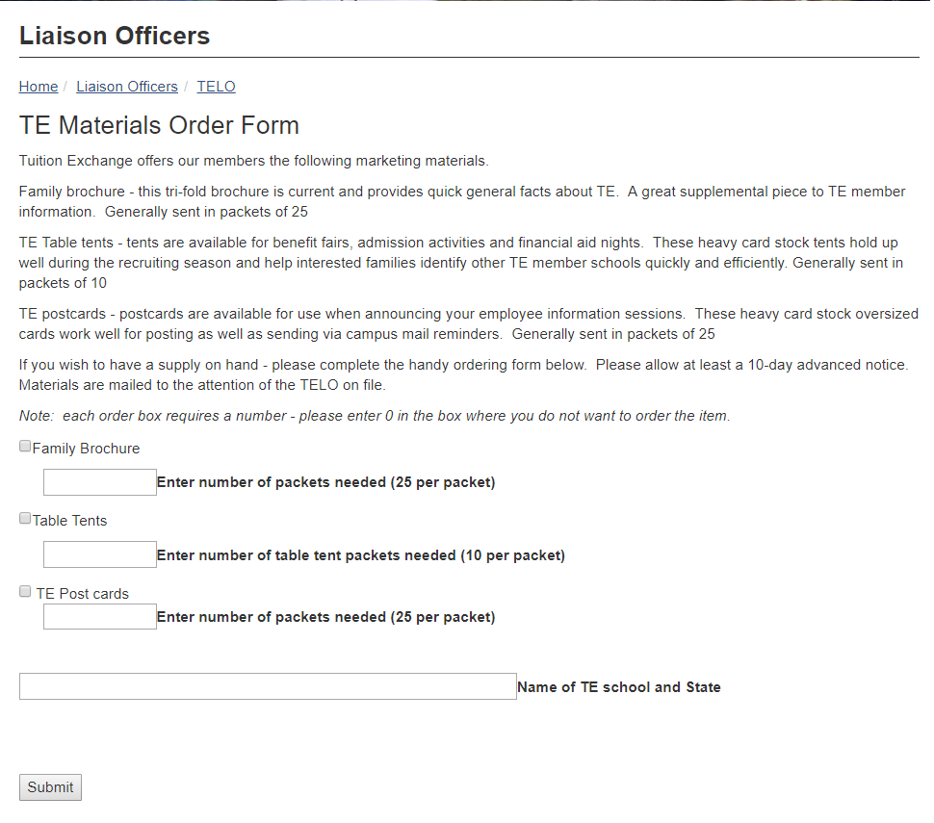
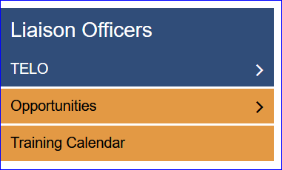
How to order TE marketing materials
www.TuitionExchange.org
Select Liaison Officers
Select TELO option
Note every box needs a number,
even if the number is ZERO

