Slide 1
TE 103
Janet Hanson and Bob Shorb
November 2019

Slide 2
Today’s Focus
TE Guidelines
What’s in yours?
Balance Sheet scenarios
Let’s do the Math
TE Central updates

Slide 3
TE Guidelines
Define your program inclusions
Define your audience of participants
Define your process

Slide 4
TE Guidelines
Program inclusions
Undergraduate programs
Degree-completion programs
Graduate programs
Professional degree programs
Locations
Main campus
Branch campuses
Online

Slide 5
TE Guidelines
Define audience participants
Employees
Required length of employment
Type of eligible employment
Full time
Regular part-time
Adjunct
Visiting faculty
Consultant
Eligibility
Calculation and determination of years of service
Application priority deadline
What if both parents are employed at a TE school
Multiple student issues

Slide 6
TE Guidelines
Define audience participants
Who is a dependent
Biological child
Step-children
Other child issues
Employee
Employee spouse/partner

Slide 7
TE Guidelines
Student enrollment expectations
Full time
Degree seeking
Undergraduate
Eight semesters or graduation, whichever comes first
Graduate or Terminal/professional degree
Four semesters or graduation, whichever comes first
Other considerations
Less than full time enrollment
TE scholars wanting to transfer
TE scholars taking a leave of absence for more than one consecutive semester

Slide 8
TE Guidelines
Defining your process
Export
The E is for employees
Import
The I is for incoming students

Slide 9
TE Guidelines
Tuition Exchange is not an employee benefit
Consider mirroring your campus Tuition Remission guidelines
Tuition Exchange is truly a scholarship program

Slide 10
TE Guidelines
Exports
Explain how employees are approved
Years of service
First-come, first-serve
Every application is assigned a number and on X date, using www.random.org a pre-determined number of applications are approved and entered into the TE system for Import consideration
Consider implementing an application priority date
Keep employees informed
Don’t forget mitigating circumstances occur
Consider allowing prior higher education experience in your years of service calculation

Slide 11
TE Guidelines
Imports
Explain how students are approved
First-come, first-serve
Academic requirement
Geographic footprint
Wait list considerations
Consider implementing an application priority date
Keep applicants informed
Don’t forget mitigating circumstances happen

Slide 12
TE Guidelines
Continuing student renewal
Exports
Continued eligible employees
Recertify
Employees who
Resign
Loose eligibility immediately or at the beginning of the next enrollment period
Retire
depends
Reduction in Force (RIF)
depends
Pass-away while employed or on long-term disability
TE Central suggests maintaining employment eligibility
Be sure to cover yourself with a mitigating clause

Slide 13
TE Guidelines
Continuing student renewal
Imports
Continuing scholars
Enrollment
Full time each term
Academic credentials
Meet or exceed the credentials
Maintain eligibility
Below the required credentials
Loose funding at the beginning at the next term
Be sure to cover yourself with a mitigating clause

Slide 14
TE Guidelines
Where are TE Guidelines published?
Employee Handbook
College Catalogue
Student Handbook
How do you ensure EXPORT families understand program expectations?
Memo of Understanding
How do you ensure IMPORT students understand program requirements?
College catalogue
Student handbook

Slide 15
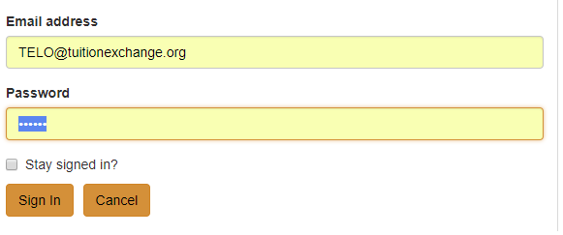
TE Guidelines
www.tuitionexchange.org
Select the TELO ONLY Resource section
All use the SAME email and password to access this portal
Telo@tuitionexchange.org
TELO14
Communication folder – look for TE Guidelines template
A skeleton template is available inside the
Prospective Membership tab

Slide 16
Balance Sheet Scenarios
Four schools
Four different scenarios
Please make note of any questions you might have until the four scenarios are explained.

Slide 17
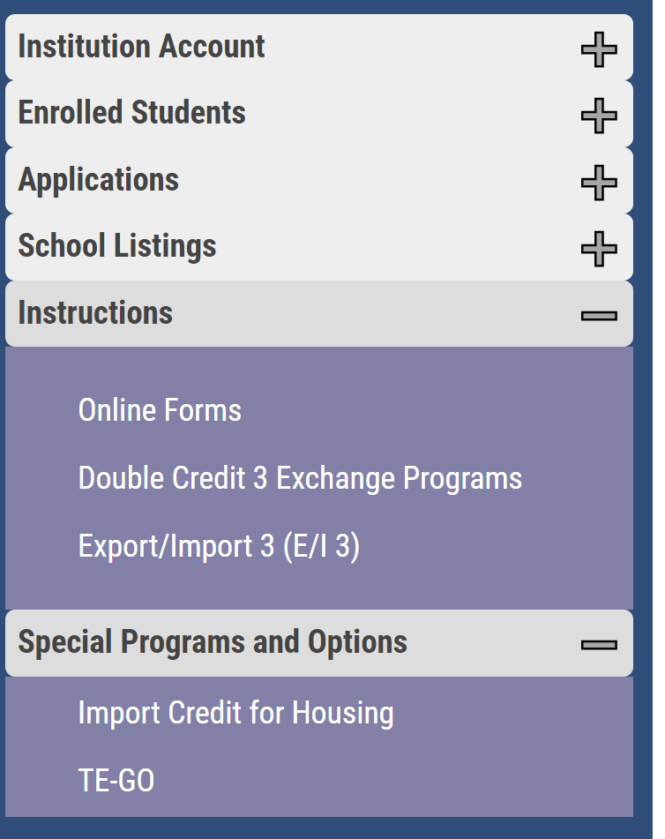
TE Program options
Feeling stressed about too many Exports and not enough Imports? Consider the following
Export/Import 3 (E/I 3)
Double Credit 3 (DC 3)

Slide 18
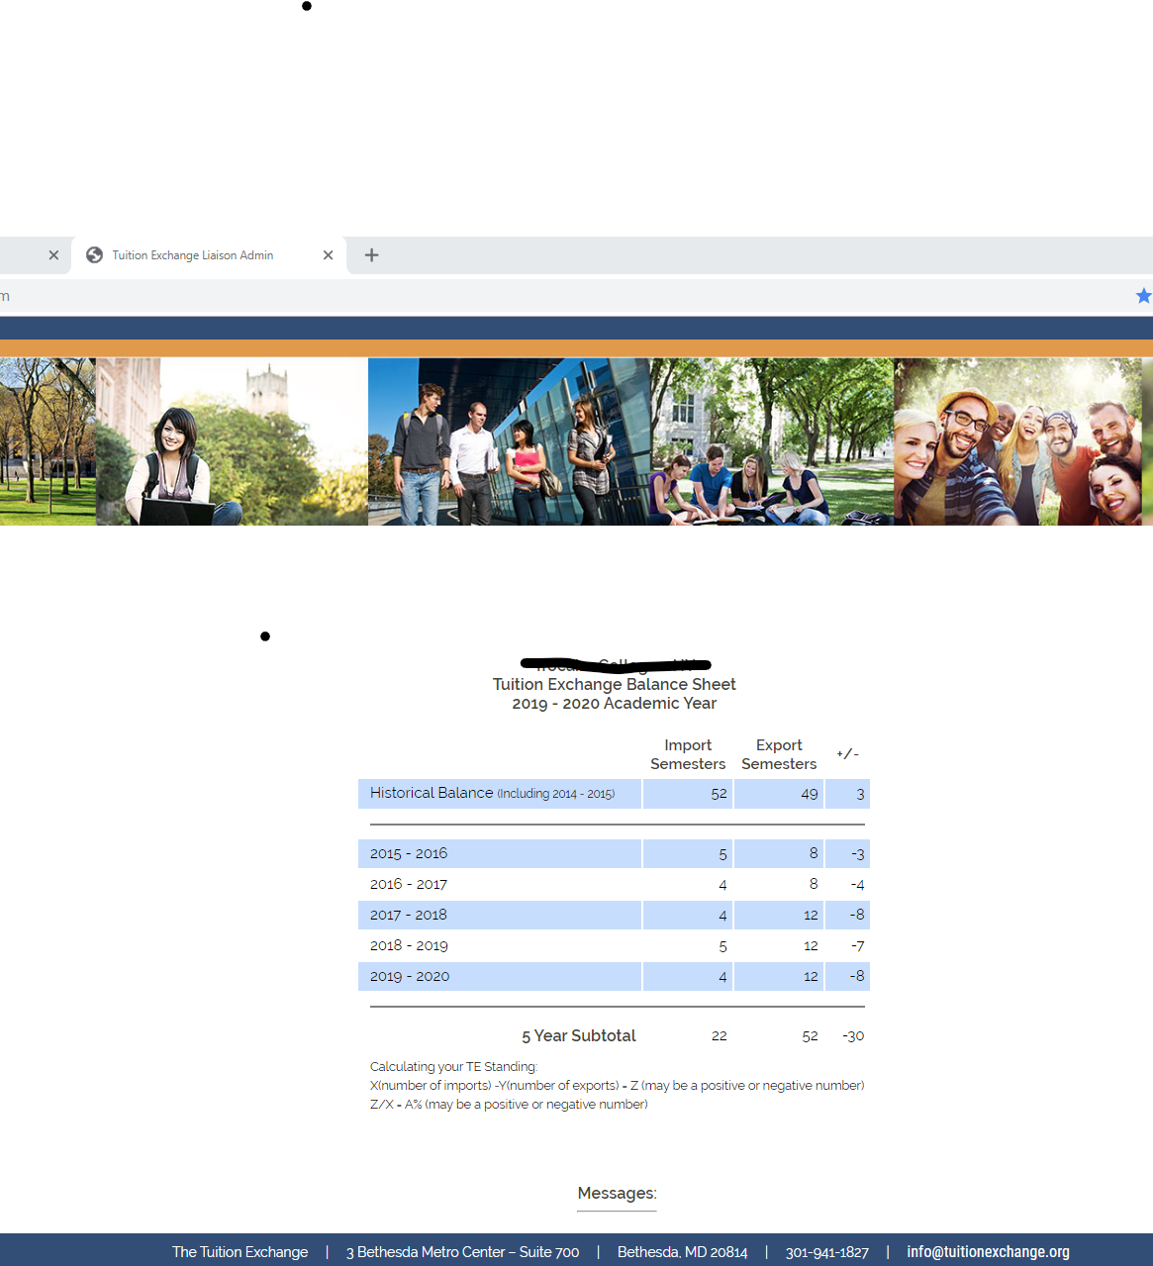
Scenario One
School is not an E/I 3 school but should be
22 imports
- 52 exports
-30 difference
(-30/22) x 100 = (136)%

Slide 19
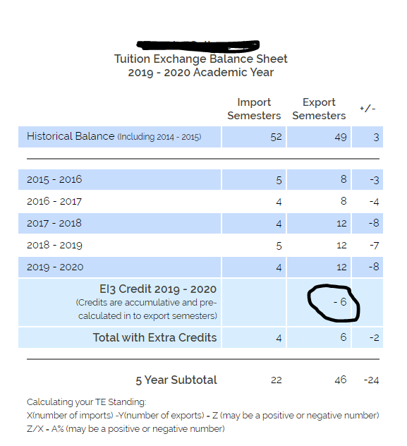
Scenario One as an E/I 3 school
22 imports
-46 exports (E/I 3)
-24
(-24/22) x 100 = (109)%
Still on Restriction but…
E/I trumps all

Slide 20
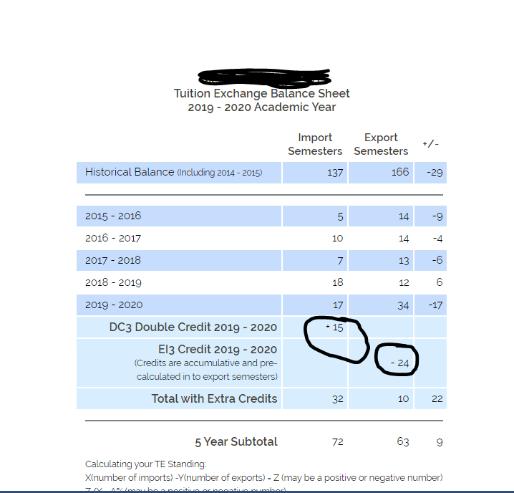
Scenario Two before Double Credit 3 and Export/Import 3
57 import credits
87 export credits
-30
(-30/57) x 100 = -53%
57
87
-30

Slide 21
Scenario Two after
Double Credit 3 and Export/Import 3
School
72 import credits
63 export credits
9
(9/72) x 100 = 12.5%
E/I 3 status trumps all other status

Slide 22
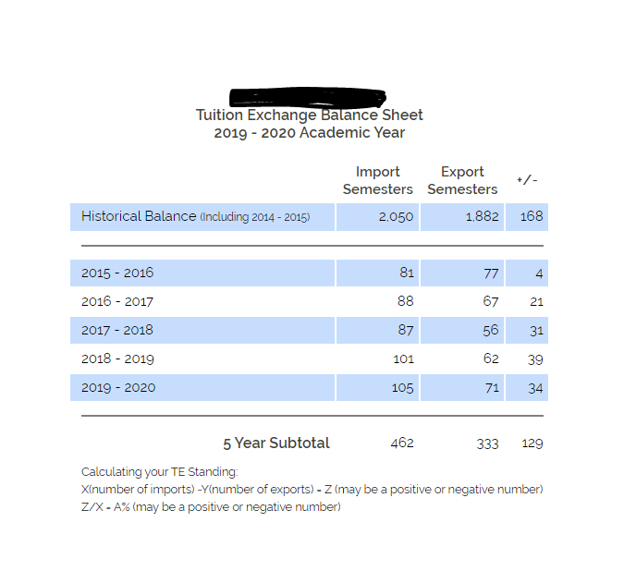
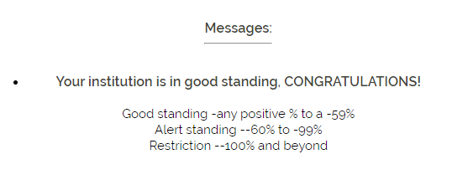
Scenario Three
462 Import semesters
333 Export semesters
129
(129/462) x 100 = 28%

Slide 23
Let’s do the math
21 – 48 = -27
(-27/21) * 100 = -128%

Slide 24
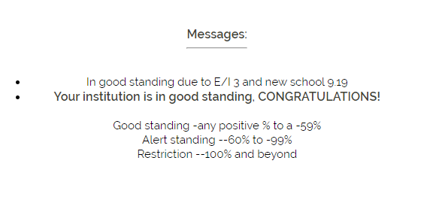
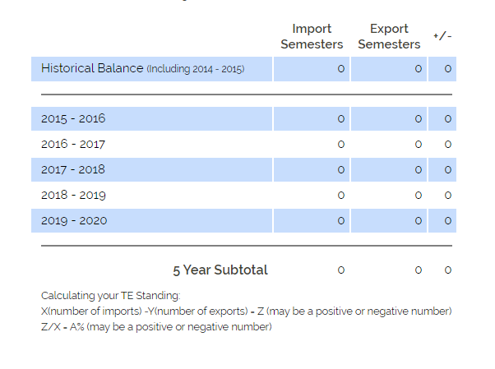
Let’s look at your Balance Sheet
_______ Import semesters
_______ Export semesters
_______ difference
(difference/import semesters) x 100 = your status
See Messages above

Slide 25
TE Central updates and reminders
The entered application date and Export Approved application dates are now stored in the system – check the Export or Import reports for details
The training credits are now added to your enrollment reports for 18-19
2019–20 Set Rate is 37,000
2020--21 Set Rate will be 38,000
As a reminder if your tuition is less than the set-rate you are obligated to provide tuition. If your tuition is at or greater than the current year’s set-rate you are obligated to provide at least set-rate
Offering Room credit? Be sure to double the number on your Enrollment Report

Slide 26
Join Tuition Exchange for an hour conversation on Communication, Funding and Capacity Nov 21, 2019 1:00 PM CST TE 104 (f) - Enrollment Report Review Dec 5, 2019 1:00 PM CST Follow the link for registration links http://www.tuitionexchange.org/vcalendar/
Upcoming Training options

