Slide 1
End of year closeout
Tuition Exchange –
April 2020
Janet Hanson, Director of Communications
Bob Shorb, CEO/Executive Director

Slide 2

Today’s focus
TE Closeout
Review of 2019-20 Enrollment Report
Dues and Participation fees
Claiming 2020-21 students
Reminders
News and updates
Recap

Slide 3
TE Closeout
Enrollment Report
Recertification of continuing students
Export/Import 3
Participation Fees
Balance Sheet
TE Import Audit

Slide 4
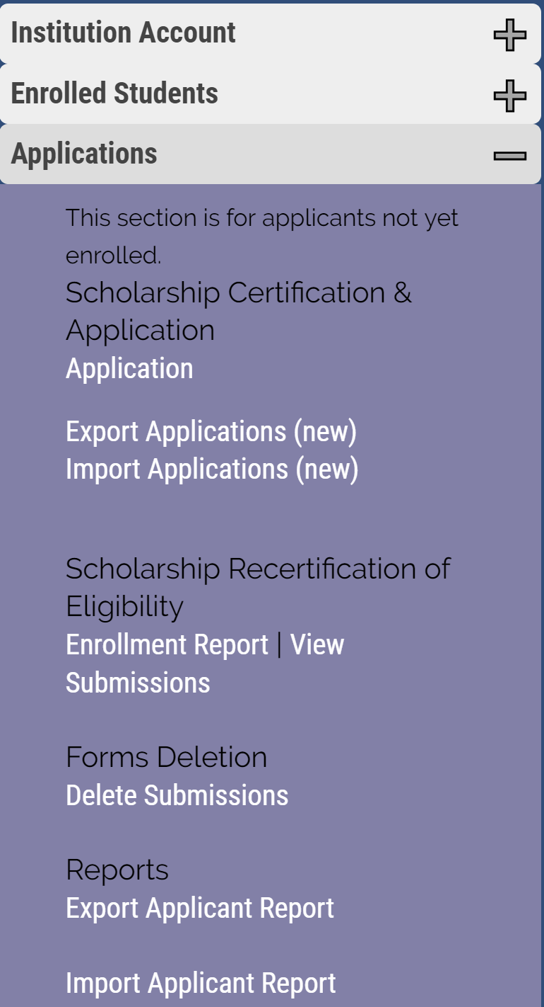
TE Closeout
Enrollment Report
  Fluid
  Changes occur when either the EXPORT or IMPORT school update a shared student
  EXPORT Schools
    Recertification of eligible current students
REMEMBER: Recertification refers to Continuing students

Slide 5
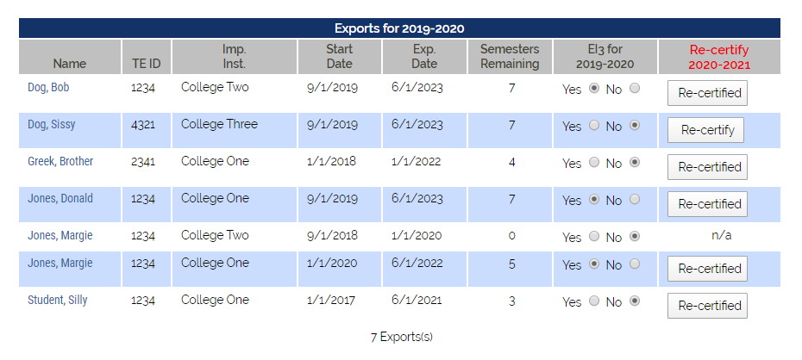
TE Closeout
Are your eligible students recertified for 2020-21?
Please update each student soon
Should the student lose eligibility, update the expiration date
Re-certify requires attention
Re-certified means all is complete

Slide 6
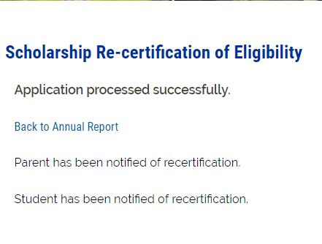
TE Closeout

Slide 7
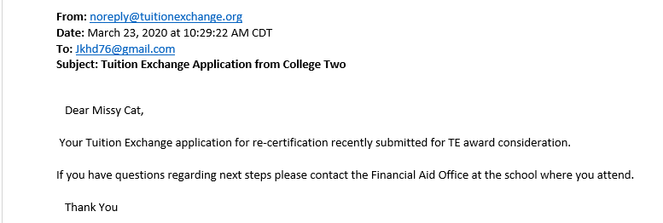
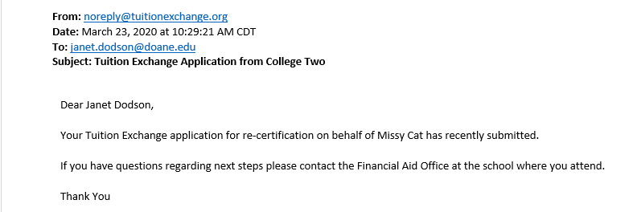
Recertification Emails to Family
The Student
The Parent

Slide 8
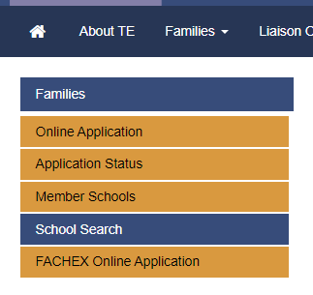
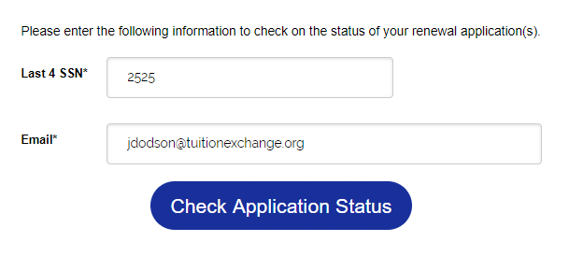

Reviewing the continuing student’s application status
This information must match 100%
Families tend to email or call TE Central. We do not provide personal identifiable information – we send them back to you.

Slide 9
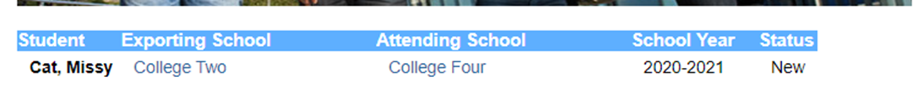
Understanding the status

Slide 10
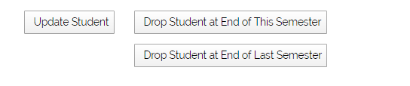
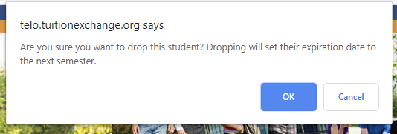
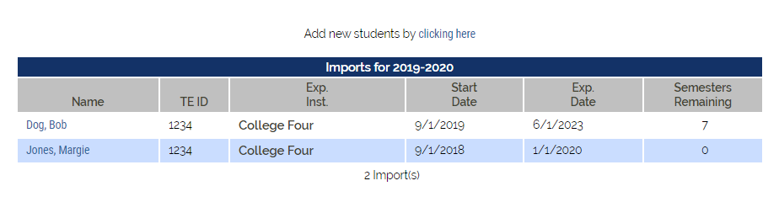
Updating Expiration Date
Click on the student’s name
Then again
Scroll to the bottom on the student’s record and click on Drop at the END of THIS semester or
Drop at the end LAST semester

Slide 11

TE Closeout
Continuing students
Export Schools did their work by clicking the RECERTIFY Button on the Enrollment Report
Import Schools need to approve the individual student and update the record – see next slide

Slide 12
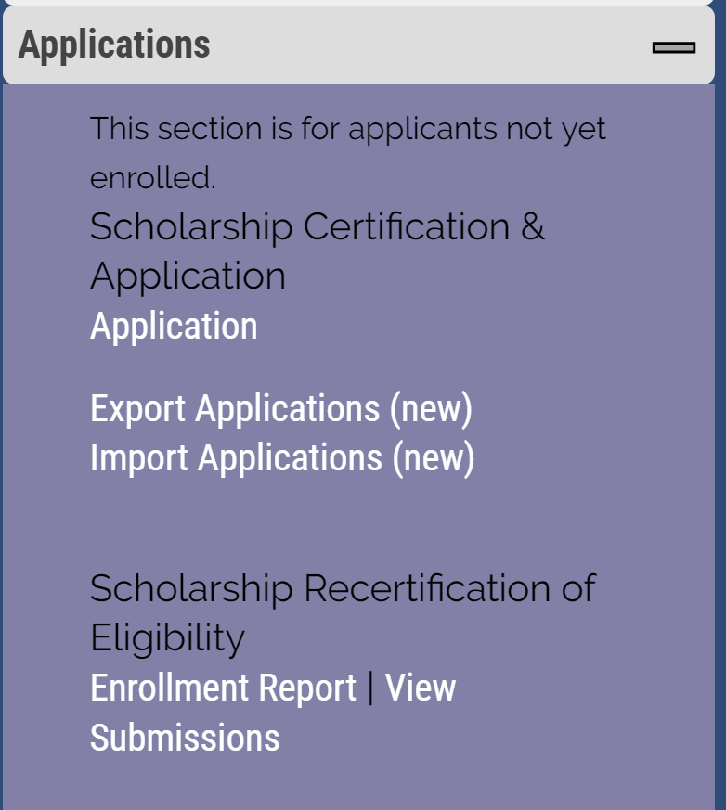
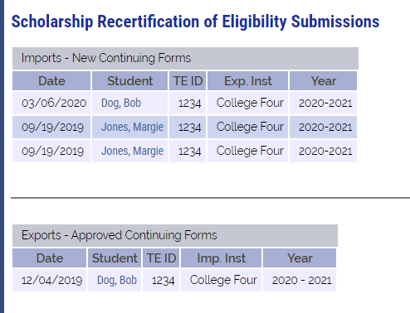
TE Closeout
For eligible continuing students to appear in the VIEW Submissions area you MUST click the recertify button
Import New Continuing Forms are Export recertified continuing students that need funding in order to move to the 2020-21 academic year
Exports Approved Continuing Forms are students funded by the Import school for the 2020-21 academic year

Slide 13
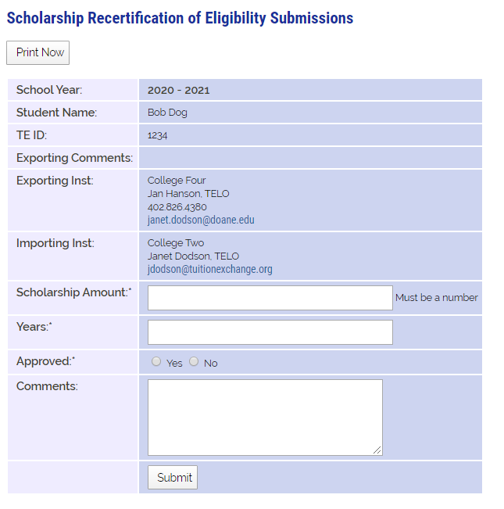
Import Recertification
Tuition or Set-Rate
Enter 4 for all students
Click YES if eligible Click NO if no longer eligible

Slide 14
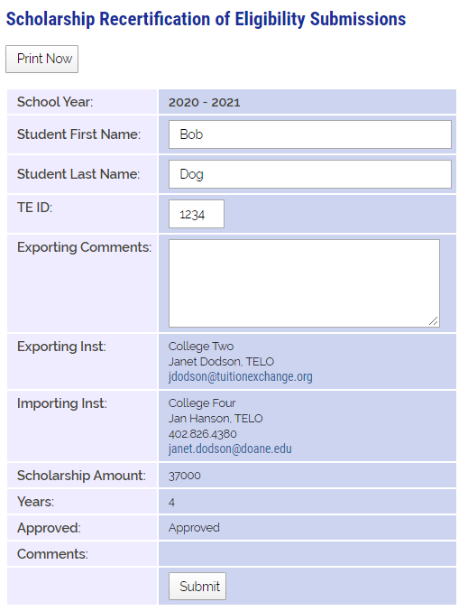

Information is shared between TELO’s only

Slide 15
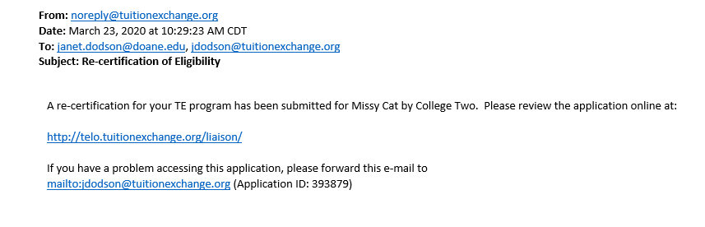
TE Closeout email to IMPORT TELO
The email to the left is shared with the IMPORT school
The IMPORT school now has a valid continuing application for the 2020-21 academic year
DO NOT FORWARD THIS EMAIL TO FAMILIES – it only causes confusion

Slide 16
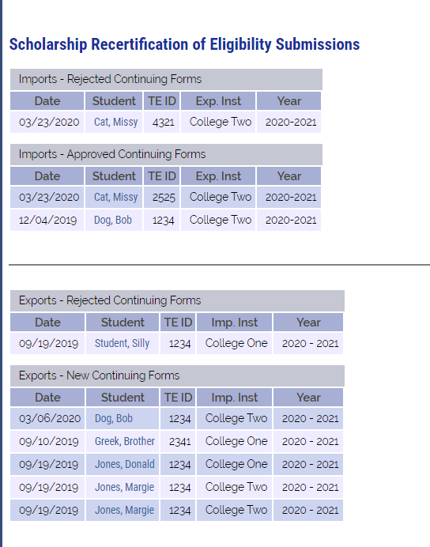
TE Closeout
Export
Check out Brother Greek. The EXPORT school recertified his continuing application.
He is now in the NEW Continuing Forms section.
This means Brother’s IMPORT School is responsible to APPROVE or DENY
the 2020-21 TE scholarship award
2020-21 Set Rate is $38,000
As a reminder – IMPORT schools confirm continuing student awards once Spring grades are available.
Current FIRST YEAR parents are anxious. Remind them TE scholarship awards now hinge on the student’s academic success too plus the employee’s continued eligibility

Slide 17
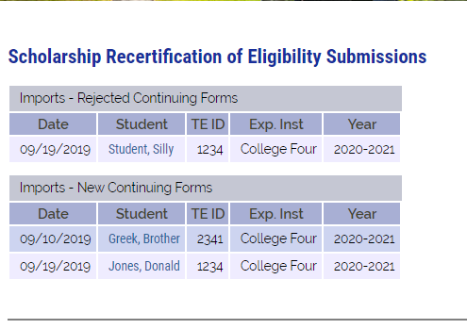
Import school continuing students
Imports – New Continuing Forms – these students are awaiting IMPORT school funding.
Imports – Rejected Continuing Forms – these students will not be funded for the 2020-21 academic year. You can open the record to review any comments provided.

Slide 18
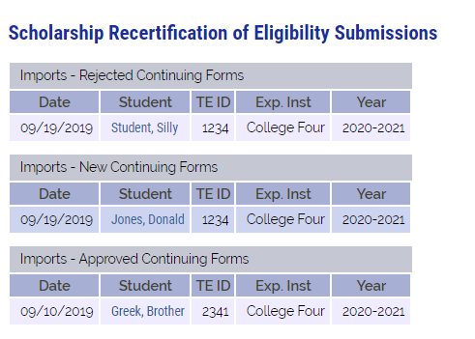
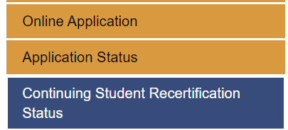
Import school’s recertification action required
The Import school funded the student.
Families can monitor the applications progress online at www.tuitionexchange.org Families – Continuing Student Recertification Status

Slide 19
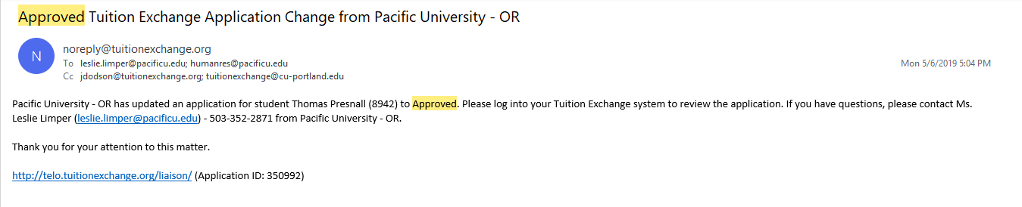
TE Closeout
Once the IMPORT school approves the continuing student’s 2020-21
Renewal application, the EXPORT school receives the email above
Please do not share this email with families – it only causes confusion.

Slide 20
TE Closeout – upcoming tasks and reminders
If you have students in the status of recertify, you will receive an email reminder from INFO@tuitionexchange.org
If you have continuing students yet to be recertified for the following academic year. Students can be recertified on the Enrollment Report located in the Liaison Portal located at https://telo.tuitionexchange.org.

Slide 21

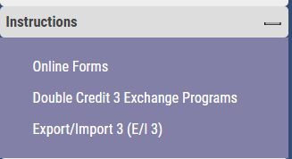
Export/Import 3
(E/I3)
Is your school an E/I 3 school?
What does it mean to be an E/I 3 school?

Slide 22
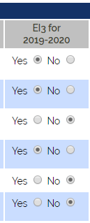
E/I3 school
Select up to three NEW students annually as E/I 3 students on your current on your Enrollment Report
Select the newest students so that you receive the most credit
You cannot replace students in future years should the student graduate or terminate their educational journey early

Slide 23
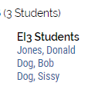
E/I 3
Your lists grows each year you select E/I 3 students.
Only the first year you selected the student will you have record of the student’s name.
Always select the students with the largest number of remaining semester.

Slide 24
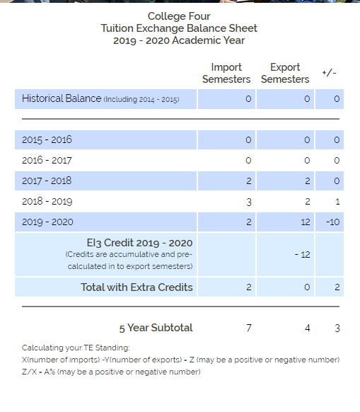
The value of being an E/I 3 school
The Balance Sheet to the left does
include E/I 3 student credits.
TE Member school is in good standing
(3/7) * 100 = 43%

Slide 25
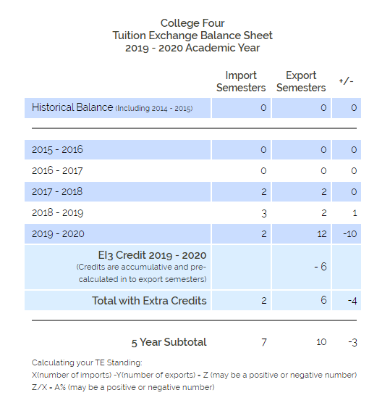
The value of being an E/I 3 school
Same school, but this Balance Sheet does not include E/I 3 student credits.
TE Member school is not in good standing, as their standing is <128%>
This school cannot EXPORT any more
students
(-9/7) * 100 = <128%>
16
-9

Slide 26
E/I 3
If your school is an E/I 3 school with open E/I 3 slots, you will receive the following email reminder from info@tuitionexchange.Org
The email is your reminder of open E/I 3 slots students are selected inside the enrollment report
See slide 22 for a visual how-to reminder

Slide 27
TE Closeout
Participation Fees
Every time you click Submit on your Enrollment Report a new Participation Fee Statement generates
Review your Participation Fee Statement carefully
If you owe – please remit payment upon receipt
Due to COVID-19 we updated our billing address, please note the change on your Invoice.
If you have a zero balance – THANK YOU!

Slide 28
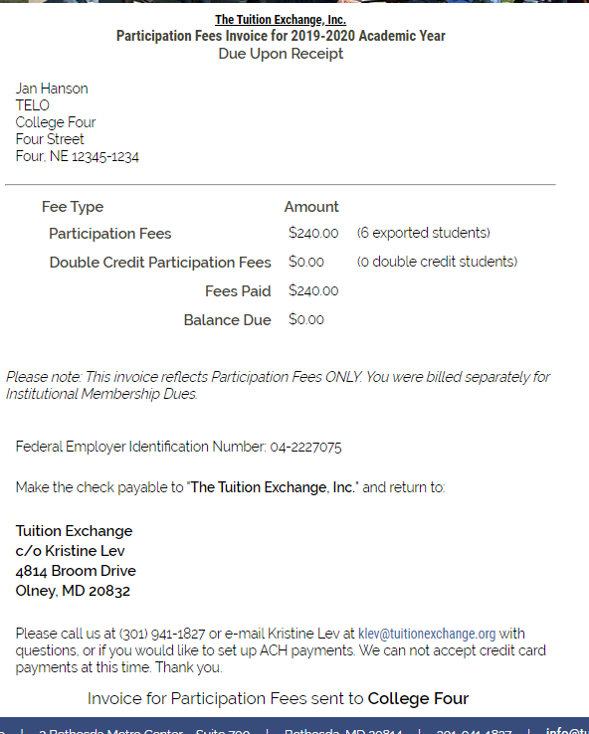
TE Closeout
Participation Fee Invoice
$40 per enrolled EXPORT and Double Credit 3 student associated with your school
Participation Fee payments are due upon submission of the Enrollment Report
As a reminder, every time a change is made to the Enrollment Report, you are responsible for any additional Participation Fees that may be due
A new invoice creates every time you submit your Enrollment Report
TE Central will access a $50 late fee beginning November 1, 2020 for all unpaid Fall, 2020 Participation Fees
Due to Maryland’s requirement to Shelter in Place – we are asking all payments be sent to the updated address on the invoice.

Slide 29
TE Closeout
Balance Sheet
Your Balance Sheet helps you to understand your current program standing
The Balance Sheet adjusts with each Enrollment Report modification
When you review your Enrollment Report it is important to review your Balance Sheet too

Slide 30
Balance Sheet Review

Slide 31
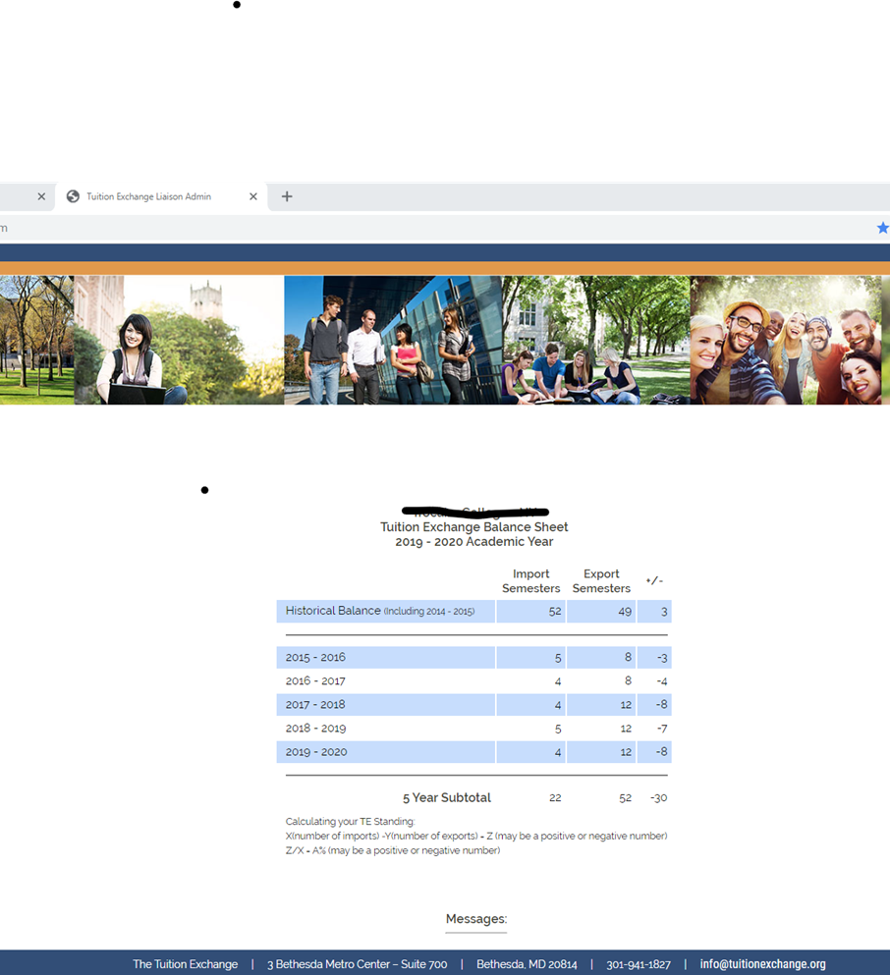
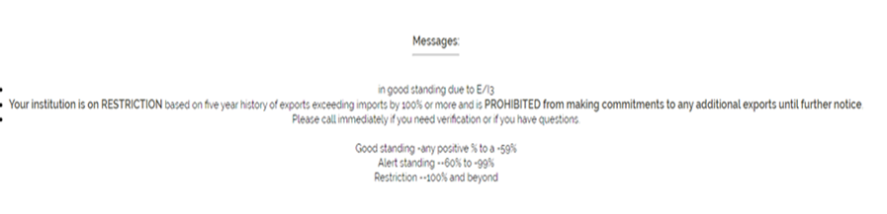
Scenario One
This school is not an E/I 3 school but should be
22 imports
-52 exports
-30 difference
(-30/22) *100 = -136%

Slide 32
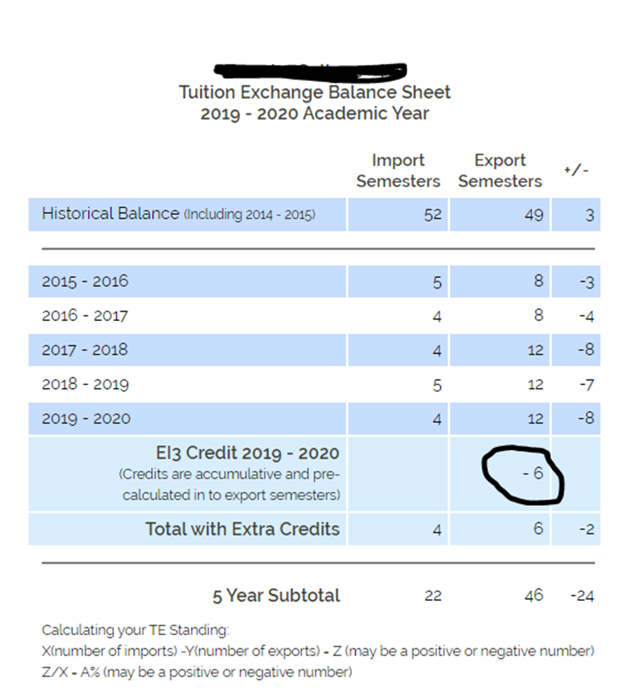


Scenario One as an E/I 3 school
22 imports
-46 exports (E/I 3)
-24
(-24/22) x 100 = -109%
Still on Restrictions but…

Slide 33
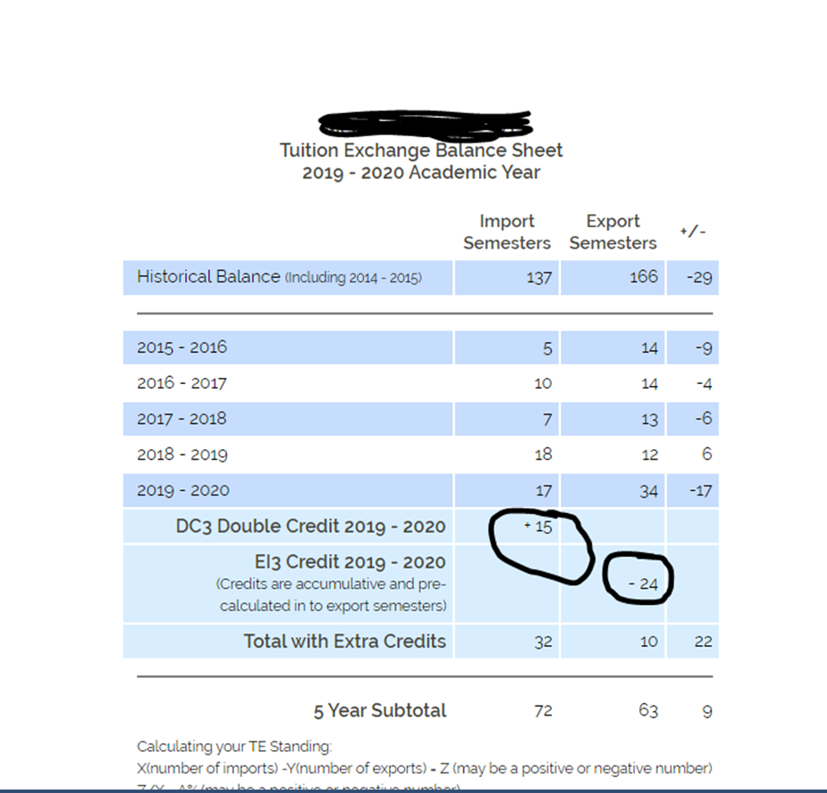
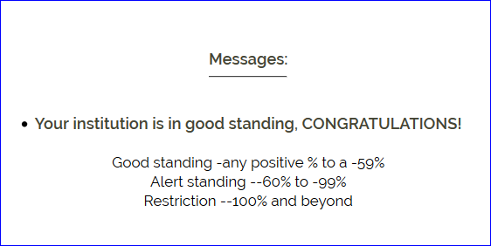
Scenario Two before Double Credit 3
And Export/Import 3
57 import credits
87 export credits
-30
(-30/57) x 100 = -53%

Slide 34

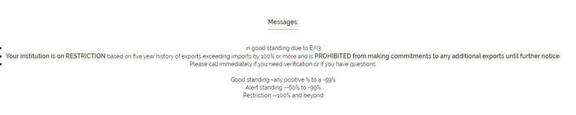
Scenario Two after Double Credit 3 and Export/Import 3 School
72 import credits
63 export credits
9
(9/72) x 100 = 12.5%
E/I 3 status trumps all other status

Slide 35
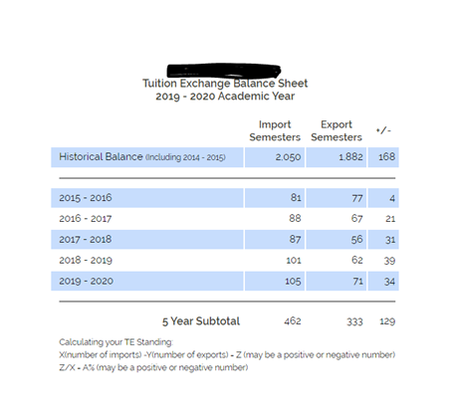
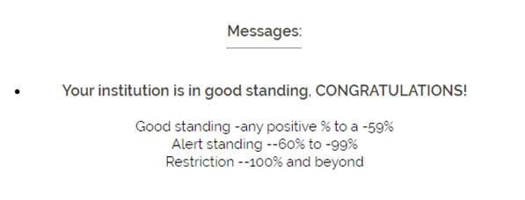
Scenario Three
462 Import semesters
333 Export semesters
129
(129/462) x 100 = 28%

Slide 36
Let’s do the math remember it is the order of operation
Print out your Balance Sheet
Five-year total
number of Imports _______________
minus
Five-year total
number of Exports _______________
this box
is your X
(X divided by # 5 year of imports) = ___ ?
? X 100 =____ %
Status
  Any positive % to -59% is good standing
  -59 to -99 is Alert
  -100 and beyond is Restriction
  Remember an E/I 3 school can always export three NEW students every year!

Slide 37
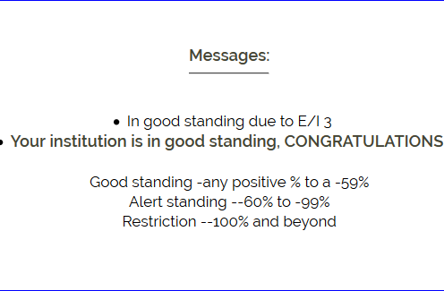
TE Closeout
There is no reason for any TE school to be on Restriction
E/I 3 provides three NEW exports each year
In return, TE Central expects schools to offer to all eligible TE applicants a TE award
There is no additional cost for this program beyond the $40 Participation Fee
Update your Mandatory Institutional Profile by answering YES to question 9

Slide 38

TE Import verification
Thank you to those schools working with FA on this report
We continue to add students to the system, but the number is dwindling
This is an ongoing event every March
IMPORT information from the Enrollment Report is sent to the Financial Aid Office for confirmation and the TELO is copied

Slide 39
Annual TE Dues
Early June TE Central emails your Annual Dues Invoice
Dues for 2020-21 are $550
Dues payment is expected July 1
Any outstanding dues after October 1 are accessed a $50 late fee
TE Central accepts checks and ACH payments
Interested in ACH contact Kristine Lev directly
Need a W-9 it is available inside the TELO Only Resource Section under Annual Reports

Slide 40
TE Closeout
TE Central electronically retains your June 30 Enrollment Report and Balance Sheet
You should retain your Enrollment Report and Balance Sheet every time you make a change

Slide 41
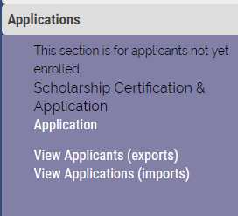
Claiming 2020-21 students
View Applicants is the spot housing all NEW 2020-21 student applications
You are encouraged to visit soon and often ☺

Slide 42
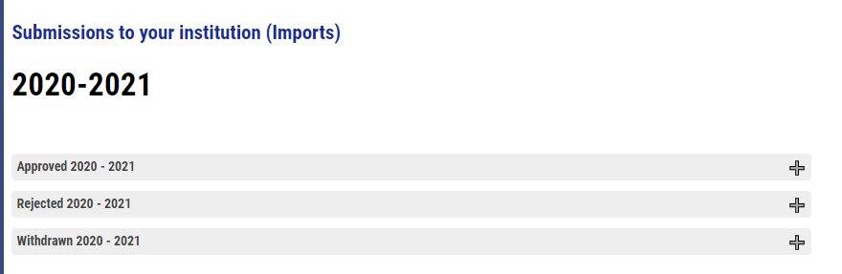
Claiming 2020-21 students
Review all Import Decision Pending and decide
Approve
Decision Pending you need to act!
Rejected
  You say no OR
  The student says no
Waitlist
Withdrawn
Click the + sign to open the folder. Once you make decisions,
the student record moves to the updated category

Slide 43
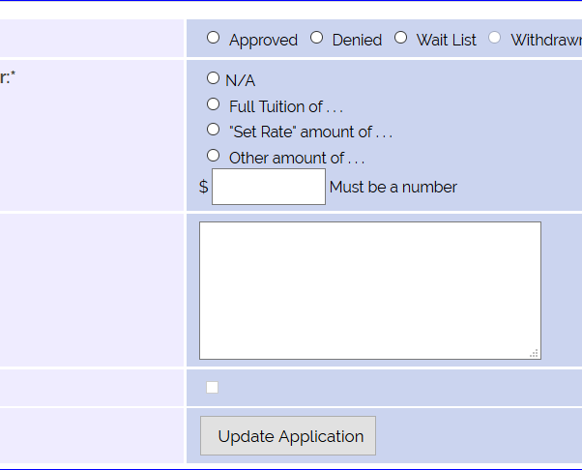

Claiming 2020-21 Students
R
IMPORT schools complete all information with the R
Remember Approved means this student receives a TE Award
  Student and parent receive email notification
Denied means this student is NOT receiving a TE Award
  An email is sent telling the parent and student the TE application status recently changed
Waitlist means maybe the student might receive a TE Award
  An email is sent telling the parent and student the TE application status recently changed
ONLY export schools can select the Withdraw option
  No email notification launched
You must click full tuition OR set-rate, the box will automagically fill

Slide 44
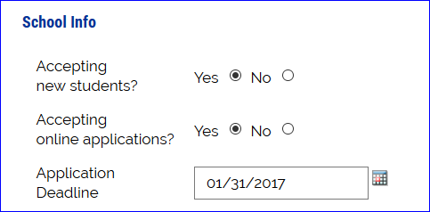
Reminders
Mandatory profile updates cannot occur until the 2020-21 Enrollment Report year closes
  July 15 at the latest
Please update your Institutional information application deadline seen to the left
Online degree programs that are TE Scholarship eligible
Provide the name of your AP for Invoice
We strongly encourage using the TE-EZ application process

Slide 45
Reminders
May 1 Available Seat Survey
Available seat survey available now and will be published April 15 and continually updated with new schools
The results of the available seat survey will be posted to the front page of the TE website and pushed to app holders
This is our sixth year providing the May 1 open seats announcements

Slide 46

News and Updates
Be sure you are accessing the TELO portal with YOUR login credentials only
  Do not share your login
  TE Central is happy to create additional and personalized TELO logins
    email Janet Hanson
A variety of notification emails are in the system and launch as changes happen to a student’s TE record
Print your final Enrollment Report and Balance Sheet just before June 30

Slide 47
Recap
TE Closeout
Review of 2019-20 Enrollment Report
Dues and Participation fees
Claiming 2020-21 students
Reminders
News and updates

Slide 48

That’s all folks
We work all summer too so contact us if you get stuck along the way!
Thank you for all that you do every day promoting higher education.
Stay well!
This Photo by Unknown Author is licensed under CC BY-NC-ND

