Slide 1
Tuition Exchange 102
TE Central Staff
2023-2024

Slide 2
New TE Liaison Officer (TELO) Training Series Details
Available On-Demand
An excellent resource for new and seasoned TELOs
101 – TELO Basics
102 – TELO Website details, TE-EZ Online app
103 – TELO Guidelines, TELO Expectations & Employee Eligibility Issues
104 – TELO Monthly Training, Reporting & Frequently Asked Questions by TELOs

Slide 3
Today’s Focus
TE Website Overview
TELO Portal
Institution Account
TE-EZ Online applications
Export Process
Import Process
Tracking the application

Slide 4
TE Website Overview – www.Tuitionexchange.org

Slide 5
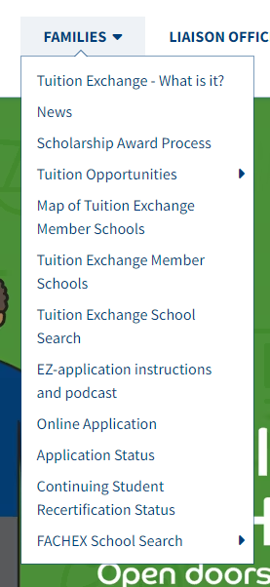
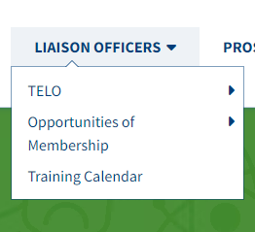
Tuition Exchange Website www.tuitionexchange.org Liaison Officers Section Families Section

Slide 6
Tuition Exchange Website www.tuitionexchange.org Liaison Officers tab
Inside the LIAISON OFFICERS section, TELOs will discover:
The TELO Handbook
Material Order form
The Value of Membership
Training Calendar
Past Webinars
Training Materials

Slide 7
TE Website Overview
Current Membership List available here
Families should watch the EZ-APP PODCAST before starting the TE-EZ Online App process
The APPLY NOW button is where the TE-EZ Online app can be found
TELO login

Slide 8
Tuition Exchange Website www.tuitionexchange.org Families Section
Encourage your employees to take the tour. Most questions are answered inside the Family Section

Slide 9
TELO Portal

Slide 10
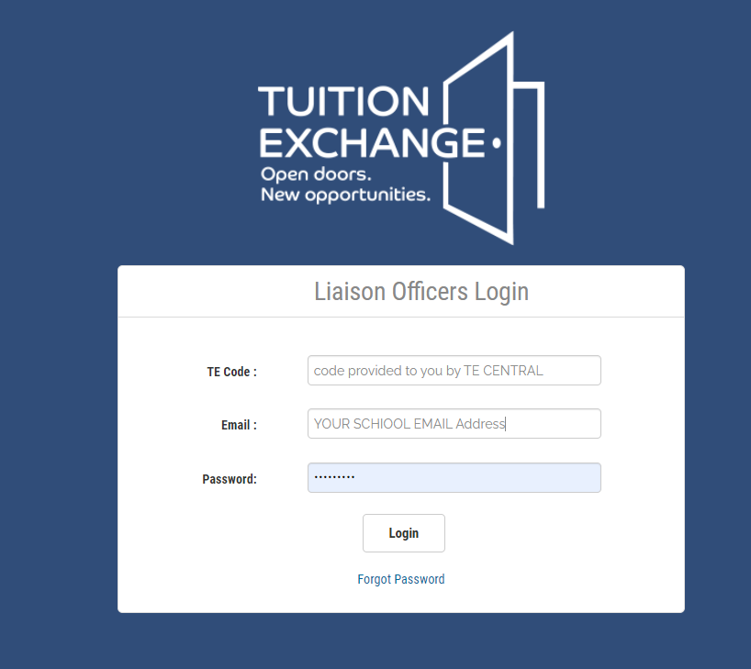
TELO website
TELO Login

Slide 11
Logging in to the TELO Portal
Every active TELO requires a personal login – do not share logins
Email Suzanne LeAnce at sleance@tuitionexchange.org and provide the following:
Name of new TELO and title
Email address and contact number of the new TELO
What role will the TELO serve?
Liaison Primary
Liaison Secondary
Export-only access
Import-only access
Who is the new TELO replacing, and should that person be deleted from the system?
Suzanne will provide login details to the new TELO via email

Slide 12
Institution Account Menu
Institution Account is where…
TELO’s update information here
User’s update their password – must include at least 1capital letter
Manage, review, and update the Enrollment Report
See the Balance Sheet
Review continuing scholars Balance Sheet style
Observe continuing scholars Enrollment Report
Confirm Annual Membership dues paid

Slide 13
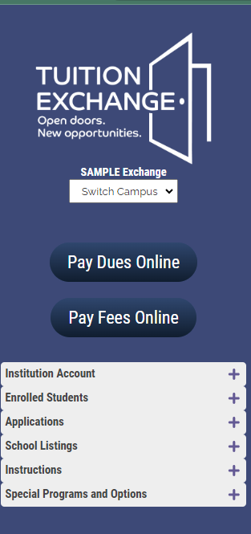
Inside the TELO Portal
If you see Pay Dues Online, click on the blue button, and if paying by credit card – click pay with Credit Card and follow the instructions
If paying by check – print a copy of the invoice and forward the invoice to your Accounts Payable division
Membership Dues are due July 15 and considered late after September 15. Late fees of $50 per month may be accessed
Membership Dues for 2023-2024 are $600.00
If you see Pay Fees Online, click on the blue button, and if paying by credit card – click pay with Credit Card and follow the instructions
If paying by check – print a copy of the invoice and forward the invoice to your Accounts Payable division
Participation Fees are due October 5 and considered late after November 5. Late fees of $50 per month may be accessed
Participation Fees for 2023-2024 are $45 per successful export and are paid by the Export school
The Invoice for Participation Fees is tied to the Enrollment Report

Slide 14
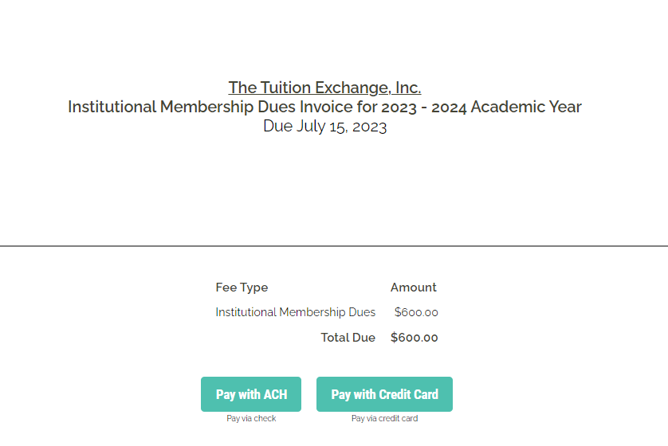
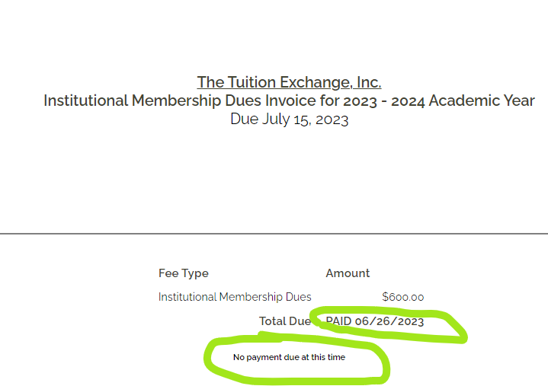
Membership Dues
Membership Dues
Payment options
Membership Dues are to be paid upon receipt and considered late if not paid by July 15
TE Central accepts credit cards and paper checks
No fees are charged when using a credit card for payment
Once payment is received, an updated statement is emailed with a No payment due at this time message
Invoices were emailed to the primary and backup TELOs and Invoice contact if listed
If your invoice is paid, the option is missing when logging into the system
You can always review your Membership Dues statement

Slide 15
When paying by check, please allow 14 days for processing

Slide 16
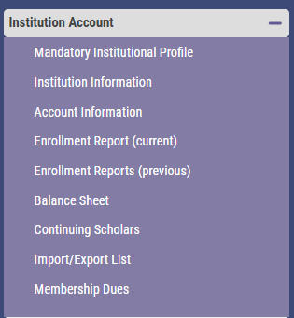
Where Do I Update the School Profile?

Slide 17
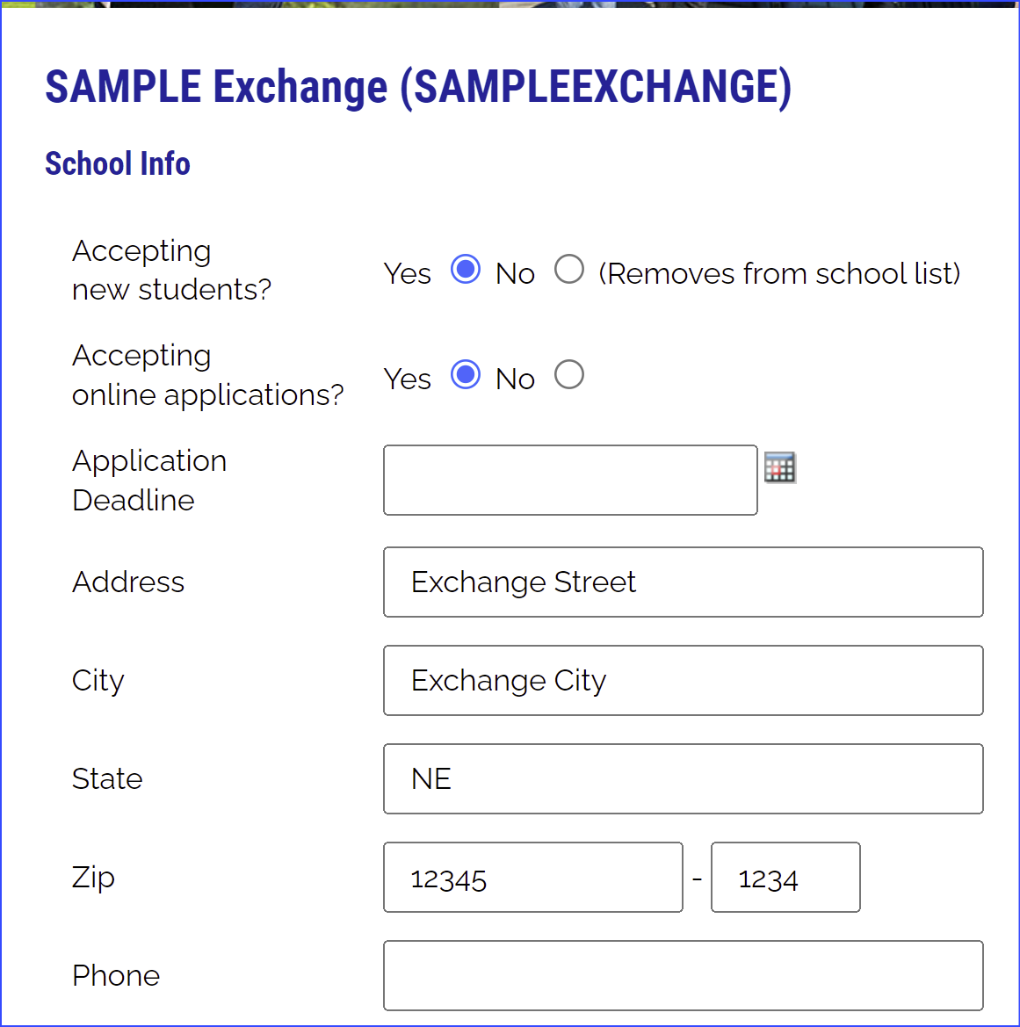
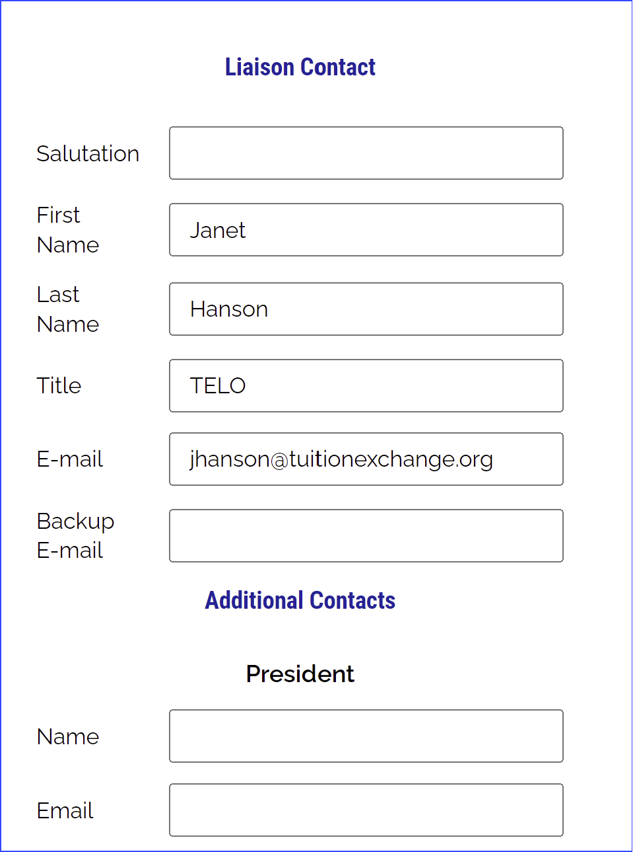
Processing Reminders inside Institution Information
Confirm & Update
Review listed employees

Slide 18
Annual Mandatory Updates inside Institution Account
Update Tuition and Scholarship amount
Confirm the application deadline is not blank
If you do not have a deadline, enter 08.15.2024
No deadline means your school does not appear on the list of participating schools
Is the listed TELO information, correct? If not, email Suzanne at sleance@tuitionexchange.org with the name, email address, contact number and title of the new TELO
Be sure to share whom the new person is replacing so Suzanne can remove them
Is your school’s name and mailing address, correct?
If not, email Suzanne with the updated information

Slide 19
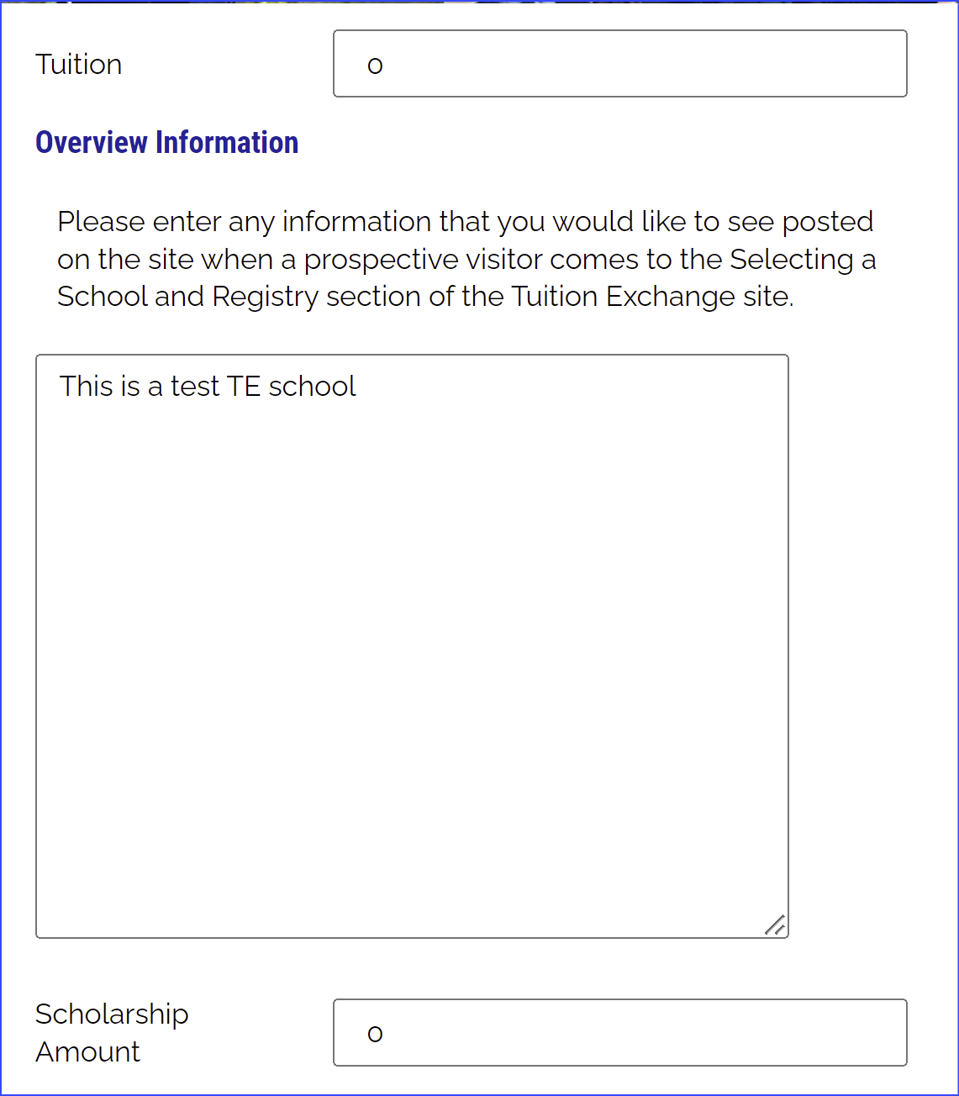
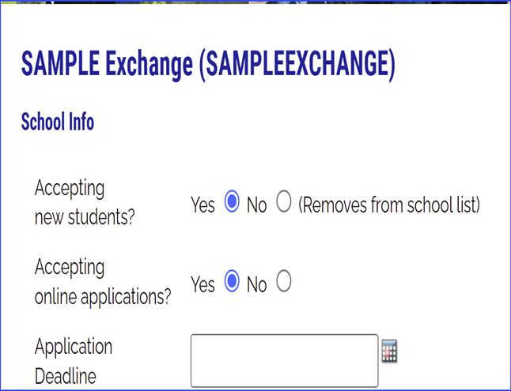
Annual Mandatory updates inside Institution Account
TE-EZ Online app, say YES and be sure to
include an application deadline
Update Tuition and Scholarship amounts
Be sure your overview is friendly and accurate

Slide 20
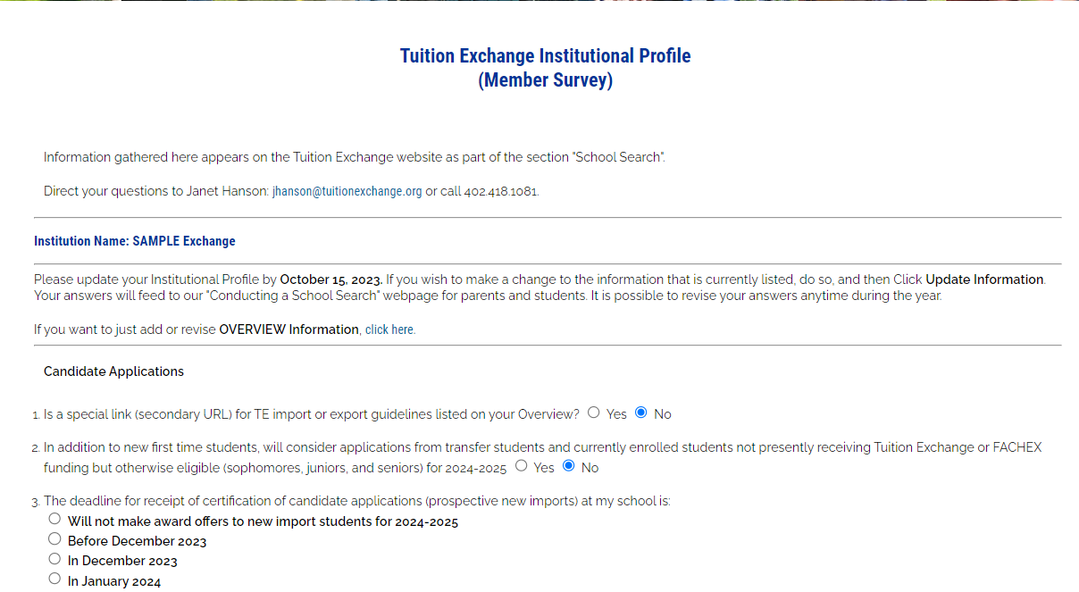
Annual Mandatory Review inside Mandatory Institutional Profile
Confirm your answers mirror your actions!
Review the Member Survey

Slide 21
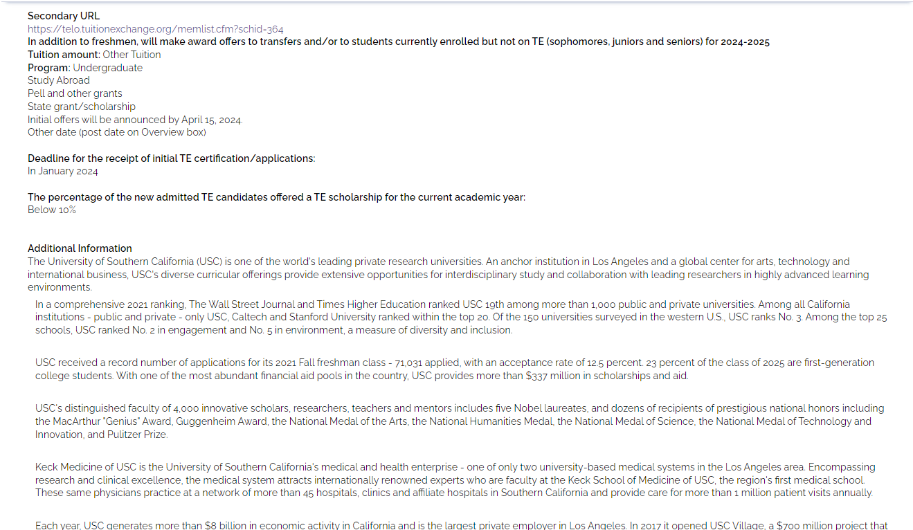
The Annual Mandatory Institution Survey feeds this area

Slide 22
Is the Additional Information friendly and informative?
This Photo by Unknown Author is licensed under CC BY-NC-ND

Slide 23
TELO Options
TELO–Primary and Secondary
TELO–Export and Import
Primary and secondary are responsible for the entire process but:
If the primary is in Human Resources (HR), there are Admissions and Financial Aid issues
If the primary is in Admissions, there are HR and Financial Aid issues
Consider…
Two TELOs with access to and knowledge of specific issues
HR knows employees
Admissions and Financial Aid know new students and continuing students
The TE system can accommodate a split in duties

Slide 24
TE-EZ Online application

Slide 25
EXPORT TELO and the TE-EZ Online App
Make your office hours count
The TE-EZ Online App allows the student to complete their application
The TE-EZ Online app first goes to the EXPORT school for eligibility certification and approval
The EXPORT school approves or denies the TE-EZ Online app based on employee eligibility
Remember, once the TE-EZ Online app is approved, there is NO recall option unless the parent no longer satisfies the Export school’s eligibility requirement

Slide 26
TE-EZ Online App
The TE-EZ Online application process has three (3) steps:
1. The student completes and submits the TE-EZ Online app, and then applies for Admission to the selected TE Member school(s)
2. The employee’s export eligibility is reviewed and confirmed eligible (approved) or ineligible (deny) by the Export TELO
3. The Import school reviews the TE-EZ Online app and determines the student’s scholarship eligibility

Slide 27
TE-EZ Online App EXPORT process
Step 1 – Student completes & submits the TE-EZ Online app
Step 2 – Export TELO receives a notification email from NOREPLY@tuitionexchange.org that the TE-EZ Online app is available for review
Step 3 – Export TELO looks inside Applications – Exports Applications (new) - Decision Pending 2024-2025
Step 4 – Export TELO approves or denies the TE-EZ Online app based on the employee's eligibility
This only means the employee meets the school’s eligibility guidelines for Export
Step 5 – Emails launch to the student and employee listed on the TE-EZ Online app, updating them on the Export school’s decision
Now the student can shift their focus of communication to the IMPORT school

Slide 28
TE-EZ Online App IMPORT process
Step 1 – Import TELO receives a notification email from NOREPLY@tuitionexchange.org that a TE-EZ Online app is available for review
Step 2 – Import TELO looks inside Applications – Import Applications (new) - Decision Pending 2024-2025
Step 3a – Click the Approved button if the student meets the eligibility guidelines for import and will receive a TE scholarship to attend your school
Step 3b - Click the Denied button if the student does not meet the eligibility guidelines for import and will not receive a TE Scholarship to attend your school
Step 4 – Emails launch to the student and employee informing them of the import decision

Slide 29
TE-EZ Online apps can be tracked by the student The tracking details require information to be entered exactly as it was submitted on the TE-EZ Online app Typical applicant error issues include the student’s birthdate and email address TELO can share a copy of the app with the student upon request
Families can track the TE-EZ Online app status
Select Application Status

Slide 30
New Student Application Status
Decision Pending – the TE-EZ Online app is waiting for action
To Be Enrolled – the Export school needs to add the student
Enrolled – the Import school has marked the student as enrolled
Approved – the TE-EZ Online app is approved for Export or Import
Withdrawn – the Export school withdrew the application
Be sure to include why in the comment section
Rejected – the Import school denied the application
Be sure to include why in the comment section

Slide 31
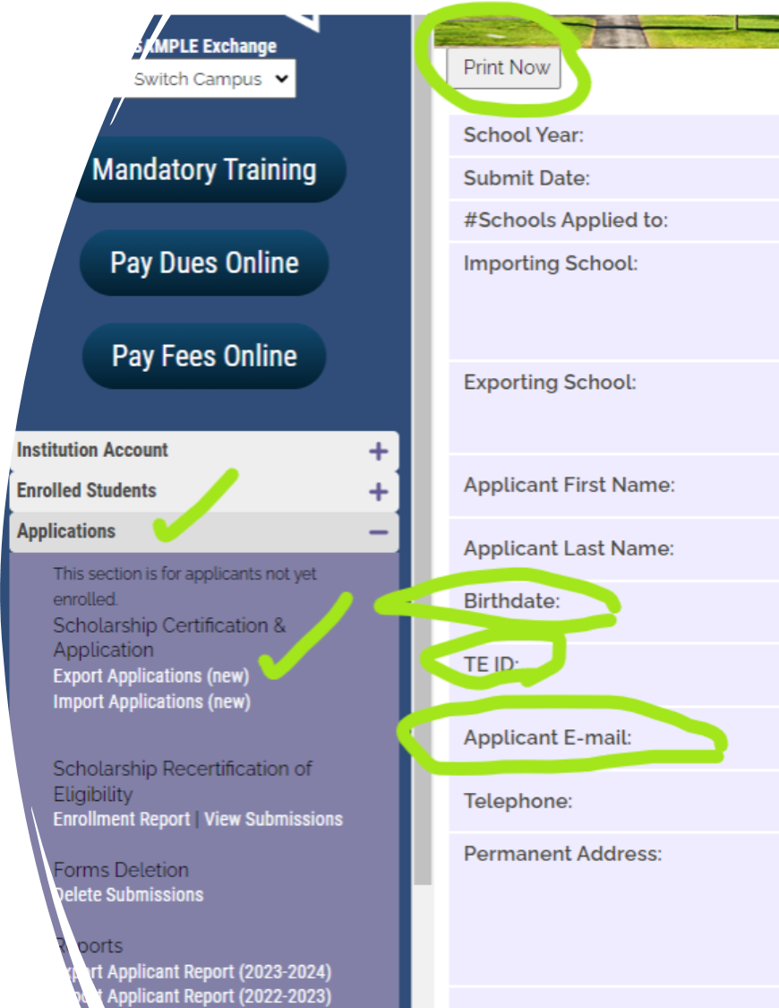
Sharing a copy of the TE-EZ Online app with the student*
TELO Portal
Applications
Export Applications New
Open student record
Click print
Print a PDF
Email PDF to student
* Due to FERPA rules, schools should never send the information to anyone but the student

Slide 32
Import Students – New & Continuing
New students - IMPORT
Continuing students - IMPORT
Confirm the new student’s admit status
If not admitted at this point in the year, deny the application
Communicate with FA that the TE scholarship is official
If admitted, confirm the student paid their enrollment deposit and plans to attend your school in the fall
Once school begins in the fall, the Import school clicks the Enrollment Box provided the student “showed up”
Confirm the student is enrolled for the upcoming semester/term
If not enrolled, update the expiration date – Drop Student at the End of Last Semester
Confirm academic progress (Check with FA or the Registrar)
Communicate with FA that the TE scholarship continues
Confirm the expiration date is valid
Do not recertify until Spring 2024

Slide 33
TE Central Contact Information
www.tuitionexchange.org
Robert “Bob” Shorb Janet Hanson
Executive Director/CEO Director of Communications
rshorb@tuitionexchange.org jhanson@tuitionexchange.org
518.859.7301 402.418.1081
Kristine Lev Suzanne LeAnce
Director of Administration Assistant Director of Communications
klev@tuitionexchange.org sleance@tuitionexchange.org

