Slide 1
Understanding Institutional Capacity & your Balance Sheet
December 2018 Monthly TE webinar series
presented by:
Janet Dodson and Bob Shorb

Slide 2
A sister, an aunt, a great-aunt, a sorority sister, a baker, a volunteer, and a proven leader
Involved in higher education since 1979
An educator, a trainer, and now a student too
Myers-Briggs says ENFP and most agree

Slide 3
A father, stepfather, brother, uncle, great uncle, great-great uncle, fraternity brother, speed walker, volunteer, team leader
Involved in higher education since 1977
An administrator who choose a career in financial aid administration
A first-generation student dedicated to help thousands of students get their college degrees

Slide 4
Today’s Focus
Understanding Institutional Capacity
Balance Sheet
TE Program options
Export/Import 3 (E/I 3)
Double Credit 3 (DC3)

Slide 5
Understanding Institutional Capacity
First one needs to understand the issue of capacity at your school…
Who fills your classroom seats?
Faculty and staff are hired to work with students
Do you have empty residence hall beds?
Residence halls and dining facilities are built to house and feed students
Notes:
Fills – Skidmore model. Different kids in the seat… Set rate issue

Slide 6
Understanding Institutional Capacity
Increasing TE scholarship offers
potential for an increase in Auxiliary income
recent graduate isn’t burdened by student loan debt
potential for an increase in giving income
national footprint increases geographical diversity
Make every student’s experience a positive one and your Balance Sheet improves

Slide 7
Understanding Institutional Capacity
Funding is always an issue
Think creatively
Combine with Academic and co-curricular awards
Don’t forget to check on Athletic rules to stay in compliance
Require all students to complete the FAFSA
If they don’t comply – consider reducing the TE award by the maximum Pell Grant and if available, maximum State grant.
Require all TE scholars to live in campus housing
If you have a robust Greek system you may need to provide leniency in this case
Work with CFO
Since TE scholarships are available to employees.
Consider a set-aside fund so TE funds don’t count as a Financial Aid expenditure

Slide 8
Understanding Institutional Capacity
Always work closely with your Enrollment Management Team, Financial Aid Office and Human Resources
Remember TE Scholarships are NOT a guaranteed employee benefit
There are program deadlines
Keep your TE profile up to date
Share your TE stories
Remember TE is a two-way street.
Exporting schools approve the export but…
Importing schools approve the award

Slide 9
A very important Export detail to understand
The student’s TE application is approved if entered and approved via TE-EZ or entered by the TELO
THIS MEANS YOUR SCHOOL AGREES TO EXPORT THE STUDENT
You cannot and should not enter an export application and then determine the application is ineligible later

Slide 10
Balance Sheet review
Please have your TE Balance sheet in front of you for the next few slides.

Slide 11
Let’s look at a school
Today imports and exports are balanced
1
Today school limits the export opportunity to a total of 20 TE students annually (this is 5 per class)
2
Today school has 50 new import applications for TE
3
Annually, the school offers 5 imports and typically 3 import students accept
4
This school could accept more imports which in turn allows for the option for increased exports
5

Slide 12
Let’s look at another school
Today this school’s balance sheet is unbalanced. It is Export heavy
School is approving all TE exports
School is limiting TE imports, yet they have the applicant pool
This school needs to increase its import offerings

Slide 13
Let’s look at another school
Today maintains balance by not being bold
School receives numerous export requests
School receives numerous import requests
School offer two imports annually
School provides for two exports annually
This is a school with empty seats
Why???

Slide 14
Yield
The concept of YIELD can be a mystery
Using the Export Report option review all Exports for your school in the TE system
Count the student as one rather than counting each school export request
You have access to 2015, 2016, 2017 and 2018 information
Once you determine who was offered an Export opportunity you need to know who enrolled
Your Enrollment Report provide the you Enrollment Information
Example: 25 student valid export records
7 students accepted and enrolled
Your Export YIELD is rate is 28% (7/25)

Slide 15
Yield
Now let’s review the Import side of YIELD
Using the Import Report option review all Imports requests received via the TE system
You have access to 2015, 2016, 2017 and 2018 information
Determine who enrolled
Your Annual Report tells you Enrollment Information
Example: 30 student Import requests were approved
10 students accepted and enrolled
Your Import YIELD is rate is 30% (10/30)

Slide 16
Tuition Exchange Officer Duties and Responsibilities
Tuition Exchange website
1
www.tuitionexchange.org
2
Keep your information current
Liaison Officers tab
Mandatory Institutional Profile Confirm and/or add overview information

Slide 17
Tuition Exchange Officer Duties and Responsibilities
Tuition Exchange Student Guidelines template
a guideline to confirm your guidelines are up-to-date
template to record your guidelines if guidelines are in your head
Tuition Exchange Handbook
A fluid document
Research when in doubt

Slide 18
Tuition Exchange Officer Duties and Responsibilities
Timing
Fall seek TE applications
Spring update Import applicants of their final TE status
Summer confirm FA and Student Accounts has knowledge of TE Import funding

Slide 19
Best Practice Hints!
Families need reminding to complete the FAFSA and share the consequences if required!
Request a TE specific email address Think: TE@myschool.edu
Get assistance from Marketing make sure your message is school approved!
This is a potential scholarship opportunity – but not one that is guaranteed! Be sure you disclose this…
www.random.org can help with lottery decisions
A calendar helps you keep track of what do I need to do next.
Each school administers TE differently, encourage families to contact the TELO at their importing school for concise information.

Slide 20
Communication and Documentation
Policy and Procedures
Always share your TE policies because it
Reduces confusion
Eliminates incorrect information sharing
Demonstrates professionalism
Share information often
Newsletters, FAQ’s, and general internal emails
Internal websites
REMEMBER not all employee access their email.

Slide 21
Communication and Documentation
Policy and Procedures continued
Create a working calendar
Helps with future year TE management
No missed information
Reduces your stress and
Minimizes TE applicant stress

Slide 22
Communication and Documentation
Letters, emails and calls
Families desire information
Does your school require a TE RENEWAL application? WHY?
Create and share a Frequently Asked Questions document
Keep employee in the loop
What is my kid’s application status? is their biggest question
Steer them to the TE website
Share your contact email
The number one parent phone call TE Central receives!!!
Second parent phone call is I am thinking about applying for a job at a local college. What do I need to know for my kid to be eligible for TE?

Slide 23
TE Program options
TE members can choose to participate in E/I 3 and or DC 3
Still your program for purposes of administration and oversight
TE Central knows these additions provide for increased exports
Check out the Instructions area for additional information

Slide 24
TE Program options
Export/Import 3 (E/I 3)
Opportunity to export up to three TE scholars annually without impacting your Balance Sheet
each TE school can offer increased export opportunities to employees
can export with any TE school – not just a few
issue of Restriction should be a non-issue
update your profile question #9 to YES!
No additional cost to participate in this option

Slide 25
TE Program options
Double Credit 3 (DC 3)
Provides TE member schools credit for exchanging with other TE recognized exchange programs
Matches done via the Enrollment Report
School gains import credit
Cost is $40 per import for this program

Slide 26
TE-EZ Application process
The TE-EZ application process moves the
application entry from your office to the
family.
YOU CONTROL the process for approval
or denial all new EXPORT applications
Any TE application can be reviewed by
the family provided…
The family knows the entered TEID,
the student’s entered email, and
the student’s entered birthdate.
TE Central will not assist any family with information.
We will tell the family to contact their EXPORT TELO
and copy you when the family emails from their TE
Member email.

Slide 27
TE Export and Import Report options
Can run Export Application and Import Application reports
Use Chrome or Firefox for best results
Can upload the information into your student data system

Slide 28
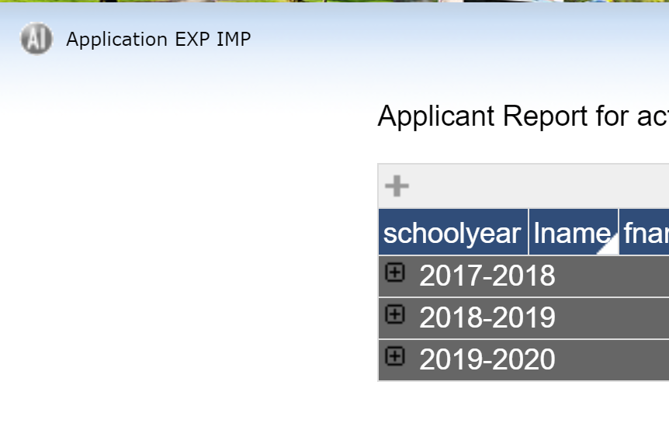
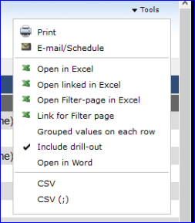
TE Export and Import Report options
When you open the report, all years are displayed.
Each academic year is separated by a line
The years are in numerical order
Go to the year you are seeking and delete all other years in order to upload the data into your CMS systems.
Confused? Ask your IT staff for help!

Slide 29
Let’s Recap
Understanding Institutional Capacity
Balance Sheet
TELO Responsibilities
TE program options

Slide 30
Contact Information
Janet Dodson, Associate Director of Communications
jdodson@tuitionexchange.org
402.418.1081
Robert Shorb, Executive Director and CEO
rshorb@tuitionexchange.org
518.859.7301
Kristine Lev, Assistant Director of Administration
klev@tuitionexchange.org
Tuition Exchange Central
info@tuitionexchange.org
301.941.1827
On line at www.tuitionexchange.org

Slide 31
Join us December 13
https://attendee.gotowebinar.com/register/2878663673151013389
At 2:00 eastern time; 1:00 central time; Noon, mountain time; or 11:00 pacific time
Topic is TE 103 - TE Guidelines - what's in yours? sharing the TE story on your campus and understanding your Balance Sheet.

Slide 32
This Photo by Unknown Author is licensed under CC BY

