Slide 1
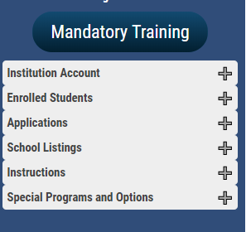
Understanding what is found inside each menu tab

Slide 2
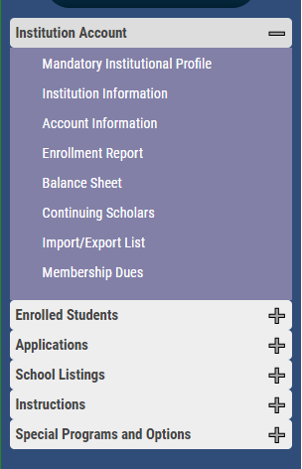
Institution Account is where…
TELO’s update information about the school
User’s update their password – must include at least one capital letter
Manage, review, and update the Enrollment Report
See the Balance Sheet
Review continuing scholars Balance Sheet style
Observe continuing scholars Enrollment Report style
Confirm Annual Membership dues are paid

Slide 3
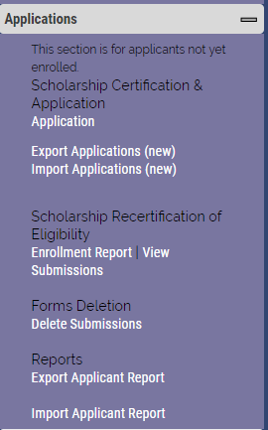
Applications is the section that sees the most action!
Application is where you enter a new student TE application.
Export Applications (new) are EMPLOYEE students looking for
alternatives to home for college
Import Applications (new) are IMPORT students looking for
Tuition Exchange scholarship consideration at your school
The Enrollment Report is where you RECERTIFY eligible continuing
your exports
View Submissions is where you find a list of all recertified continuing
your school imports and exports

Slide 5
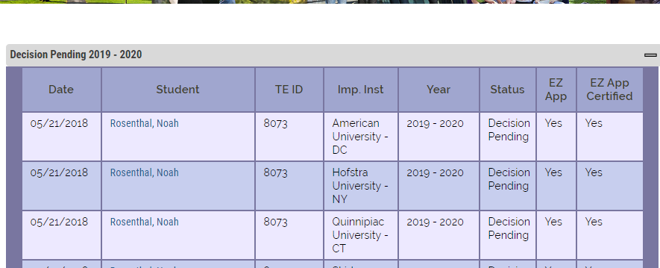
Decision pending – Exports. Your school approved the student is waiting on Import school approval

Slide 6
Waitlist – Exports. Lasalle has approved the student, the Import school reviewed the request
and moved the Import student to their Wait List

Slide 7
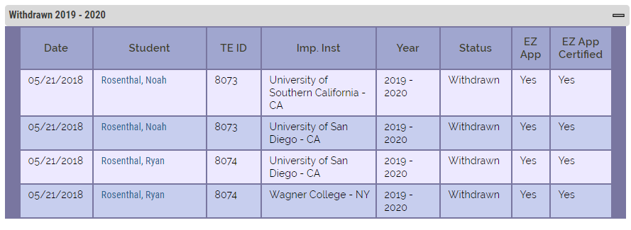
Withdrawn – Exports. Lasalle did not approved the student
request (may be a duplicate application or family error)
Export schools withdraw and Import schools deny

Slide 9
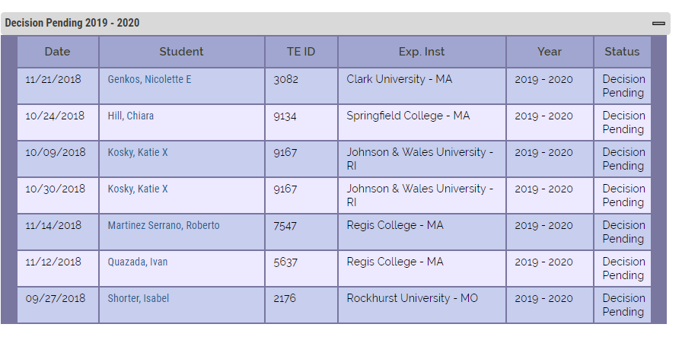
Decision pending – Imports. The export school approved the student. He is waiting on the Lasalle
Import approval
Import students appear on this list once the Export school approves the application.

Slide 10
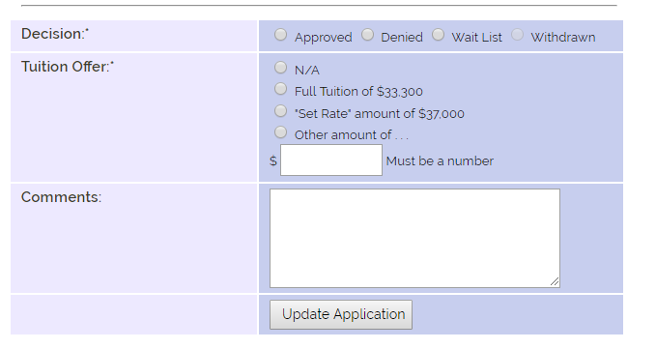
Reacting to eligible Import applications
Confirm the student has applied and
is admissible. If yes, approve the
student’s import application
Select the correct Tuition Offer
Make comments as appropriate
To save – update application
A new category is displayed – Approved 2019-20
Email notifications launch to the student and parent provided valid emails are provided.
The Export TELO is also notified.

Slide 11
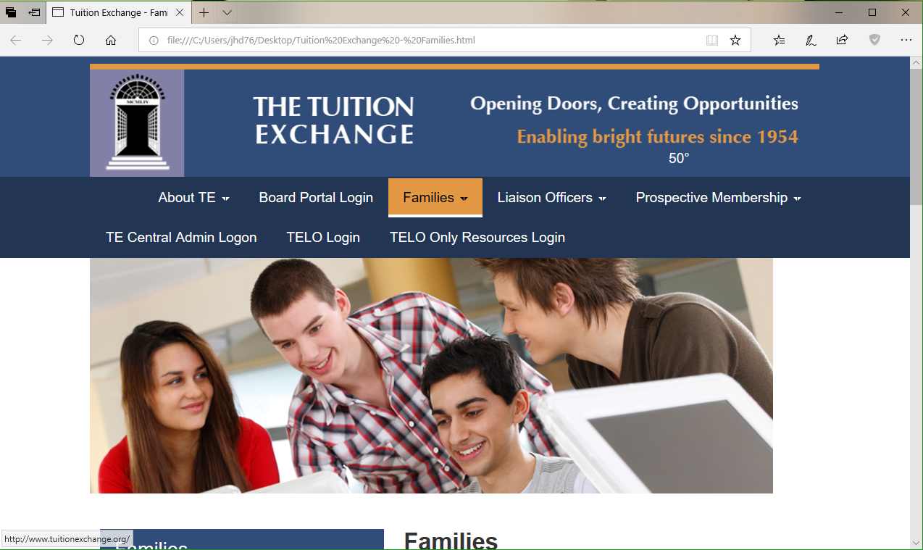
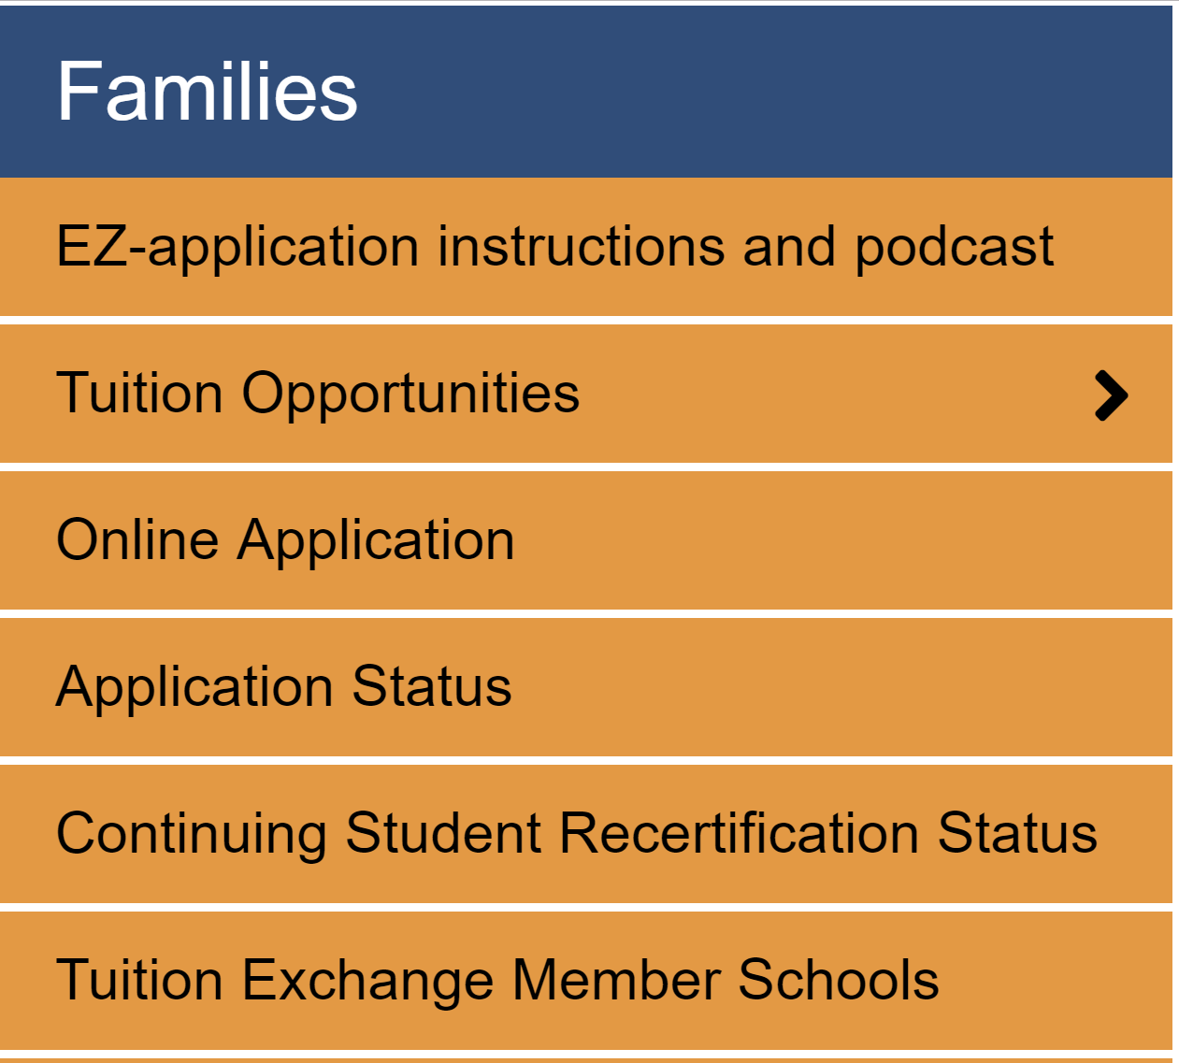

Slide 12
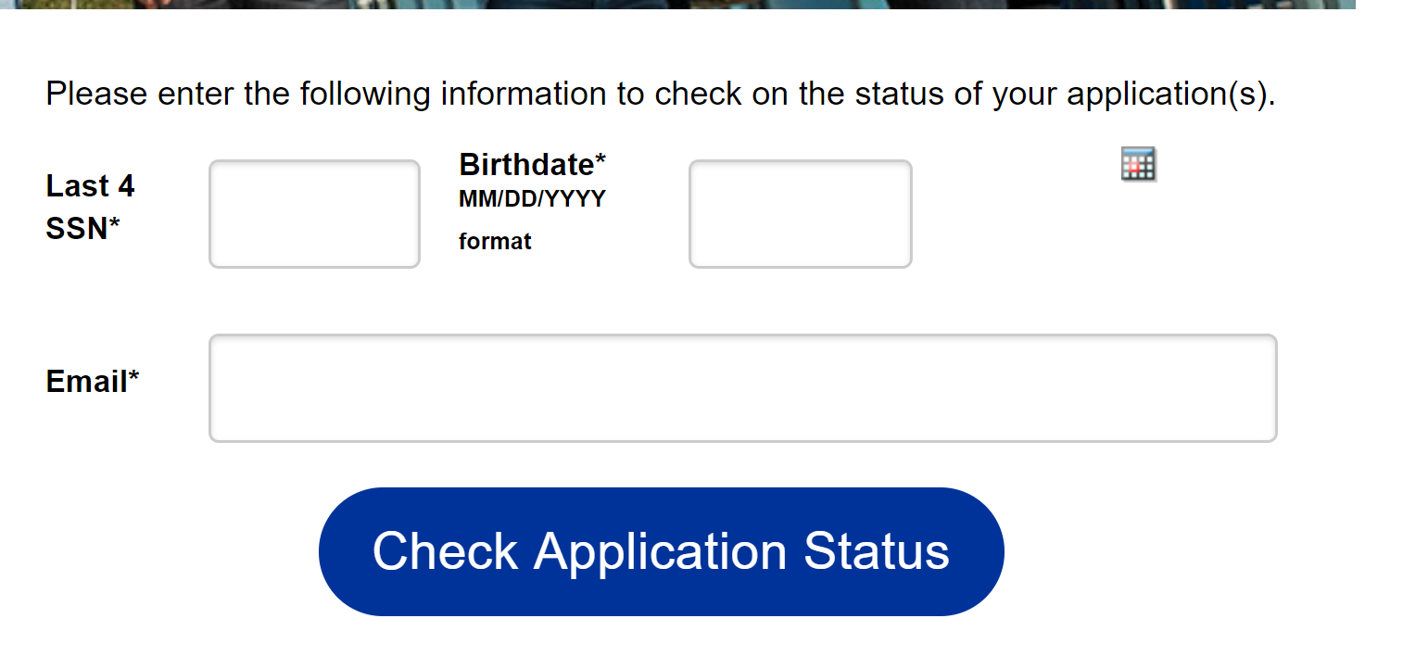
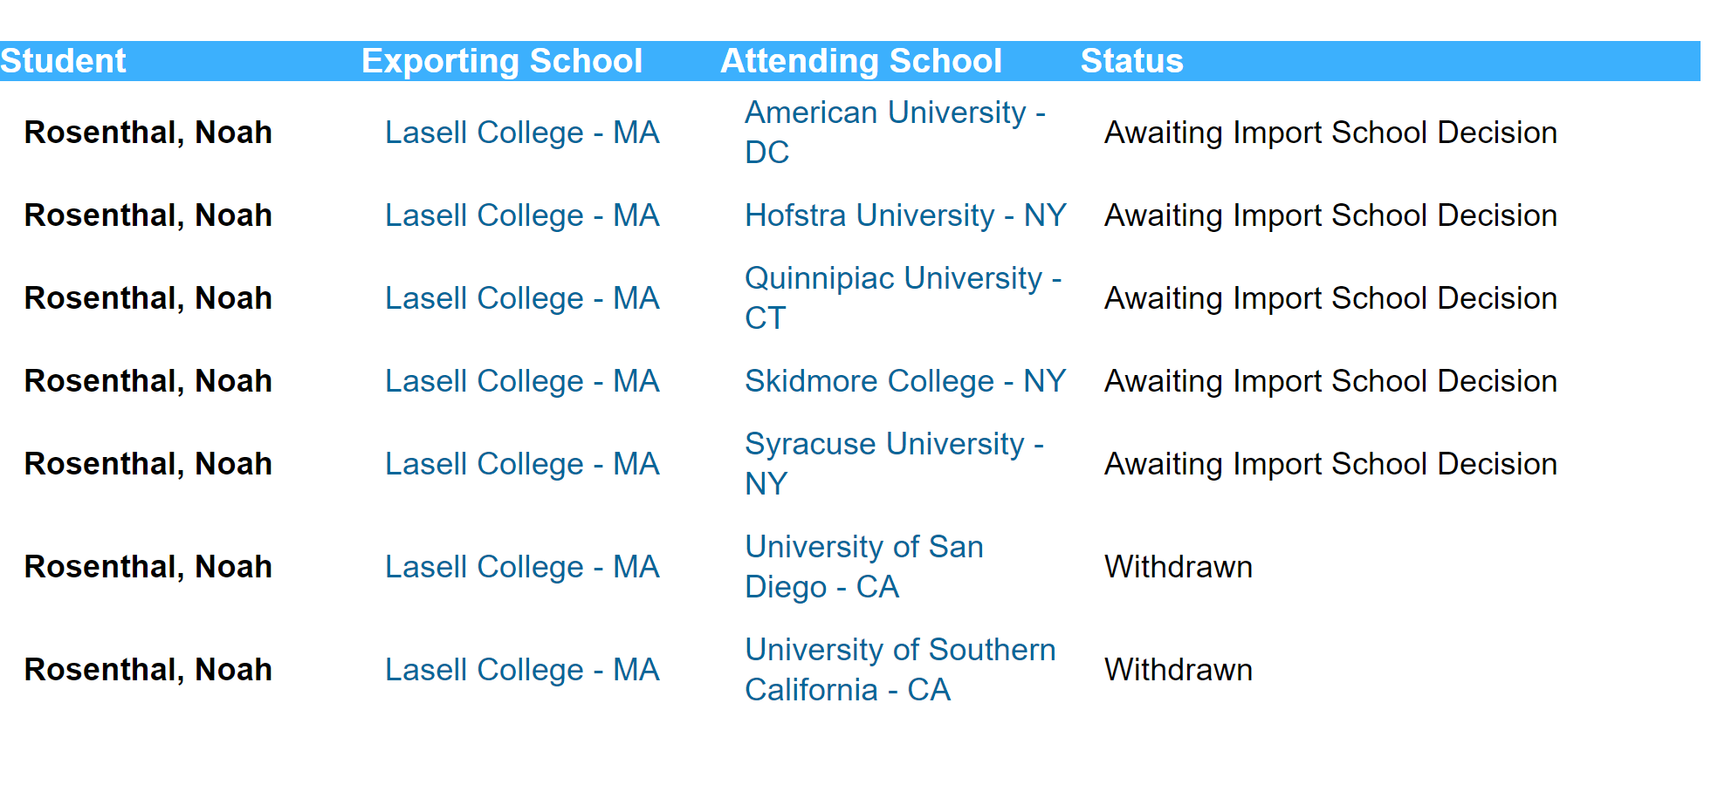
The data requested MUST match PERFECTLY
for the family to access application information
TE Central does not provide assistance to
Families with the EZ application or the App
Status options

