Slide 1
EZ – App How to… A guide for families
Available for Tuition Exchange and FACHEX families

Slide 2
Contents
What you need to know before you begin
Completing the EZ application
What’s next
Tracking my student’s EZ application
Tuition Exchange is the proud host for the FACHEX scholarship system.
If you are employed at a participating FACHEX school, the EZ application is available
at both FACHEX schools and Tuition Exchange schools.
If you have questions specific to the FACHEX Program, please contact
your FACHEX Administrator directly.

Slide 3
What you need to know before you begin
Does my employer participate?
Does my employer require any additional information?
What are my employer eligibility guidelines?
Tuition Exchange is the proud host for the FACHEX scholarship system.
If you are employed at a participating FACHEX school, the EZ application is available
at both FACHEX schools and Tuition Exchange schools. If you have questions specific
to the FACHEX Program, please contact your FACHEX Administrator directly.

Slide 4
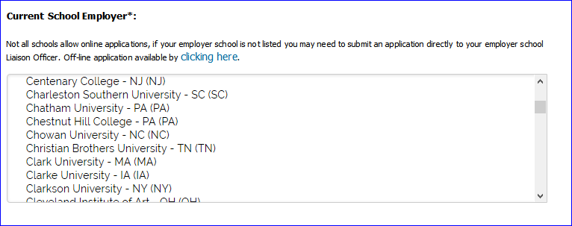
Does my employer participate in the EZ application process?
Not sure? Check the application at: https://telo.tuitionexchange.org/apply.cfm
If your employer is listed – you are eligible to utilize the EZ application process.
If your employer is
not listed – download
the off-line application, complete
the application, and forward it to your
Tuition Exchange Liaison Officer (TELO) or FACHEX Administrator.

Slide 5
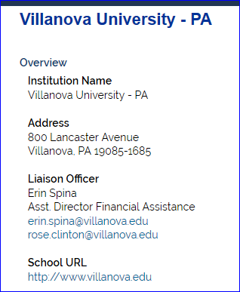
Does my employer require any additional information?
You need to ask this question of your TELO or FACHEX. Administrator. Not sure who to email? Check the Tuition Exchange website at:
https://telo.tuitionexchange.org/schools.cfm - TE employee click on your employer’s link
https://telo.tuitionexchange.org/fachexschools.cfm - FACHEX employee click on your employer’s link
TE Central does not provide the phone number
of our TELO’s or FACHEX Administrators.
Email is your best communication option!
Additional information may be available on
the search page. Please take the time to read the entire
page!

Slide 6
What is my employer’s eligibility guideline?
Contact your employer.
See previous slide for determining your TELO or FACHEX Administrator contact information.
Consider checking your Employee Handbook and search your campus Intranet – key word search Tuition Exchange, FACHEX, or Tuition Reimbursement.
Many TELO’s or FACHEX Administrators offer Lunch and Learns or evening programs on your school’s Exchange programs. Be sure to watch your email for information.
Many employers require a certain length of service to be considered eligible.
Tuition Exchange or FACHEX is not a guaranteed employee benefit.
There is no guarantee your student’s application will be selected for Export or Import consideration.
Your student must be applying for admissions and be admitted before Tuition Exchange or FACHEX funds is considered and potentially extended to your student.

Slide 7
Completing the EZ-application
The EZ-application requires employee and applicant information:
Student’s complete email address;
Last 4 digits of the student’s SSN;
Employee’s complete email address;
Employee’s years of employment;
Will the student complete the Free Application for Federal Student Aid? (www.fafsa.ed.gov); and,
What schools is the student considering:
Students can select a maximum of 10;
Student must be applying for admission or be admitted in order for TE/FACHEX consideration.

Slide 8
Tuition Exchange is the proud host for the FACHEX scholarship system.
If you are employed at a participating FACHEX school, the EZ application is available at both FACHEX schools and Tuition Exchange schools.
If you have questions specific to the FACHEX Program, please contact your FACHEX Administrator directly.

Slide 9
Completing the EZ-application podcast
Click here to start the nine minute podcast

Slide 10
The EZ-application is found at: www.tuitionexchange.org
Select the Families option and click on the carrot to the right of the “s”;
Select Online application option.
Before jumping into the application – please take three minutes to review the instructions .
Answers to the most asked questions are detailed on the following slide.

Slide 11
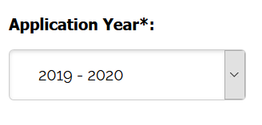
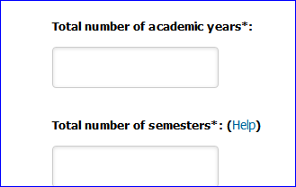
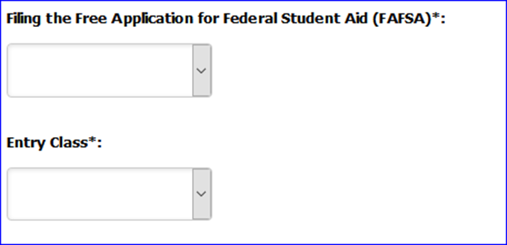
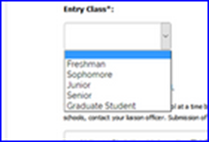
Frequently Asked Questions
Application year
Select the year the student
plans to begin his college career.
College Academic year
Freshman 4 years;
Sophomore 3 years;
Junior 2 years; and, Senior 1 year.
Number of College semesters
Freshman 8 semesters;
Sophomore 6 semesters;
Junior 4 semesters; and, Senior 2 semesters.
Use the dropdown box

Slide 12
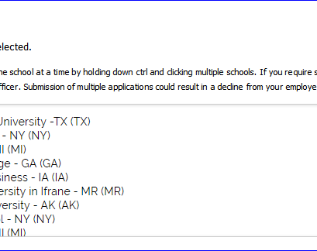
Other important items
Student’s may select a maximum of 10 IMPORT schools.
You must continually hold down the Control button if your application is to be sent to more than ONE school

Slide 13
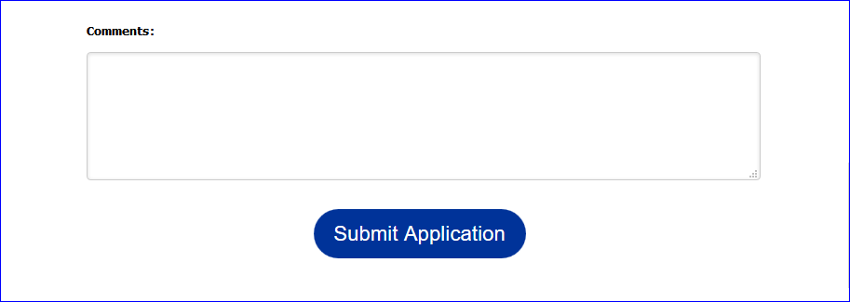
Final step
The information in this section is shared with your TELO/FACHEX Administrator and all schools selected
Don’t forget to click SUBMIT!
If you haven’t already viewed the podcast – click here now.

Slide 14
What’s next
Once the EZ application is submitted, the screen details the names of the schools the application is to be submitted.
REVIEW the list confirming that your application includes each school your student is interested in attending.
The next step is for your employer to certify your EZ application.
Approved means your student applications are shared with the school(s) your student selected as a potential IMPORT school.
Deny means the employee does not meet your Employers’ eligibility guidelines.
Emails are sent to both the student and employee if the EZ application is approved for potential export.
In the case of denial – only the Employee receives an email
Questions about why denied? Contact your employer. TE Central has no knowledge of why.

Slide 15
Timing of Export approval is up to the EXPORT TELO or FACHEX Administrator.
It is important that your student submits all admissions applications and required documents timely to the schools where the EZ app is submitted.
Generally TE or FACHEX applications not having a corresponding admissions application are not reviewed or offered any Exchange funding opportunities.

Slide 16
Dear Employee, Your applications are now recorded and await your employer's approval. The next step will be review and approval or denial by your employer. If you have questions about next steps, please contact your Liaison Officer. Liaison Officer Mr. Robert Shorb Tuition Exchange (The) 3 Bethesda Metro Center, Suite 700 Bethesda, MD 20814 jdodson@tuitionexchange.org klev@tuitionexchange.org;rshorb@tuitionexchange.org
The Tuition Exchange | 3 Bethesda Metro Center – Suite 700 | Bethesda, MD 20814 | 301-941-1827 | info@tuitionexchange.org
As your student’s TE or FACHEX application moves through the system, emails generate updating both the student and the employee of action taken.
The system does not generate emails unless action occurs.
If you have questions about the EXPORT process – contact your employer.
If you have questions about the IMPORT process – contact the Admissions Office or TELO/FACHEX administrator at the IMPORT school.
TE Central is unable to provide you any information about your student’s application.

Slide 17
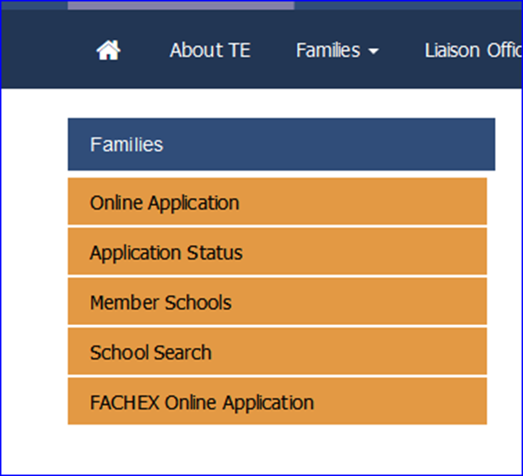
Tracking my student’s EZ application
Another way to track the EZ application is to use the Application Status option.
As mentioned on the prior slide and provided you entered valid emails on the EZ application, the student and employee receives emails as application action occurs.

Slide 18
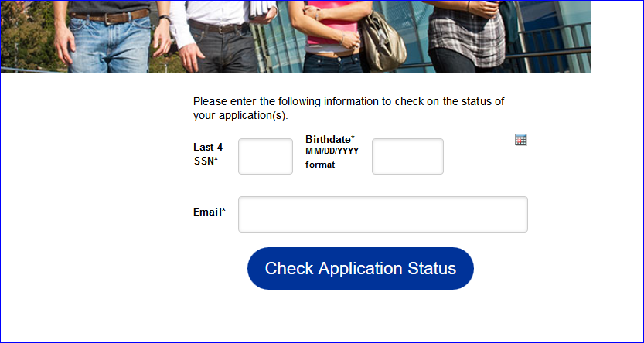
Use the student id information entered on the student’s application to access your EZ app account.
Should questions arise, contact the correct TELO or FACHEX Administrator.
The link for administrator’s contact information is:
https://telo.tuitionexchange.org/schools.cfm - TE employee click on your employer’s link;
https://telo.tuitionexchange.org/fachexschools.cfm - FACHEX employee click on your employer’s link.

Slide 19
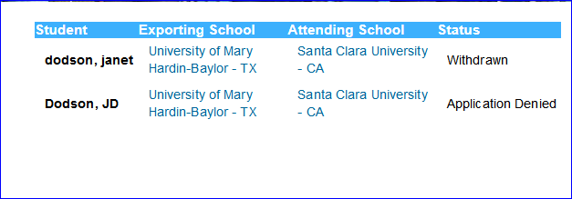
Below is an example of what you might see inside your student’s
EZ App status.
HINT! Both the EXPORT and ATTENDING school names are hyperlinks.
By clicking on the link, you are directed to the TE Overview page.

Slide 20
We hope you found the information shared valuable.
Again, if questions arise, contact your Tuition Exchange
Liaison Officer or FACHE Administrator.
Tuition Exchange is the proud host for the FACHEX scholarship system. If you are employed at a participating FACHEX school, the EZ application is available at both FACHEX schools and Tuition Exchange schools. If you have questions specific to the FACHEX Program, please contact your FACHEX Administrator directly.

