Slide 1
Tuition Exchange 101
Janet Dodson and Bob Shorb, Fall, 2018

Slide 2
Training series updates
Training series details
Fall and Spring
101 – TELO basics – New TELO Training
102 – TELO website details, EZ app, FERPA
103– TELO Guidelines, Yield & Capacity
104 – Mandatory Enrollment Report Training – July, August, and September only
105 – Import Verification Training – April
Sign-up via the Training button inside the TELO portal
For each webinar you attend your school receives 1 semester of IMPORT credit
FINE PRINT
Must register via the TELO portal
Must attend the full webinar
Only one staff member from each school can earn the extra Import credit

Slide 3
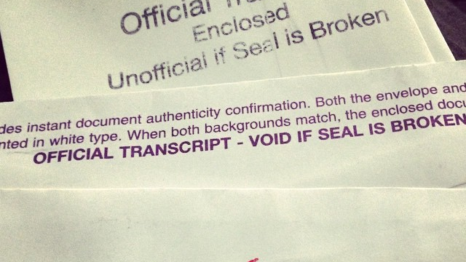
Learning Objectives
TE 101
Responsibilities
Expectations
Campus collaboration
Program review
Export/Import 3
Double Credit 3
Room Credit
Training Credit
EZ-APP
This Photo by Unknown Author is licensed under CC BY-SA
This Photo by Unknown Author is licensed under CC BY

Slide 4
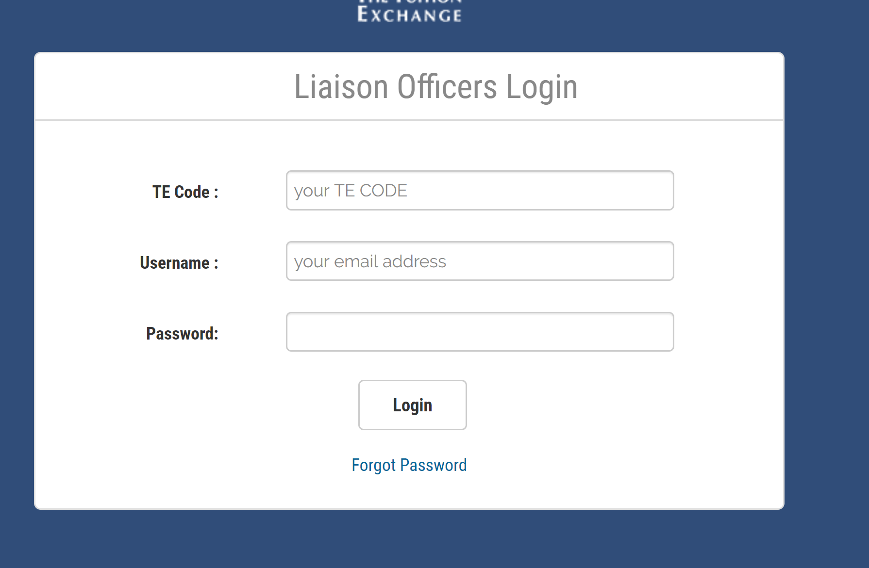
How do I log into the TELO Portal?

Slide 5
Responsibilities
This Photo by Unknown Author is licensed under CC BY-SA
So much change and too little history
Where are your guidelines?
Don’t have any!
Consider replicating your Tuition Remission policy

Slide 6
www. Tuitionexchange.org
TELO14

Slide 7
Look inside the Communication Folder
Remember Mitigating circumstances is a valuable phrase to use in your TE guidelines

Slide 8
Expectations
So much change and too little history
Document, document, document!
Update TE Central when you leave your TELO position
Always have a TELO back-up
You never know when you might win the lottery

Slide 9
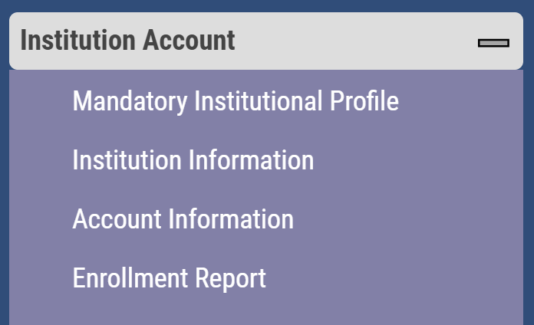
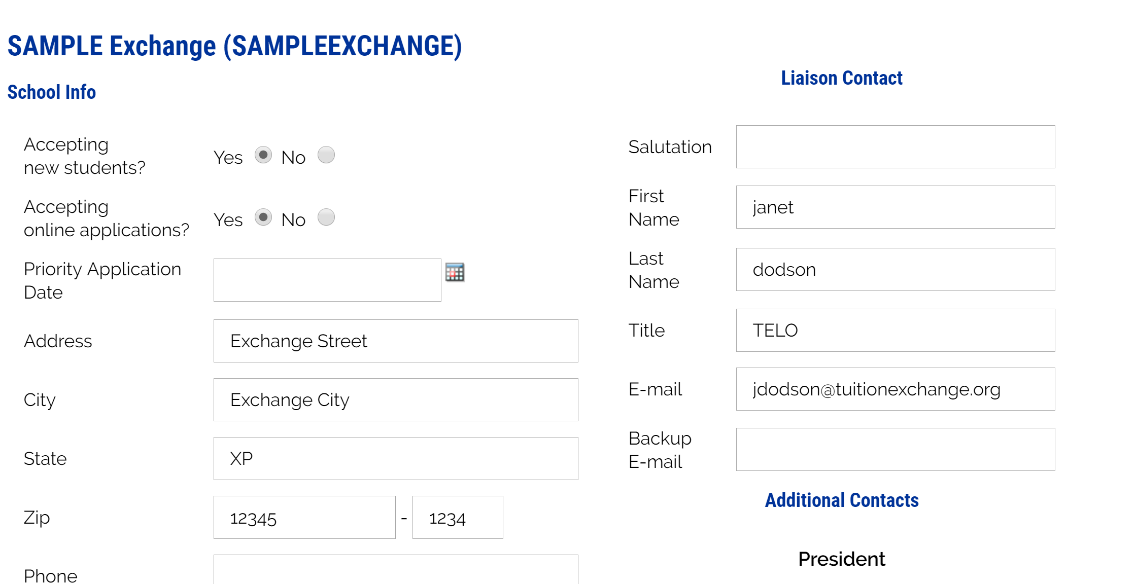
Keep the Liaison Contact information current

Slide 10
TE Handbook is your guide Summary of TELO Responsibilities
To maintain fiduciary compliance with TE Central
To create and share equitable and fair TE guidelines
To advise eligible employees and their families about the Tuition Exchange program;
To certify the eligibility of faculty and staff family members who apply for TE scholarships at other institutions;
To re-certify the eligibility of “exports” each academic year;

Slide 11
TE Handout is your guide Summary of TELO Responsibilities
To monitor the eligibility of “imports” each academic year
To monitor “export” and “import” applicants enrollment
To maintain a reasonable balance between “exports” and “imports”
To comply with limitations and restrictions imposed by Tuition Exchange;
To resolve exchange problems with TELOs at other member institutions;
To complete the Enrollment report no later than September 30
To review and modify as necessary the Enrollment Report throughout the academic year
To keep current the TE Mandatory Profile ; and
To maintain up-to-date TELO information with TE Central

Slide 12
Campus Collaboration
This Photo by Unknown Author is licensed under CC BY-ND

Slide 13
Campus Collaboration
Who is involved?
Enrollment Management – Admissions & Financial Aid
Human Resources – employee relations
Business Office – funding and capacity

Slide 14
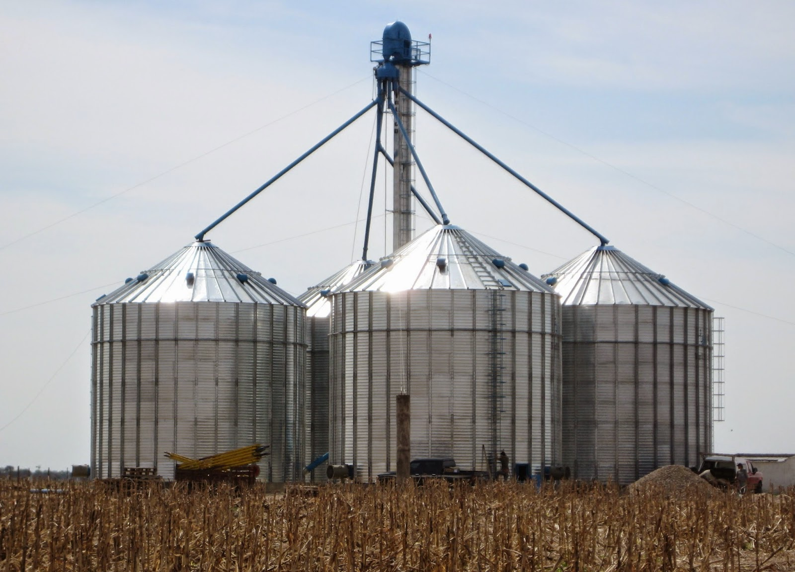
Campus Collaboration
This Photo by Unknown Author is licensed under CC BY-NC-ND
This Photo by Unknown Author is licensed under CC BY-NC-ND
Which picture is your TE process most like?

Slide 15
Campus Collaboration
Imports provide potential new students to the recruitment pool
Share the student information with Admissions
Update Financial Aid when you award any Tuition Exchange scholarships
Exports provide scholarship opportunities to employee families
Promote your TE scholarship program effectively
TE provides you examples and materials
Funding of the TE scholarships
Import institution funds the award
Export school pays the Participation fee

Slide 16
Program Review

Slide 17
Program Review
Schools offering free room to TE recipients receive one (1) additional semester of import credit per semester when the student is residing in institutional housing
For each TE webinar series* you attend your school receives 1 semester of IMPORT credit
FINE PRINT
Must register via the TELO portal
Must attend the full webinar
Only one staff member from each school can earn the extra Import credit
* Webinar series is defined as 101 – 104 or
of the eight monthly stand alone webinars and you must attend four each academic year
By attending TE webinars, you can earn for your school two extra import credits annually.

Slide 18
EZ Application
Make your office hours count.
The EZ Application allows families to complete their own application.
Application goes to the EXPORT school only for certification of eligibility
The EXPORT school controls the approval or denial of the EZ application
A note of importance – once you approve the EZ or ENTER the application yourself and hit submit, you have approved the family for scholarship consideration – there is NO recall option

Slide 19
EZ Application
The website includes a 9 minute how to video for families
A special how to webcast is available to you inside the TELO ONLY Resource portal
Don’t be afraid – use this excellent tool
No data entry or inability to read the applicants chicken scratch

Slide 20
EZ Application process
Step 1 – family completes the application and lists your school as the employer
Step 2 – you receive notification email from NOREPLY@tuitionexchange.org
Step 3 – Look inside Applications – New Exports – 2019-20 Decision Pending
Step 4 – Approve or Deny each application for Import scholarship consideration
This means the employee meets your eligibility guidelines for Export only!
Step 5 – emails launch to family informing them of your decision
Now families need to focus their communication with the IMPORT school

Slide 21
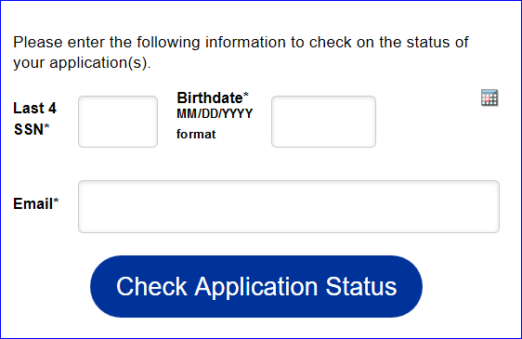
EZ Application process
Regardless of how the initial application is entered the parent or student can track the application
The information MUST be entered exactly and email addresses MUST be remembered
Error issues are birthdate and email entered wrong

Slide 22
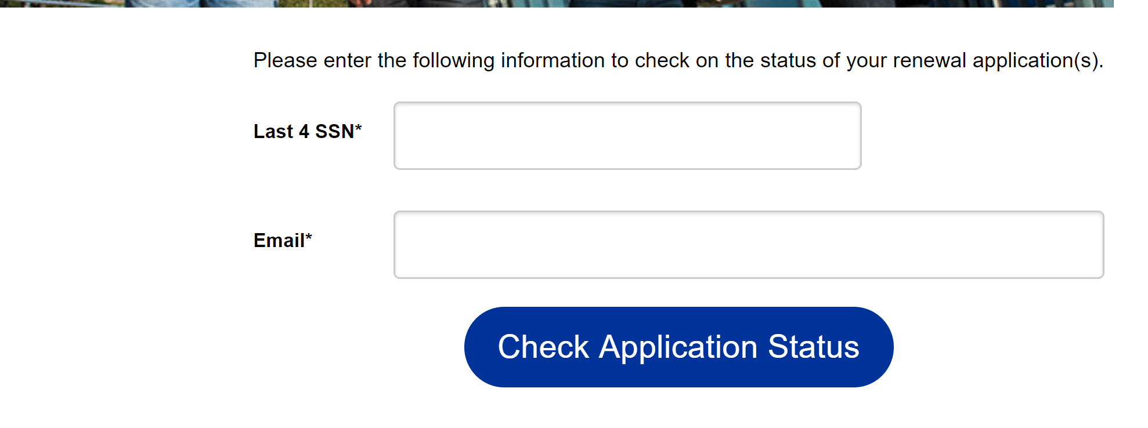
Continuing Student Recertification
Continuing students can check on their
Renewal application too

Slide 23
Upcoming Training Events
101 – TELO basics – new TELO Training
102 – TELO website navigation, application approval and FERPA
103 – TELO guidelines, yield and capacity
104 (f) – TELO Mandatory Enrollment Report Training – July, August and September only
104 (s) – Import Verification Training – April only

Slide 24
Recap
TE 101
Responsibilities
Expectations
Campus collaboration
Program review
Thank you for attending – see you soon!
Questions – email Janet at Jdodson@tuitionexchange.org

