Slide 1
End of year closeout Tuition Exchange – April 2018
Janet Dodson, Associate Director of Communications
April 19, 2018

Slide 2
Today’s focus
TE Closeout
Review of 2017-18 Annual Report
Dues and Participation fees
Claiming 2018-19 students
Reminders
News and updates
Recap

Slide 3
TE Closeout
Annual Report
Recertification of continuing students
Export/Import 3
Participation Fees
Balance Sheet
TE Import Audit

Slide 4
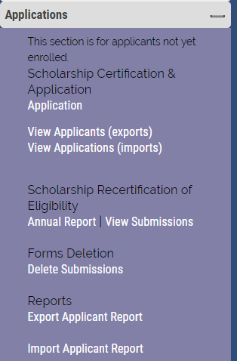
TE Closeout
Annual Report
Fluid
Changes occur when either the EXPORT or IMPORT school update a shared student
EXPORT Schools
Recertification of eligible current students
REMEMBER: Recertification refers to Continuing students

Slide 5
TE Closeout
Are your eligible students recertified for 2018-19?
Please update each student soon
Should the student loose eligibility, update the expiration date
Re-certify requires attention

Slide 6
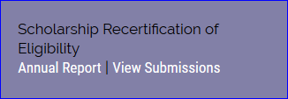
TE Closeout
For eligible continuing students to appear in the VIEW Submissions area you MUST click the the recertify button

Slide 7
TE Closeout
Information in the box is shared between TELO’s only

Slide 8
TE Closeout

Slide 9
TE Closeout
The email above is shared with the IMPORT school
The IMPORT school now have a valid continuing application for the 2018-19 academic year
DO NOT FORWARD THIS EMAIL TO FAMILIES – it only causes confusion

Slide 10
TE Closeout
Check out George Henry’s. The EXPORT school recertified his continuing application.
He is now in NEW Continuing Forms section.
This means George’s IMPORT School is responsible to APPROVE or DENY
the 2018-19 TE scholarship award
As a reminder – IMPORT schools confirm continuing student awards once
Spring grades are available.
Current FIRST YEAR parents are anxious. Remind them TE scholarship awards now
hinge on the student’s academic success too plus the employee’s continued eligibility

Slide 11
TE Closeout
Email notifications launch when valid parent and student emails are present
01
The email informs the student and parent the Tuition Exchange application for re-certification recently submitted for TE award consideration. The parent and student are directed to contact the Financial Aid Office at the school where the student is enrolled.
02

Slide 12
TE Closeout Continuing students
Export Schools did their work by clicking the RECERTIFY Button on the Annual Report
Import Schools need to approve the individual student and update the record – see next slide

Slide 13
TE Closeout
Moving ahead to the IMPORT SCHOOL
On 4/8/18 George Henry’s Export school recertified his 2018-19 renewal
The EXPORT school is confirming the student’s parent remains eligible for
TE award consideration

Slide 14
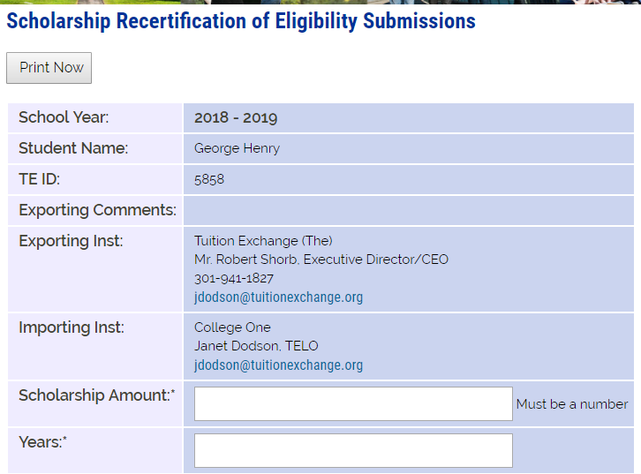
TE Closeout
This is what the IMPORT school sees and needs to do…
All boxes must be completed
Scholarship amount is whole dollars only
Approved Yes or No
Comments are shared between the Export and Import school only
Be sure to click SUBMIT
WHOLE NUMBER ONLY
4
Select yes or not
INFORMATION SHARED WITH OTHER TELO ONLY

Slide 15
TE Closeout
Once the IMPORT school approves the continuing student’s 2018-19
Renewal application, the EXPORT school receives the email above

Slide 16
TE Closeout
If you have students in the status of recertify, you will receive an email reminder from INFO@tuitionexchange.org
You have continuing students yet to be recertified for the following academic year. Students can be recertified on the Annual Report located in the Liaison Portal located at https://telo.tuitionexchange.org.

Slide 17
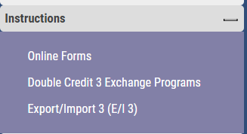
Export/Import 3 (E/I3)
Is your school an E/I 3 school?
What does it mean to be an E/I 3 school?

Slide 18
E/I3 school
Select up to three NEW students annually as E/I 3 students on your current
Annual Report
Select the newest students so that you receive the most credit
You can not replace students in future years should the student
graduate or terminate their educational journey early

Slide 19
E/I 3
Your lists grows each year you select E/I 3 students.

Slide 20
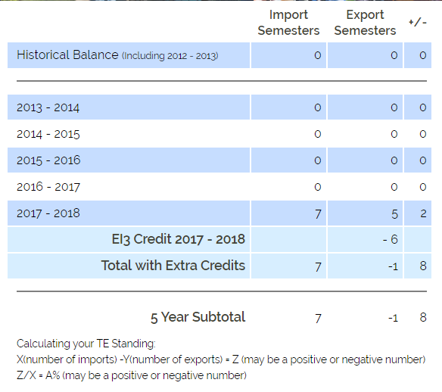
E/I 3
The Balance Sheet to the left does
Not include E/I 3 student credits.
TE Member school is in good standing
The standing is 28%
Same school, but this Balance Sheet
Includes E/I 3 student credits.
TE Member school is in good standing
The standing is 114%
This school can EXPORT many more
before they might run into EXPORT
trouble

Slide 21
E/I 3
If your school is an E/I 3 school with open E/I 3 slots, you will receive the following email reminder from INFO@tuitionexchange.org
The email is your reminder of open E/I 3 slots Students are selected inside the Annual Report
See slide 18 for a visual how to reminder

Slide 22
TE Closeout Participation Fees
Every time you click Submit on your Annual Report a new Participation Fee Statement generates
Review your Participation Fee Statement carefully
If you owe – please remit payment upon receipt
If you have a zero balance – THANK YOU!

Slide 23
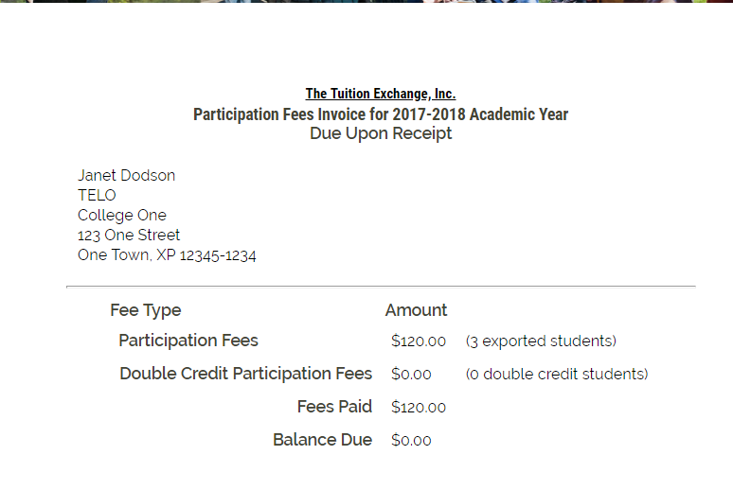
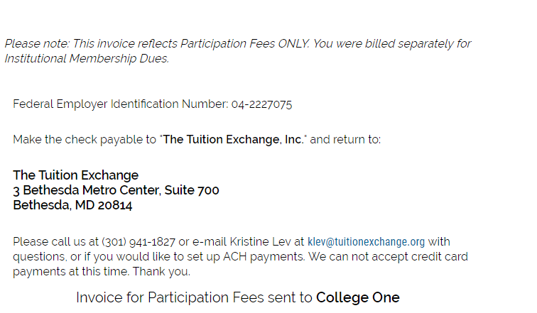
TE Closeout
Participation Fee Invoice
$40 per enrolled EXPORT and Double Credit 3 student associated with your school
Participation Fee payments are due upon submission of the Annual Report
As a reminder, every time a change is made to the Annual Report, you are responsible for any additional Participation Fees that may be due
A new invoice creates every time you submit your Annual Report
TE Central will access a $50 late fee beginning November 1, 2018 for all unpaid Fall, 2018 Participation Fees
The invoice is emailed to the primary TELO

Slide 24
TE Closeout Balance Sheet
Your Balance Sheet helps you to understand your current program standing
The Balance Sheet adjusts with each Annual Report modification
When you review your Annual Report it is important to review your Balance Sheet too

Slide 25
TE Closeout Balance Sheet Review
This school should consider E/I 3 to keep their employees EXPORT happy
-82%

Slide 26
TE Closeout Balance Sheet Review
A demonstration of why E/I 3 is worth considering.
150%

Slide 27
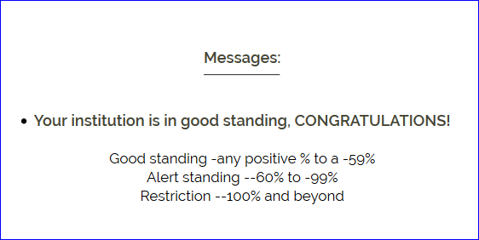
TE Closeout – Balance Sheet
Looking at the Balance Need from the previous slide – the calculation for school 1 is -82%
The calculation for school 2 is 150%
School 1 is on Alert Standing
School 2 is in Good Standing

Slide 28
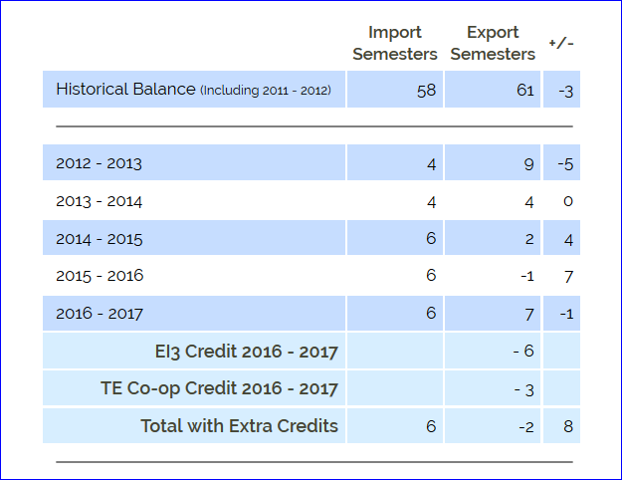
TE Closeout – Balance Sheet E/I 3 school
This school has three Export students marked as E/I 3
E/I 3 provides the school with up to three FREE student exports annually
The E/I 3 credit help this school respond to employee export requests
E/I 3 Exports cost the $40 Participation Fee

Slide 29
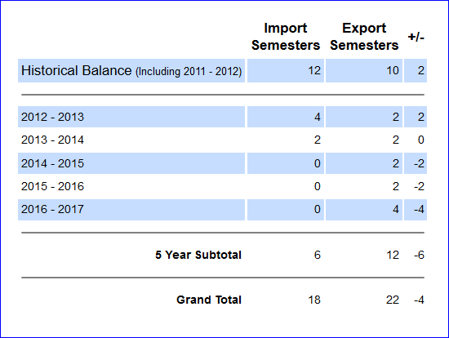
TE Closeout Balance Sheet
This school is on Restriction
6-12 = -6
(-6/6)*100 = -100%
If the school is an E/I 3 school the school is in good standing!

Slide 30
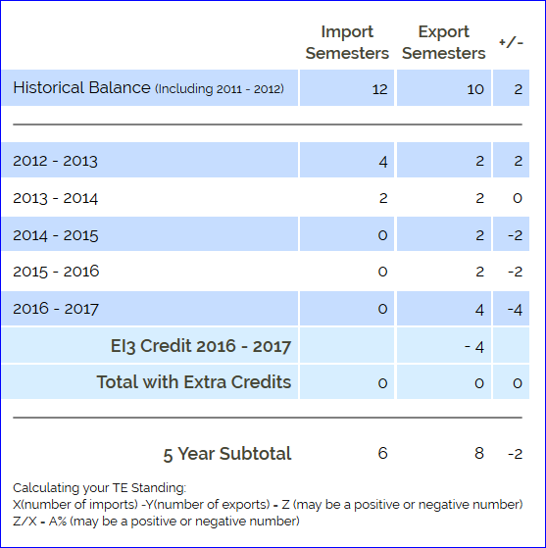
TE Closeout Balance Sheet
By updating the school profile Question 9 to Yes and clicking YES to the E/I 3 question on the Annual Report – this school is no longer on Restriction
6-8 = -2
(-2/6)*100 = -33%

Slide 31
TE Closeout
There is no reason for any TE school to be on Restriction
E/I 3 provides three NEW exports each year
In return, TE Central expects schools to offer to all eligible TE applicants a TE award
There is no additional cost for this program beyond the $40 Participation Fee
Update your Mandatory Institutional Profile by answering YES to question 9

Slide 32
TE Import Audit
Thank you to those schools meeting the April 15th response date
Together, we added more than 75 students to the system and removed 12
This is an ongoing event in March with a modified name – Import Verification
IMPORT information from the Annual Report will be sent to the Financial Aid Office for confirmation
Goal is for the report and verification to be electronic soon

Slide 33
Annual TE Dues
Early June TE Central emails your Annual Dues Invoice
Dues for 2018-19 are $550
Dues payment is expected July 1
Any outstanding dues after October 1 are accessed a $50 late fee
TE Central accepts checks and ACH payments
Interested in ACH contact Kristine Lev directly
Need a W-9 it is available inside the TELO Only Resource Section under Annual Reports

Slide 34
TE Closeout
TE Central electronically retains your June 30 Annual Report and Balance Sheet
You need to retain your Annual Report and Balance Sheet every time you make a change

Slide 35
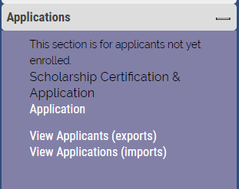
Claiming 2018-19 Students
View Applicants is the spot housing all NEW 2018-19 student applications
You are encouraged to visit soon and often ☺

Slide 36
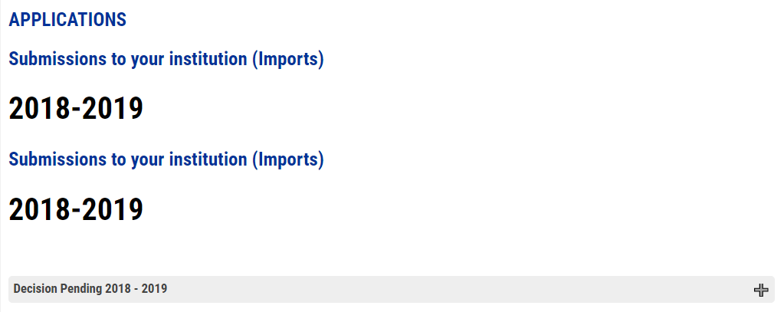
Claiming 2018-19 students
Review all Import Decision Pending and make a decision
Approve
Deny
You say no OR
The student says no
Waitlist
Click the + sign to open up the folder
Once you make decisions, the student record moves to the
Updated category

Slide 37
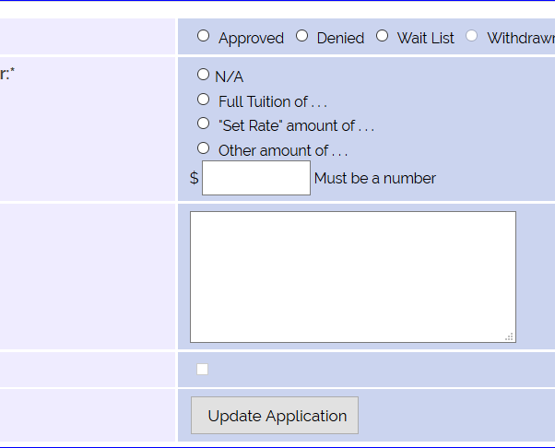
Claiming 2018-19 Students
R
IMPORT schools complete all information with the R
Remember Approved means this student receives a TE Award
Student and parent receive email notification
Denied means this student is NOT receiving a TE Award
An email is sent telling the parent and student the TE application status recently changed
Waitlist means maybe the student might receive a TE Award
An email is sent telling the parent and student the TE application status recently changed
ONLY export schools can select the Withdraw option
No email notification launched
Working on enhancement when selecting Set Rate the $ box auto fills.

Slide 38
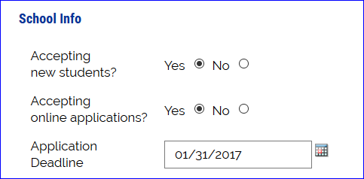
Reminders
Mandatory profile updates cannot occur until the 2017-18 Annual Report year closes
July 15 at the latest
Please update your Institutional information application deadline seen to the left
We strongly encourage using the TE-EZ application process

Slide 39
Reminders May 1 Available Seat Survey
Available Seat Survey will email to the primary TELO next week
Please follow the link emailed to you
Can’t find it – send Janet an email for a new link
The results of the Available Seat Survey will be posted to the front page of the TE website on May 2
A follow-up survey will be emailed to all participating schools mid-summer

Slide 40
News and Updates
Be sure you are accessing the TELO portal with YOUR login credentials only
Do not share your login
TE Central is happy to create additional and personalized TELO logins
email Janet Dodson
A variety of notification emails are in the system and launch as changes happen to a student’s TE record
Our 2018 Summer Newsletter, expected publication date of shares the 2018-19 academic year TELO Training calendar
TE Central continues offering NEW TELO Training opportunities in June and July
Be watching your email for the May 1 Seats Available Request
TE Central is launching a Satisfaction Survey regarding our Customer Service, our Website, the EZ-App, Reports and the TELO Portal, plus we want to know your definition of an eligible dependent and what education delivery options are available to TE prospects. Your thoughtful response is appreciated

Slide 41
Recap
TE Closeout
Review of 2017-18 Annual Report
Dues and Participation fees
Claiming 2018-19 students
Reminders
News and updates

Slide 42
That’s all folks
We work all summer too so contact us if you get stuck along the way!
Thank you for all that you do every day promoting higher education

