Slide 1
Communication, Marketing and Information Sharing
March, 2018
Bob Shorb and Janet Dodson

Slide 2
Today’s Focus
Marketing Tuition Exchange
Tuition Exchange Officer’s Duties and Responsibilities
Export/Import 3 (E/I 3)
Double Credit 3 (DC3)
EZ App reminders
TE Central update
Communication and Documentation
TE Program options

Slide 3
Marketing Tuition Exchange
Do you know your internal audience make-up?
Are you familiar with what makes-up your external audience?
What are the audience similarities and differences?
What is the one audience burning question?
How does your school communicate Tuition Exchange information?

Slide 4
Marketing Tuition Exchange Internal audiences
Think like an employee
Employees – past, present and future
You define eligible employee
Admissions – today and tomorrow’s new student applicants
Provide Admissions and student applicants clear up-to-date information
Financial Aid – new and continuing awards
Keep the Financial Aid Office informed regarding all TE award decisions
Human Resources – current employees
Confirm employee eligibility at the conclusion of each semester and before school begins in the Fall

Slide 5
Marketing Tuition Exchange External Audience
Potential new students/employees
Admissions knows…
Consider adding a question to your Admissions application
Add Tuition Exchange information to your College catalog and Student handbook
Current employees want to know…
Consider hosting a benefits fair
Include TE information
See slide 11 for how to order TE materials
New hires think they know…
Be sure new hires understand your program guidelines
Be specific about sharing eligibility guidelines
Add Tuition Exchange information to your Employee Handbook
DO NOT USE THE WORD BENEFIT – Tuition Exchange is a scholarship program because of membership. Benefit implies automatic approval

Slide 6
Marketing Information considerations
Add a link between TE Central’s website and the school website
Is your institutional mandatory profile and over-view up-to-date on the TE website?
Create an internal Frequently Asked Questions document and share it
Make sure the switchboard, Human Resources, Financial Aid and Admissions staff know the name and contact information for the Tuition Exchange Liaison Officer (TELO) at your school

Slide 7
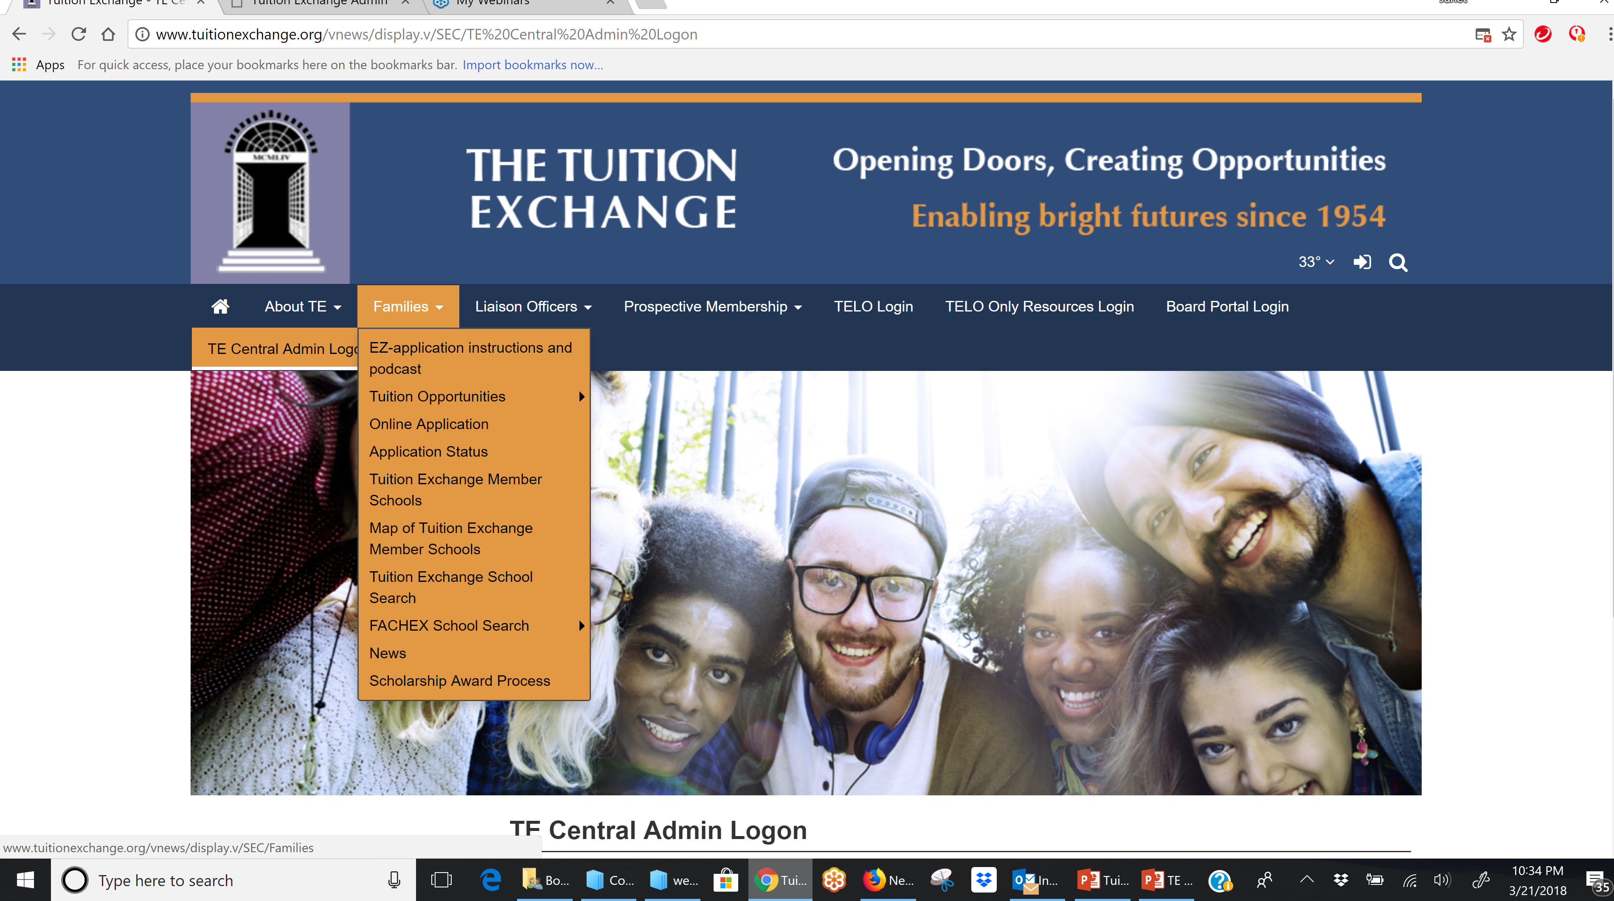
Marketing Materials

Slide 8
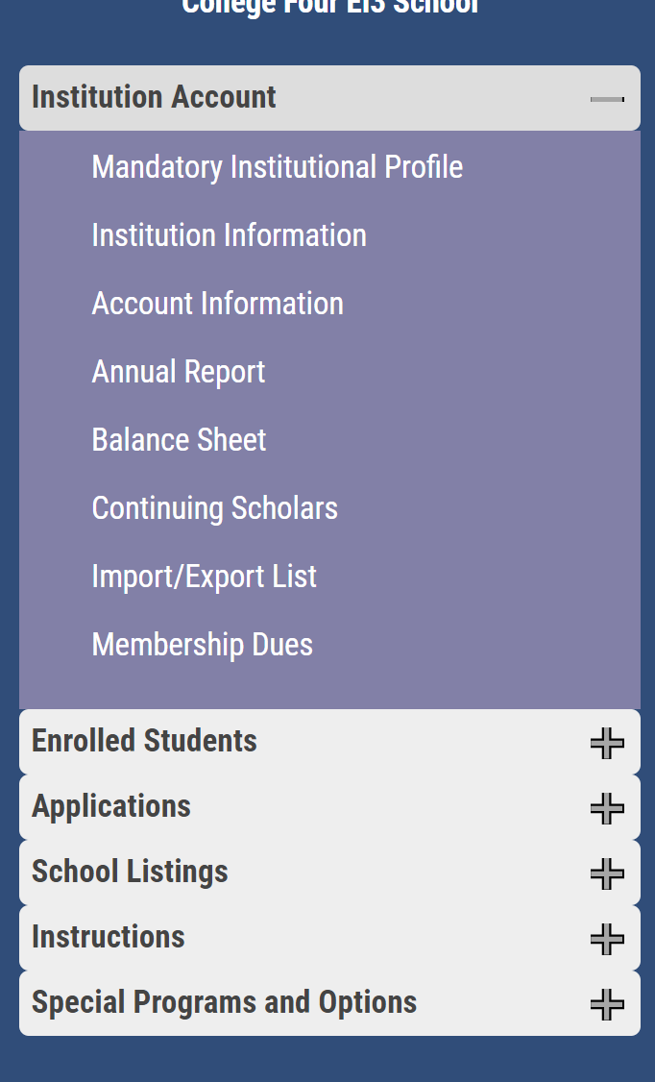
Marketing Materials
Explore why answering a few questions now can save you time along the way!

Slide 9
Marketing Materials
Your message is only as good as the information you provide
Information in the Mandatory Institutional profile is rolled forward in July with the opening of the new year
It is your responsibility to review and update as needed.
Families search for information and discover schools based on the answers provided
The percentage of new admitted TE candidates offered a TE scholarship is the only computed field

Slide 10
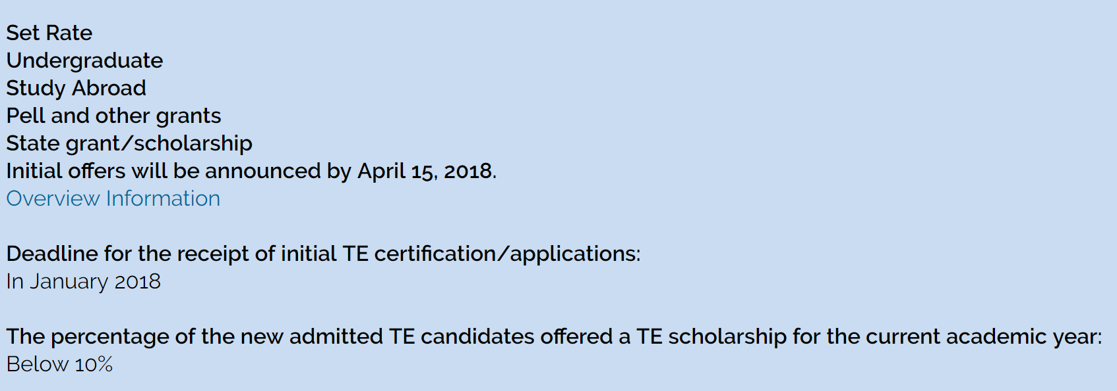
Marketing Materials
Families search for Tuition Exchange information from our website
School 1 has completed their Mandatory Profile
School 2 has not
Be like school 1 and review your information soon
1
2

Slide 11
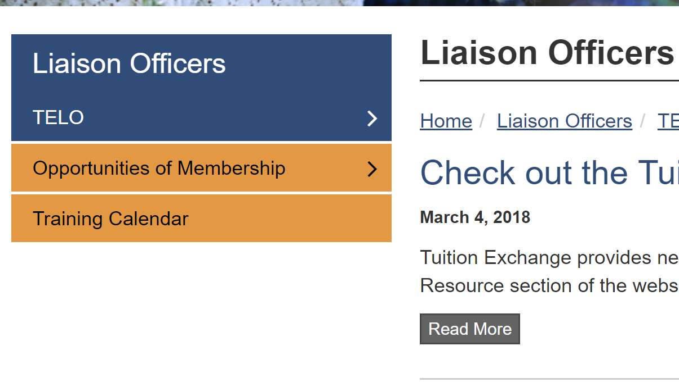
Marketing Materials
Your Annual Membership dues fund Tuition Exchange Marketing materials
You are encouraged to order TE materials to help publicize the program
Table tents, generic family employee brochures, and post cards are available for the asking

Slide 12
Marketing opportunity May 1 Seats Available
Shortly after May 1 TE Central publishes a list of all schools with remaining available TE scholarships on the front page of the public website
TE Central will contact you around April 20 asking for your response regarding available TE slots
And if you want to be included on our front page list
This is similar to the NACAC process.
Visit with your Director of Admission to see if your school should join the list

Slide 13
Tuition Exchange Officer Duties and Responsibilities
Maintaining TE policies and procedures
Explain and share the TE client process
Details
Communicate
Deadlines
Communicate
Recipients and alternates
Communicate
Provide a knowledgeable school contact
Communicate
Submit to TE Central
Membership dues
Enrollment Report
Pay participation fees
Keep TE website up-to-date

Slide 14
Tuition Exchange Officer Duties and Responsibilities
Eligibility issues to consider:
Students
New students or any full-time student?
Undergraduates only or any full-time student?
Don’t forget about graduate or professional students
Don’t forget about your online students
Free Application for Federal Student Aid (FAFSA)
Required?
Annually or just once?
Treatment of other financial aid
Federal grants
State grants
Institutional scholarships
Outside scholarships

Slide 15
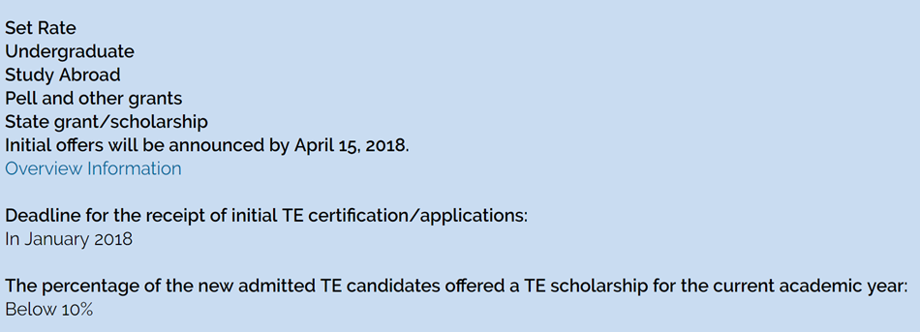
Tuition Exchange Officer Duties and Responsibilities Be like the school to the right!
Tuition Exchange website www.tuitionexchange.org
Keep your information current
Liaison Officers tab
Mandatory Institutional Profile Confirm and/or add overview information

Slide 16
Tuition Exchange Officer Duties and Responsibilities
Tuition Exchange Student Guidelines template
Use the template to confirm your guidelines are up-to-date
Use this template to record your guidelines if your guidelines are in your head
Tuition Exchange Handbook
a fluid document
refer when in doubt
If your Business Office requests a new W-9 see TELO Only Resource section. The completed document is available for download.
Where do I find this information?
TELO Only Resource portal on the website
Generic email: TELO@tuitionexchange.org
Generic password: TELO14 (just like you see it)

Slide 17
Tuition Exchange Officer Duties and Responsibilities
Policies and Procedures
Who is eligible?
Refer to your internal tuition remission policy for guidance
Employee eligibility considerations
Seniority
Longevity
Faculty and staff
Staff and faculty
How many times has the family accessed TE already if there is a long list of applicants for a few spots
A frequent call to TE Central is from the employee who is shopping for a new job. They can’t believe their student will lose their TE benefit should the parent take a different job
The second most frequent call to TE Central is hypothetically speaking if I take a job at a TE school, when does my TE benefit kick in for my dependents

Slide 18
Tuition Exchange Officer Duties and Responsibilities
Suggested Tuition Exchange Annual Calendar
January - Confirm Enrollment Report is accurate – update expiration dates for student who did not return second semester Confirm all continuing students are recertified. Update and/or add any new 2nd semester TE students
February – Continue reviewing new student applications. Share all new student application details with Enrollment Management
March – Continue the new student application review. Share approved IMPORT student details with Financial Aid. Confirm academic year costs. Consider using the EZ application. Confirm with your Financial Aid Office they reviewed and returned the TE Audit
April - Finalize Import decisions and start communicating with your Export families confirming their enrollment decisions
May – Final review of the current year’s Annual Report. All E/I 3 schools confirm you checked yes to three new students. Confirm your school has paid all participation fees. Review, print, save and submit your Annual Report and Balance sheet. Keep these documents in your TE folder.
TE Central publishes annually the available seat lists shortly after May 1.
June – Finalize Imports and continue to ask for final decisions from your Export families. TE Central emails Annual Dues invoice

Slide 19
Tuition Exchange Officer Duties and Responsibilities
Suggested Tuition Exchange Annual Calendar
July – Mark all ineligible IMPORTs rejected. Approve all eligible IMPORTs. If you did not pay your Annual Dues in June do so now. A $50 late fee will be accessed September 1.
August – Mark all confirmed IMPORTS enrolled. Update all outstanding IMPORT records as enrolled or denied. Confirm all EXPORT students maintain employment eligibility. Attend the Mandatory TE Annual Training webinar.
September – Complete your initial Enrollment Report, remit your Participation Fee invoice with payment
October – offer informational sessions for employees, update Admissions and Financial Aid on any program changes, make sure your Mandatory Overview is up-to-date
November – New applications require your attention
December – review the Enrollment Report for accuracy. Continue reviewing and sharing new student application information with your Enrollment colleagues

Slide 20
Tuition Exchange Office Duties and Responsibilities
Summer
Stay in contact with employee – Export students change their minds
Confirm with Financial Aid, HR, and Registrar all school required paperwork is complete
Continuing (renewal) student – did the Import student maintain academic eligibility? Did the Export student parent maintain employment eligibility?
Share with Admissions, Financial Aid , HR, and Registrar all TE scholars annually
Year round communication
Share and maintain with key staff supervisors the TE message
Share the TE message with all faculty and staff
Share your priority date for TE applications
Share how to apply, when to apply, where to apply, and what happens next

Slide 21
Communication
Possible communication strategies
Host a community program focused on Admissions, Financial Aid, and tuition benefits/exchange options
Create separate FAQ documents for Exports and Imports
Add eligibility criteria and general TE information to the Employee Handbook
Make sure Import students have program information including continuing eligibility requirements. Add a TE section to the College catalogue and Student Handbook
Develop and share a TE calendar with eligible employees
Think about creating a TE folder and be sure to include dates and application information
Consider adding generic TE information on your website
Share your TELO contact information
Make sure Admissions, Financial Aid and Human Resources know your TELO contact information

Slide 22
Communication and Documentation
Policy and Procedures
Always share your TE policies. Sharing:
Reduces confusion
Eliminates incorrect information sharing
Demonstrates professionalism
Share information often
Newsletters and general internal emails
Internal websites announcements
Posters

Slide 23
Communication and Documentation
Policy and Procedures
Create a working calendar
Helps with future year TE management
No missed information
Reduces your stress and
Minimizes TE applicant stress
Maintain generic copies of all TE emails
Ask Financial Aid in December for the following year tuition costs
Know the difference between the TE Set-rate and your tuition costs
Did you know all TE Set-rates are available inside the TELO Only Resources portal?
2018-19 Set Rate is $36000
2019-20 Set Rate is $37000

Slide 24
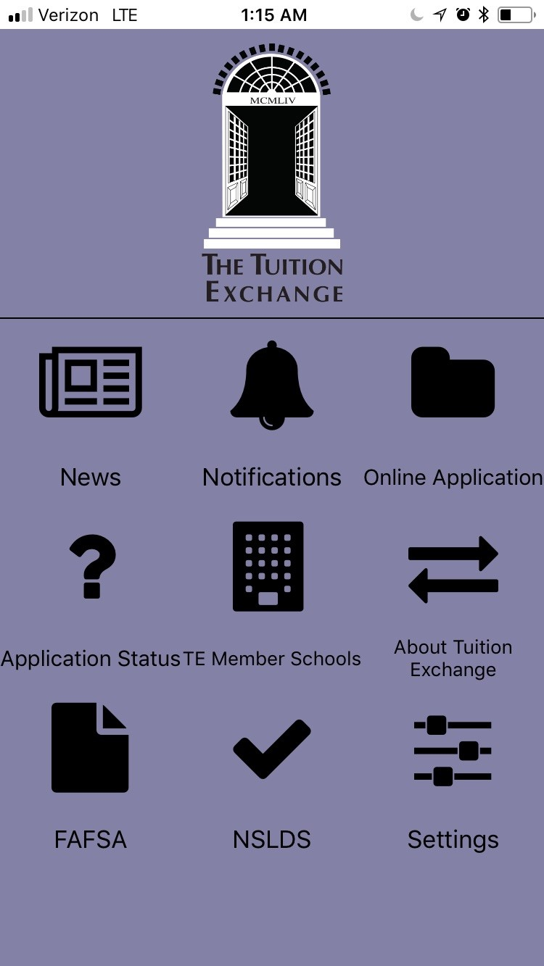
Communication and Documentation
Letters, emails and calls
Families desire information
Does your school require a TE RENEWAL application?
WHY???
Create and share a Frequently Asked Questions document
Keep employee in the loop
What is my kid’s application status?
There is an APP for that. Encourage families to check out the Google Play Store and Apple App Store searching on TE App
Use our Self-Service option inside the Families tab on the website
Share your contact email

Slide 25
Communication Hints
Request a TE specific email address for all TE communication Think: TE@myschool.edu
If your school requires all TE Imports to complete the FAFSA, remind the student each year in October. Be sure to share the consequences if the family fails to complete the federal financial aid application
Ask your Marketing Division to assist with your TE message. Above all, make sure your message is school approved!
Tuition Exchange is a potential scholarship opportunity and should never be considered a guarantee. Avoid using the word BENEFIT
Each school administers TE differently, encourage families to contact the TELO at their importing school for concise information

Slide 26
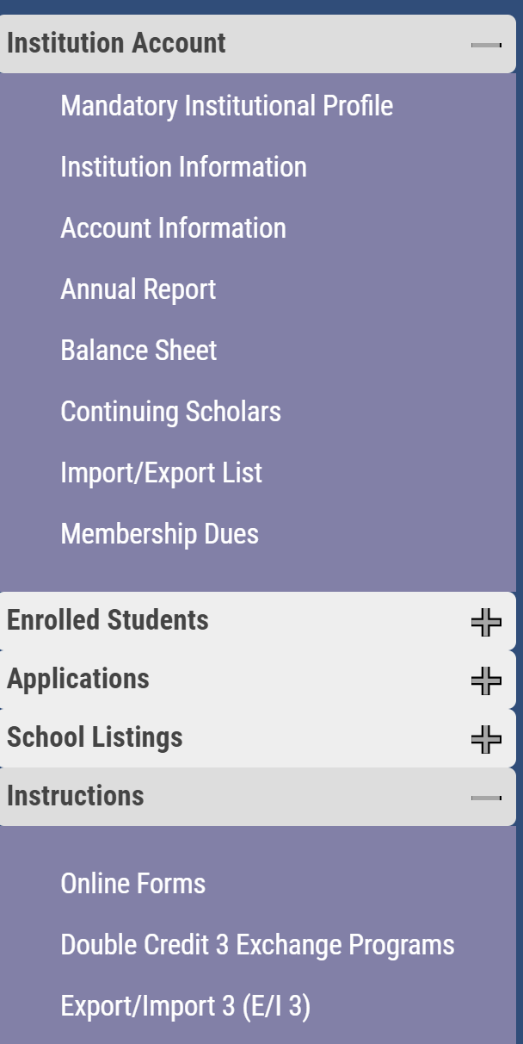
TE Program options
TE members can choose to participate in one or both of these options
TE is your program for purposes of administration and oversight
TE Central knows these additions provide for increased exports
Check out the Instructions area on your TELO portal for additional information

Slide 27
TE Program options
Export/Import 3 (E/I 3)
Each school has the opportunity to export up to three TE scholars annually
This provides each TE school the opportunity to offer increased export opportunities to your employees
Can export with any TE school – not just a few
For those schools who sign-up the issue of Restriction should be a non-issue
TE Central encourages all former TE Co-Op schools to update your profile question # 8 to YES!
No additional cost to participate in this option

Slide 28
TE Program options
Double Credit 3 (DC 3)
Provides TE member schools credit for exchanging with other TE recognized exchange programs
Match done via the Enrollment Report
School gains import credit
Cost is $40 per import recorded on the Enrollment Report

Slide 29
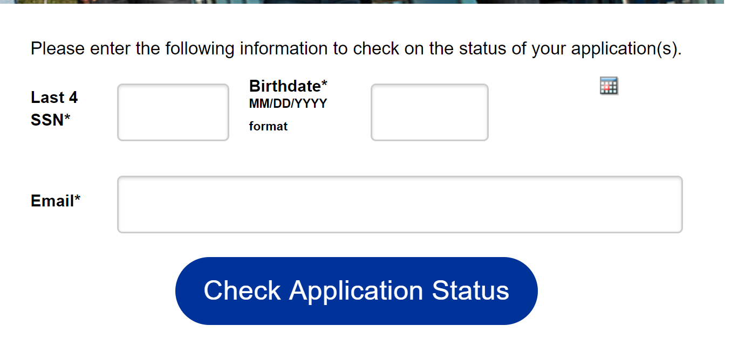
EZ Application
The EZ application process moves the application entry from your office to the family.
YOU maintain CONTROL to approve or deny any new EXPORT applications
All TE applications can be reviewed by the family provided…
the family knows the entered TEID,
the student’s entered email, and
the student’s entered birthdate
Families can track the applications online by downloading our newest technology – the TE App or on our website
Testing for the series of emails to keep the family in the know about their EZ app status is underway. The email language will be shared with all TELO’s in advance of their launch

Slide 30
A very important Export detail to understand
/
The student submits the EZ app and the TELO approves the app
The student’s TE application is entered and approved by the TELO
THIS MEANS YOUR SCHOOL AGREES TO EXPORT THE STUDENT
You cannot and should not approve a student’s export application and then determine the application is not eligible later

Slide 31
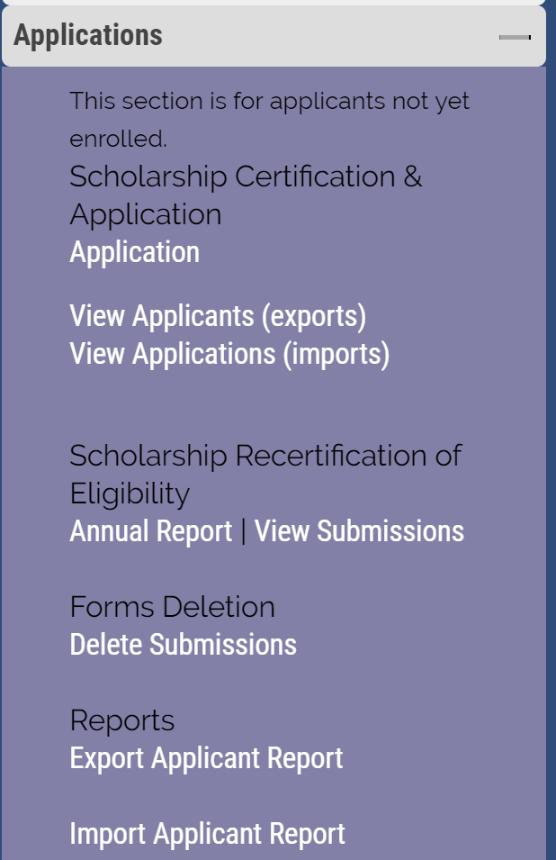
TE Export and Import Report options
You can create Export Application and Import Application reports
Use Chrome or Firefox
Create a CSV file for uploading into your student data system

Slide 32
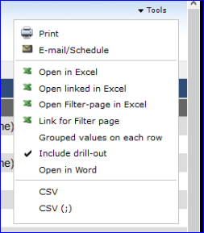
TE Export and Import Report options
The year listed is the end of the Academic Year
Runs best with Firefox and Chrome
When you open in Excel know you are downloading all
Academic year options. There is a bit of clean-up needed.
Report modification is on IT’s list

Slide 33
A few final reminders
July 1 TE dues - $550
Invoices will be emailed mid-June and considered late September 30
2018-19 Participation Fees - $40 per successful EXPORT and all DC 3 Imports
The Participation Fee invoice generates each time you submit the Enrollment Report
Review your Participation Fee invoice for any balance due
Participation fees are considered late 45 days after your Enrollment Report is submitted
TE Central will add a $50 late fee to each school’s statement if payment is not received as detailed above.

Slide 34
TE Audit
As shared in the Spring newsletter, TE is preforming an IMPORT audit
TE Central mailed your Annual Report and Balance sheet to your Financial Aid Office
Why – because we are finding way too many students not reported on the Annual Report yet funded at your school
If the student is not on your Annual Report, Import schools are not receiving proper credit
We are not pointing any fingers, like you we want the information correct
Be sure to check with your Financial Aid Office asking them to review and return the audit in the enclosed envelope provided soon
Questions – please contact Janet Dodson at jdodson@tuitionexchange.org or 402.418.1081 during Central time

Slide 35
Upcoming TE activities
2018–2019
Be watching for our 2018-19 Training webinar series announcement
April/May
Mark your calendar, in August TE will host several webinars. The webinars will review the Enrollment Report requirements.
August
You must attend one August webinar in order to have access to your 2018-19 Enrollment Report. More information to follow
Bob and Janet are attending regional CUPA-HR meetings
June
Janet is attending NASFAA in June
July
The TE Staff meets in late July for 2018-19 planning. Should you have any programming suggestions please share with Janet and Bob
August

Slide 36
Let’s Recap
Marketing Tuition Exchange
Tuition Exchange Officer’s Duties and Responsibilities
Communication and Documentation
Review of program options
TE Central update

Slide 37
Contact Information
Robert Shorb, Executive Director and CEO
rshorb@tuitionexchange.org
Janet Dodson, Associate Director of Communications
klev@tuitionexchange.org
Tuition Exchange Central
info@tuitionexchange.org
301.941.1827
jdodson@tuitionexchange.org
402.418.1081
Kristine Lev, Assistant Director of Administration
On line at www.tuitionexchange.org

