Slide 1
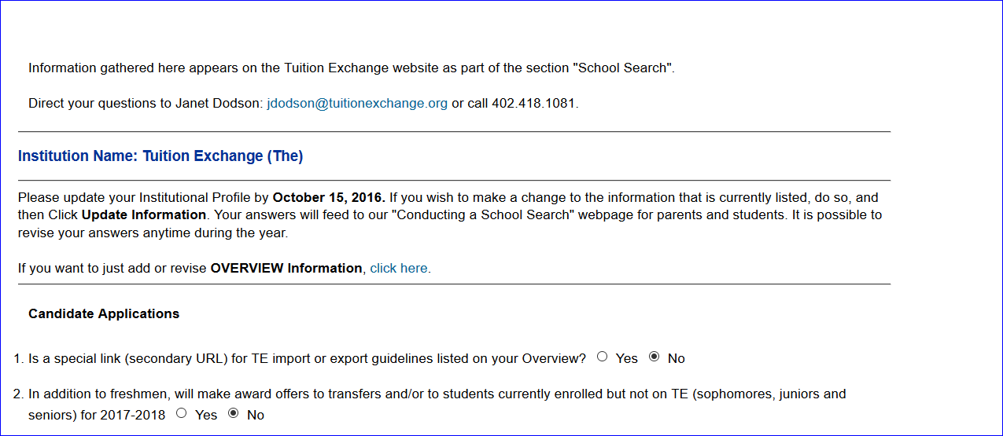
Mandatory Institutional Profile
It is important to review this information annually.

Slide 2
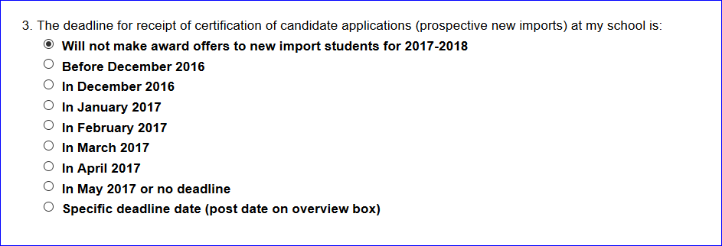
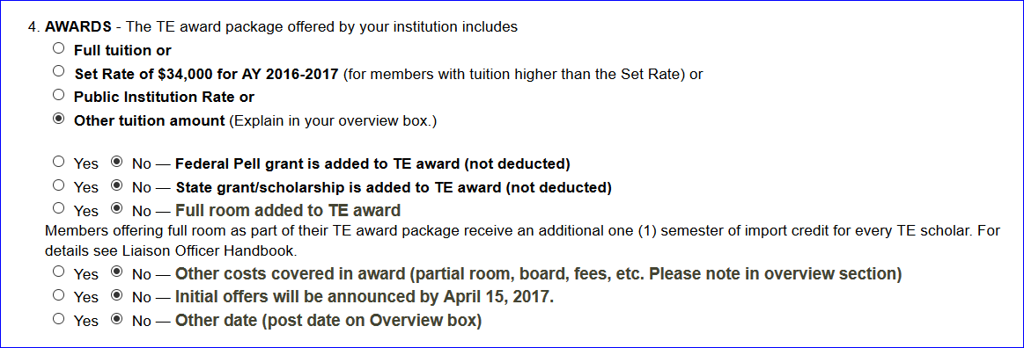
If you select Will NOT make awards, your
school is removed from the potential TE
school listing

Slide 3
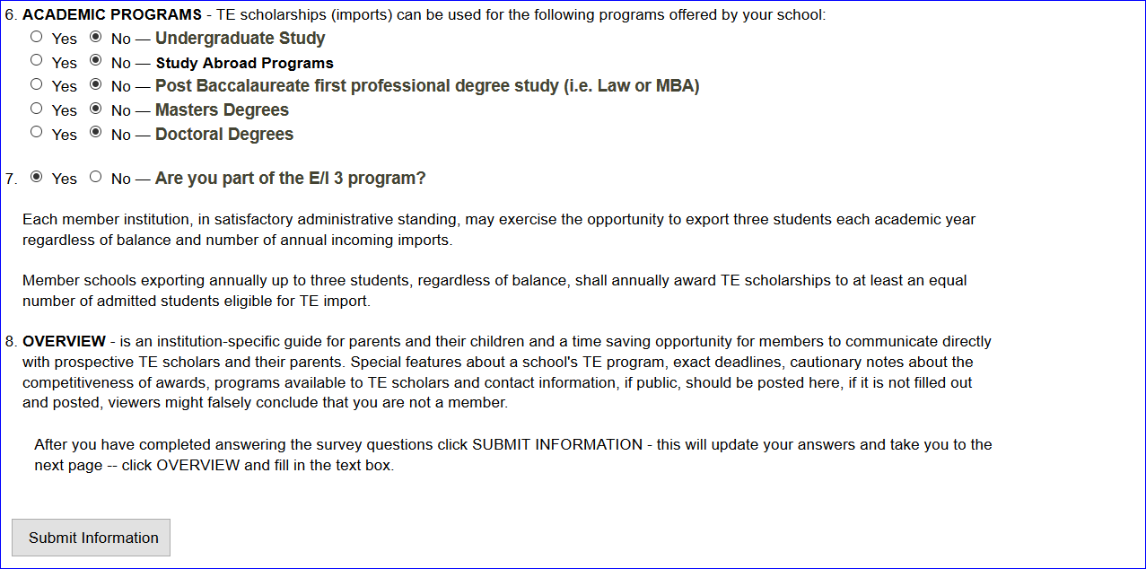
Mandatory Institutional Profile

