Slide 1
Helping families understand the Tuition Exchange program and process
Janet Dodson
Fall, 2017

Slide 2
Today’s Focus
What is Tuition Exchange
Tuition Exchange details
Tuition Exchange qualifications
Tuition Exchange value
Tuition Exchange fine print
Tuition Exchange – let’s get started
Where to find Tuition Exchange stats

Slide 3
What is Tuition Exchange?
Founded in 1954
More than 665 school choices
A school choice for all
Potential tuition award program up to full tuition or TE established Set-Rate
  2017-18 rate is $35,000
Tuition Exchange is not an employee benefit program
Notes:
Tuition Exchange is a 501-c3 non-profit association of colleges and universities; it was founded over 55 years ago with the purpose of making careers in higher education more attractive. This is done through a reciprocal scholarship program, which finances college tuition for the dependents of full-time faculty and staff employed at participating institutions.
**To be entitled to the Benefit at Bellarmine you must be employed two years, at this university**

Slide 4
Tuition Exchange details
In 2016-17 more than 7,200 students were exchanged
662 school members
TE Central located in Bethesda, MD
Organic website www.tuitionexchange.org

Slide 5
General qualifications and
Requirements?
Export must be a dependent of the eligible employee
Typically an eligible employee is defined as
  Staff or Faculty
  Full time employee
  Check out your Employee handbook for the specific details

Slide 6
Maintaining the Scholarship
Typically, student must be enrolled as a full time, degree seeking student
Must meet IMPORT schools institutional policies for
  Academic performance and
  Personal conduct
Employee must maintain eligible employment at the export school

Slide 7
TE scholarship value?
Actual awarded amount is determined by the IMPORT school
Must be full tuition or set rate – whichever is less*
TE scholarship can be made up of institutional grant funds, federal Pell or Supplement grant dollars, and/or state grant funds
Check with your IMPORT school regarding their FAFSA (Free Application for Federal Student Aid) expectations
No dollars exchanged
There may be tax ramifications
  Check out IRS publication 990 for details or your tax expert
  * Public school members may offer a different amount. Check with the school for actual scholarship amount

Slide 8
Other college costs
Other college costs can include fees, books and even room and board
  These costs are NOT covered by the TE scholarship
  A handful of schools do offer a room stipend – ask your IMPORT school
File the FAFSA if you need additional assistance to cover these other costs.
  www.FAFSA.gov is the FREE site

Slide 9
The TE fine print
YOU need to ask the following questions of both your employer and the school(s) you are considering
What is the maximum eligibility?
  Eligible for 8 semesters of funding or graduation
What educational programs are included?
  Undergraduate
  Graduate
  Online
  Non-traditional campuses
What about summer and study abroad opportunities?
What if the student gets married or the parent is no longer employed at MY School
What is the schools definition of dependent?
  Typically the same as the IRS

Slide 10
How competitive is the TE process?
The employee should attend information sessions provided by the employer regarding eligibility criteria
The student must meet all admission requirements at the schools where they are seeking TE scholarships
To receive future funding the student must maintain Satisfactory Academic Progress – see college catalog for complete policy

Slide 11
How competitive is the TE process?
The selection process at both the Export and Import schools can be very competitive
Each TE school has their own guidelines, deadlines and application criteria
TE schools have their own guidelines, deadlines and EXPORT selection criteria
It is YOUR responsibility to do your homework regarding both the Export and Import requirements, deadlines and any other specific requirement or expectation

Slide 12
How do I get started?
Visit www.tuitionexchange.org
  Checkout the Family tab
  Explore TE members
  Apply to the schools that best fit your personality and academic pursuit(s)
Ask questions of your employer’s Tuition Exchange Liaison Officer
  Watch the Family Guide of how to complete the EZ application
  Complete the EZ application online
  Be careful to select the right school – many have the same name but are in different states!

Slide 13
Now what?
Contact your Admissions Counselor(s) at each school you have applying … ASKING
  Criteria used to determine scholarship recipients
  Deadline for applying
  What about early decision admission
  What percentage of TE applicants were awarded and accepted last year
  Value of the TE scholarship
  When will I know if I am selected as a TE Scholar
  What are the renewal requirements
Notes:
-

Slide 14
What information about me is required?
Student’s:
  Full time
  Last four digits of the social security number
  Telephone number
  Permanent address
  Email address
  Starting academic year
  Anticipated college graduation date
Complete the EZ App – at www.tuitionexchange.org inside the FAMILIES tab.

Slide 15
What information is required about my eligible employee?
Full name of parent/guardian
Campus position
Number of years of employment with current employer
Where unusual circumstances arise, the Tuition Exchange Officer has the right and responsibility to ask for documents such as multiple federal tax returns or other official papers that demonstrate you are the dependent of the employee

Slide 16
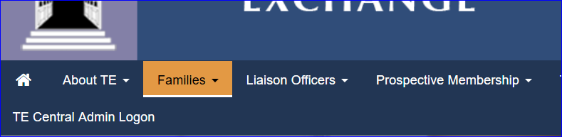
So where can I find general information ?
Let’s explore the Tuition Exchange website.
www.tuitionexchange.org
The Families tab is where you will find valuable information

Slide 17
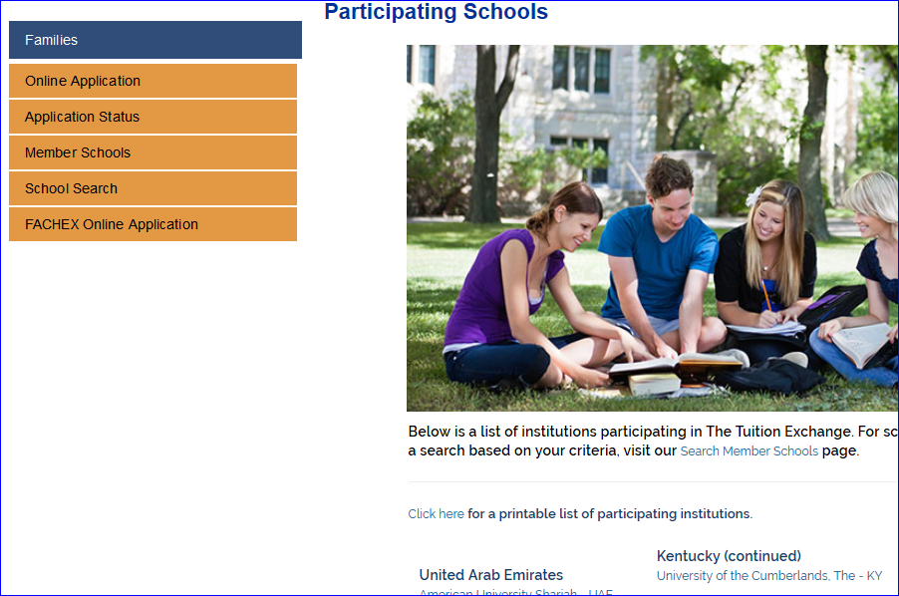
Not sure who your Tuition Exchange Liaison Officer is –
Check out the Membership page inside the Families tab –
you can look up the contact name and secure their email address too
Select Member Schools. You will discover your Tuition Exchange Officer. Real-time listing of all active Tuition Exchange member schools, and valuable information including application deadlines and eligible programs.

Slide 18
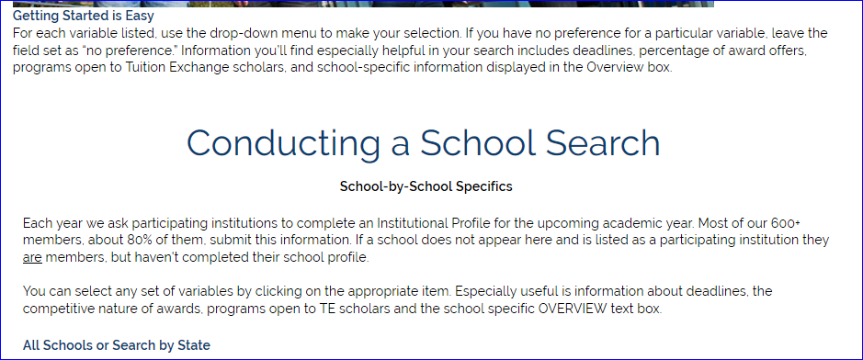
Inside the School Search option you can even narrow down your search by
state, award amount and award statistics.
A word of caution – this information is school provided and is not real time.
Tuition Exchange does not maintain a listing of every schools major. If you
are seeking a specific major, turn your search around. Who offers the major?
Then check out membership list to see if the school is a TE member.

Slide 19
Words to remember…
TE Central expects each member school maintain a balance between the number of Exports and Imports during a rolling 5 year period
This requirement may impact either the Export or Import schools ability to participate in any given year
TE scholarships are not an employee benefit – rather an opportunity because of your employment at a TE member school
Be sure when making campus visits to share with your Admissions Counselor you are seeking a TE Scholarship Export opportunity

Slide 20
Let’s Recap
What is Tuition Exchange
Tuition Exchange details
Tuition Exchange qualifications
Tuition Exchange value
Tuition Exchange fine print
Tuition Exchange – let’s get started
Where to find Tuition Exchange stats

Slide 21
Thank you for attending and best wishes on your student’s college search process
For additional information visit directly with your Export Tuition Exchange Officer
Tuition Exchange Central is not able to provide individual information about a school or their policies.

