Slide 1
Helping families understand the Tuition Exchange program and process
Janet Dodson

Slide 2
What is Tuition Exchange
Tuition Exchange details
Tuition Exchange qualifications
Tuition Exchange value
Tuition Exchange fine print
Tuition Exchange – let’s get started
Where to find Tuition Exchange stats
Today’s Focus

Slide 3
What is Tuition Exchange?
Founded in 1954
More than 672 school choices
A school choice for all
Potential tuition award program up to full tuition or TE established Set-Rate
2019-20 $37,000
Tuition Exchange is a scholarship program
Notes:
Tuition Exchange is a 501-c3 non-profit association of colleges and universities; it was founded over 55 years ago with the purpose of making careers in higher education more attractive. This is done through a reciprocal scholarship program, which finances college tuition for the dependents of full-time faculty and staff employed at participating institutions.
**To be entitled to the Benefit at Bellarmine you must be employed two years, at this university**

Slide 4
Tuition Exchange details
In 2018-19 more than 7400 students were exchanged
672 active school members
TE Central located in Bethesda, MD
Organic website www.tuitionexchange.org

Slide 5
General qualifications and requirements?
Export must be a dependent of the eligible employee
Typically an eligible employee is defined as
Full time staff or faculty
Check out your Employee handbook for the specific details

Slide 6
Maintaining the Scholarship
student must be enrolled as a full time, degree seeking student
Must meet IMPORT schools institutional policies for
Academic performance and
Personal conduct
Employee must maintain eligible employment at the export school

Slide 7
TE scholarship value?
Actual awarded amount is determined by the IMPORT school
Must be full tuition or set rate – whichever is less*
TE scholarship can be made up of institutional scholarships and grant funds, federal Pell or Supplement grant dollars, and/or state grant funds
Check with your IMPORT school regarding their FAFSA (Free Application for Federal Student Aid) expectations
No dollars exchanged
There may be tax ramifications
Check out IRS publication 990 for details or your tax expert
* Public school members may offer a different amount. Check with the school for actual scholarship amount

Slide 8
Other college costs
Other college costs can include fees, books, and room and board
These costs are NOT covered by the TE scholarship
A handful of schools do offer a room stipend – ask your IMPORT school
File the FAFSA if you need additional assistance to cover these other costs.
www.FAFSA.gov is the FREE site

Slide 9
The TE fine print
YOU need to ask the following questions of both your employer and the school(s) you are considering
What is the maximum eligibility?
Eligible for 8 semesters of funding or graduation
What educational programs are included?
Undergraduate
Graduate
Online
Non-traditional campuses
What about summer and study abroad opportunities?
What if the student gets married or the parent is no longer employed at MY School
What is the schools definition of dependent?
Typically the same as the IRS

Slide 10
How competitive is the TE process?
The employee should attend information sessions provided by the employer regarding eligibility criteria
The student must meet all admission requirements at the schools where they are seeking TE scholarships
To receive future funding the student must maintain Satisfactory Academic Progress – see college catalog for complete policy

Slide 11
How competitive is the TE process?
The selection process can be very competitive
TE schools have guidelines, deadlines and selection criteria
do your homework regarding Export and Import requirements, deadlines and any other specific requirement or expectation

Slide 12
How do I get started?
www.tuitionexchange.org
Checkout the Family tab
Explore TE members
Apply to the schools that best fit your personality and academic pursuit(s)
Ask questions of your employer’s Tuition Exchange Liaison Officer
Watch the Family Guide of how to complete the EZ application
Complete the EZ application online
Be careful to select the right school – many have the same name but are in different states!

Slide 13
Now what?
Contact your Admissions Counselor(s) at each school you apply … ASKING
Deadline for applying
Value of the TE scholarship
When will I know if I am selected as a TE Scholar
What are the renewal requirements
Notes:
-

Slide 14
The EZ application
The site is secure
https:///
Contact your EXPORT TE Liaison Officer for assistance
Made any errors – contact your EXPORT TE Liaison Officer

Slide 15
What information about me is required?
Student’s:
Full name
Last four digits of the social security number*
Telephone number
Permanent address
Email address
Starting academic year
Anticipated college graduation date
Complete the EZ App – at www.tuitionexchange.org inside the FAMILIES tab.
* Or any four digits

Slide 16
What information is required about my parent/employee?
Full name of parent/guardian/employee
Campus position
Number of years of employment with current employer
The Tuition Exchange Officer has the right and responsibility to ask for documents such as multiple federal tax returns or other official papers that demonstrate you are the dependent of the employee

Slide 17
So where can I find general information ?
Let’s explore the Tuition Exchange website.
www.tuitionexchange.org
The Families tab is where you will find valuable information

Slide 18
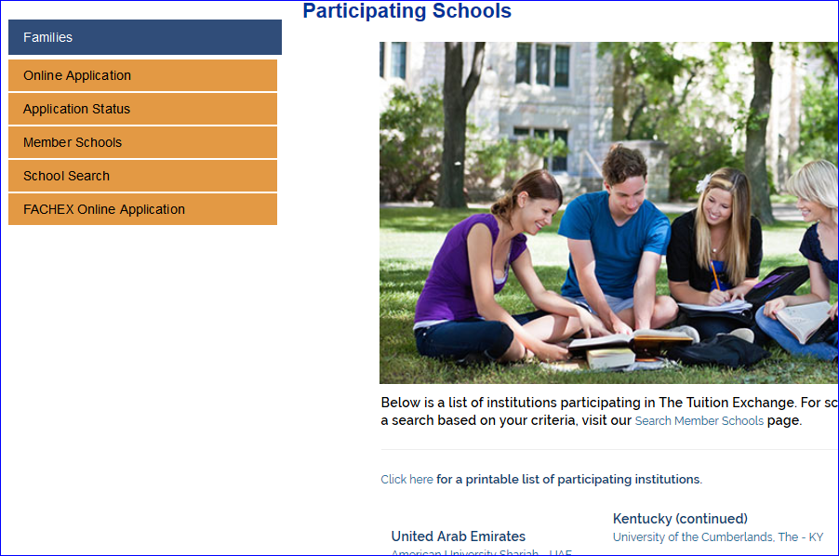
Not sure who your Tuition Exchange Liaison Officer is –
Check out the Membership page inside the Families tab –
you can look up the contact name and secure their email address too
Select Member Schools. You will discover your Tuition Exchange Officer. Real-time listing of all active Tuition Exchange member schools, and information including application deadlines and eligible programs.

Slide 19
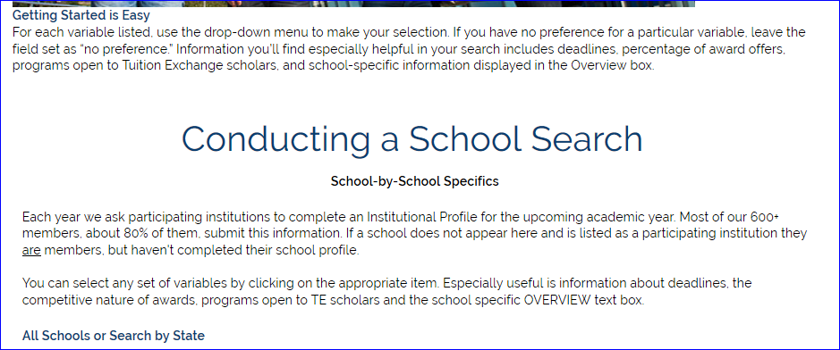
Inside the School Search option you can even narrow down your search by
state, award amount and award statistics.
A word of caution – this information is school provided and is not real time.
Tuition Exchange does not maintain a listing of every schools major. If you
are seeking a specific major, turn your search around. Who offers the major?
Then check out our membership list to see if the school is a TE member.

Slide 20
Words to remember…
each member school works to maintain a balance between the Exports and Imports during a rolling 5 year period
Balance may impact either the Export or Import schools ability to participate in any given year
TE scholarships are not an employee benefit
Be sure to share with your Admissions Counselor you are a possible TE Scholar

Slide 21
What is Tuition Exchange
Tuition Exchange details
Tuition Exchange qualifications
Tuition Exchange value
Tuition Exchange fine print
Tuition Exchange – let’s get started
Where to find Tuition Exchange stats
Let’s Recap

Slide 22
Thank you for attending and best wishes on your student’s college search process
For additional information visit directly with the TE Liaison Officer
Tuition Exchange Central is not able to provide information about a school or their policies.

