Slide 1
Updating new student TE award to Enrolled
Janet Dodson
TE Central
402.418.1081

Slide 2
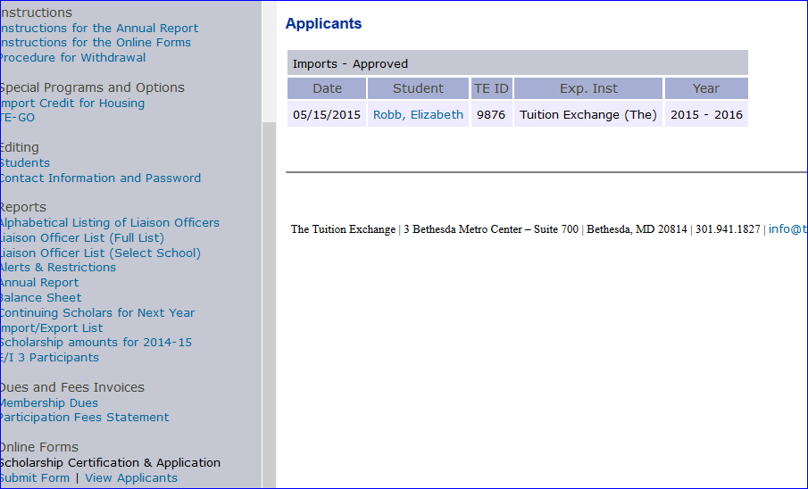
Review the list of APPROVED IMPORTS – this list contains all the students offered a TE award
Click on the individual student name that you wish to claim as enrolled – this action will open up the student’s record – see next slide

Slide 3
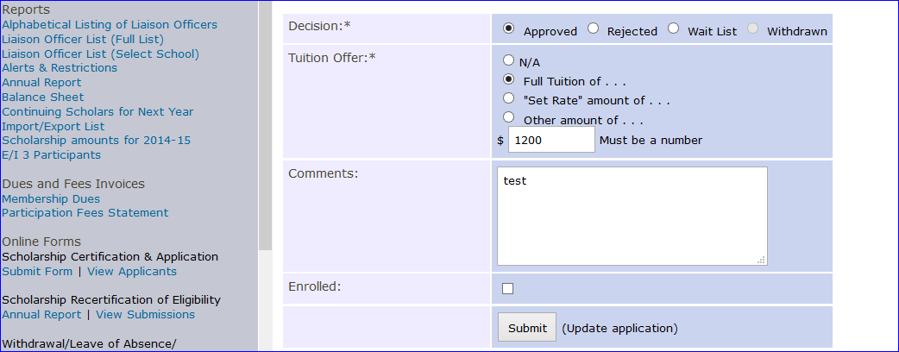
Be sure to review Tuition Amount Offered – update as needed

Slide 4
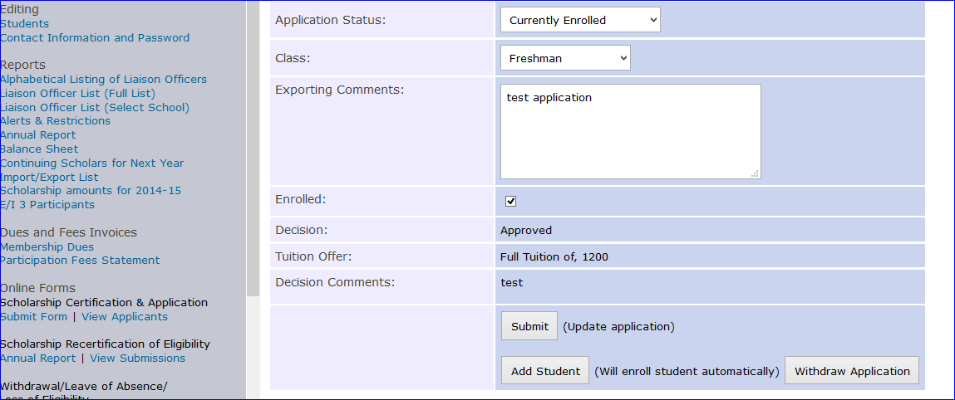
IMPORT school checks the Add Student and hits submit. This action adds the student to the IMPORT school’s Annual Report
You might consider adding a note – ie student paid enrollment deposit.

Slide 5
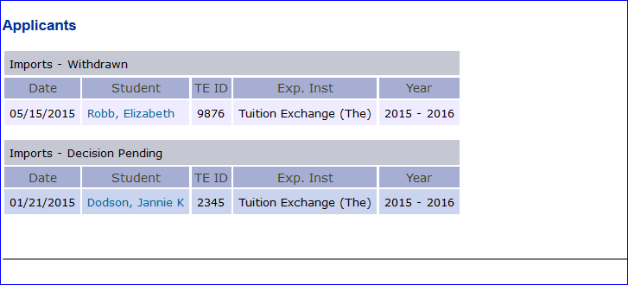
Updating new student TE award to Enrolled continued
When the IMPORTING school “enrolls” the student
The EXPORTING school details update
All other potential IMPORTING school records change to WITHDRAW

Slide 6
This is an example of a student’s application when an IMPORTING school claims the student. The student’s status updated to WITHDRAWN

Slide 7
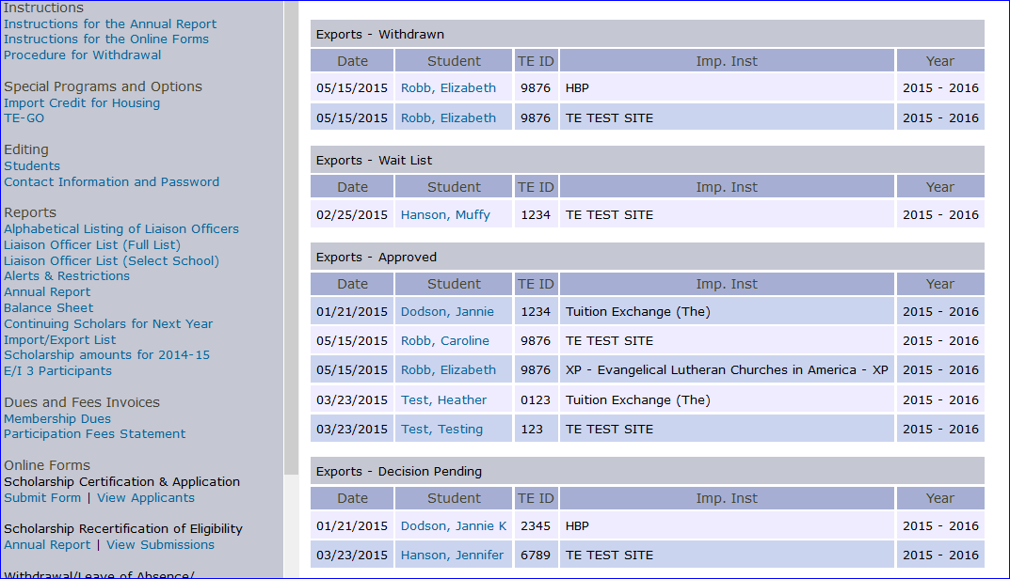
This is the EXPORTING school’s View Application option
Elizabeth applied to three schools – XP has enrolled the student
HBP and TE TEST Site schools will now show the student as WITHDRAWN
While it appears any school can uncheck the Enrolled box – only the IMPORTING school originally checking the Enrolled box can uncheck the Enrolled box making the student available to other schools.

Slide 8
Updating new student TE Award to Enrolled continued
Why update the student to ENROLLED
Claims the student as yours
When the Annual Report is created the student is added
No more double entry
Helps TE Central with additional data resources
Applied vs Enrolled

