Slide 1
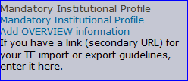
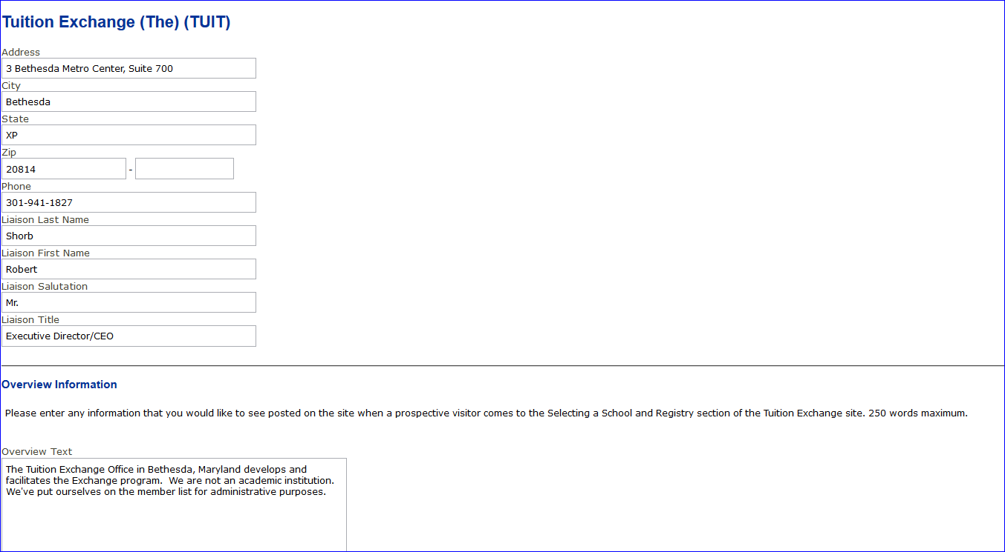
Adding my school’s overview message
Log in to your school’s TE account
Select Add Overview information
Add you school’s message here
Logos and pictures do not load properly
TE Central suggests using a positive message

