Slide 1
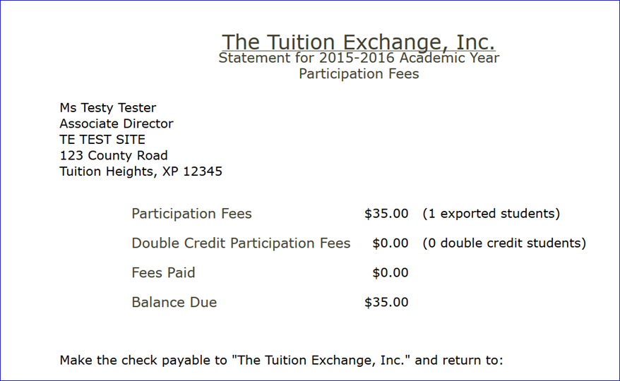
Click on Participate Fees Statement link
Request payment for Balance Due amount
Be sure to confirm our
address is correct in your
payment system.
Interested in ACH payment options?
Contact Kristine Lev at klev@tuitionexchange.org

