Slide 1
How do I delete a duplicate TE application record?

Slide 2
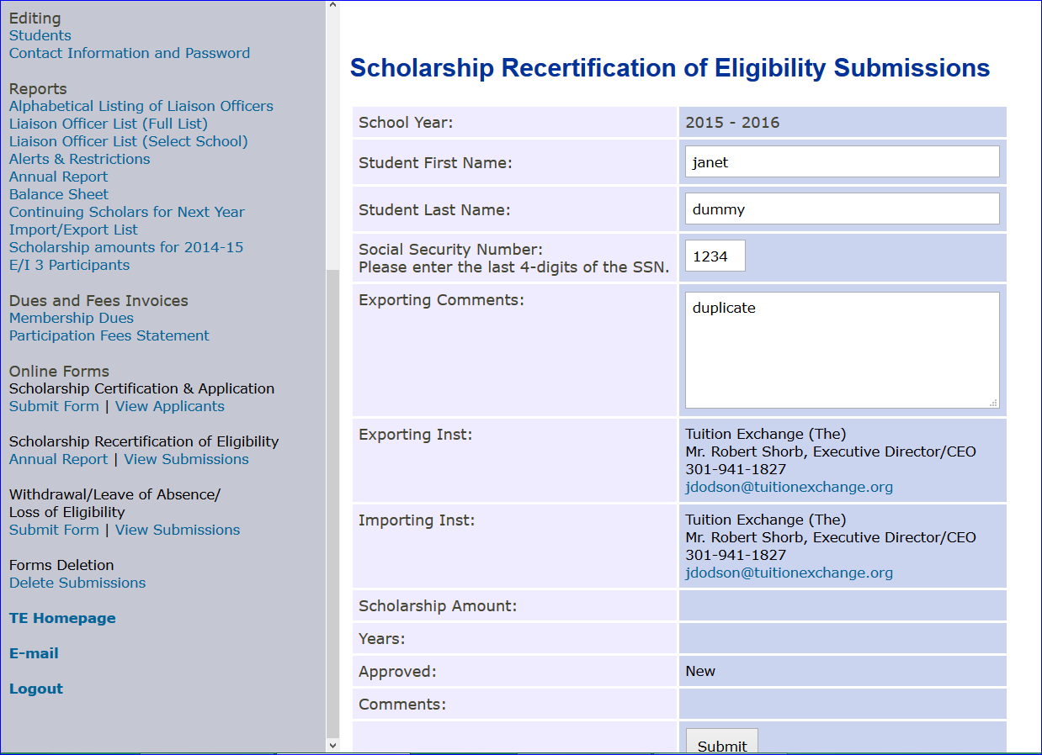
Type duplicate
Select Online Forms
Then click submit
Select View Submissions

Slide 3
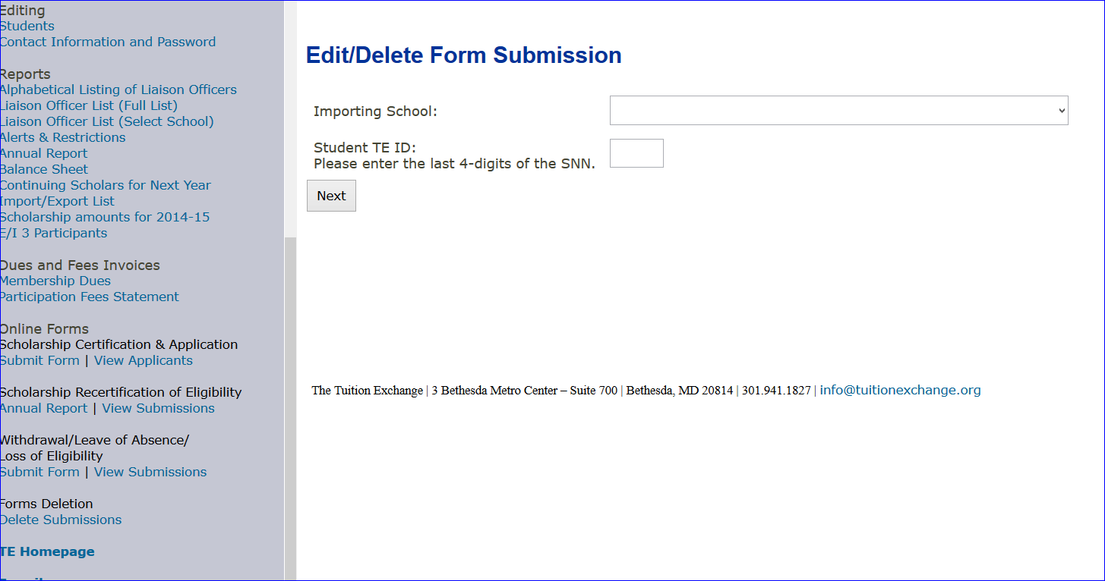
Be sure to remember the Importing school and TE ID

Slide 4
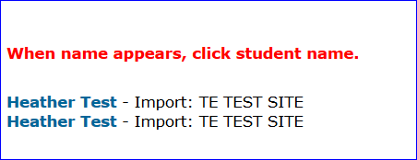
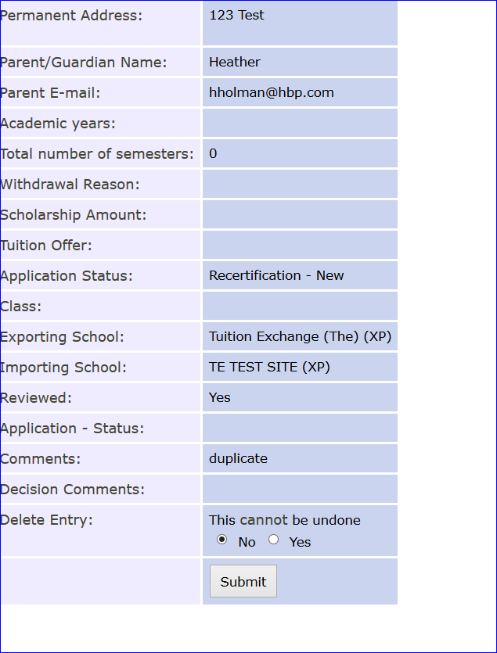
Click the last name option
If you see duplicate you have the right record. If not, try the other one
Change No to YES and click submit.

