Slide 1
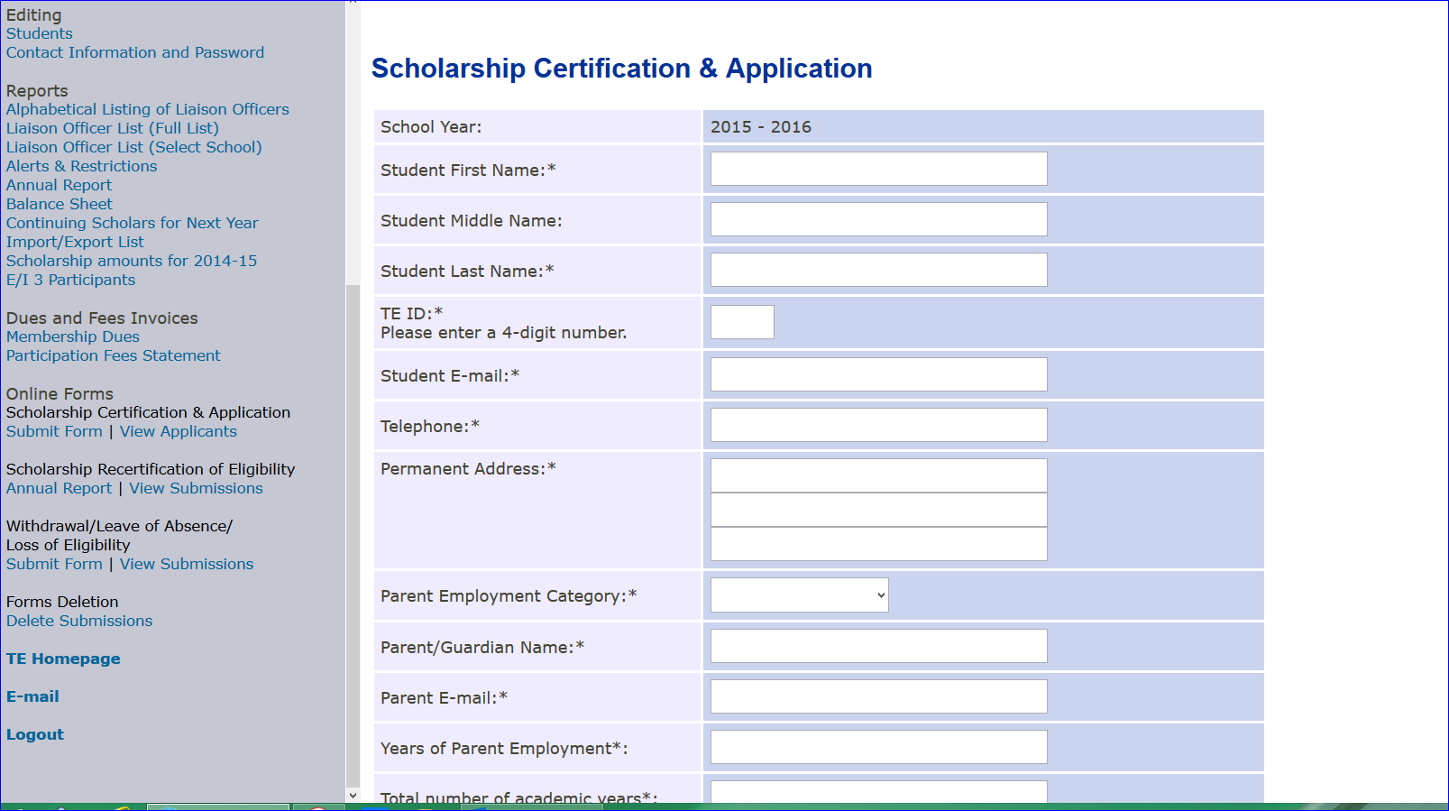
Start inside the TELO Portal
Selecting Online Forms
Submit Form
You will need to enter all the information with the *

Slide 2
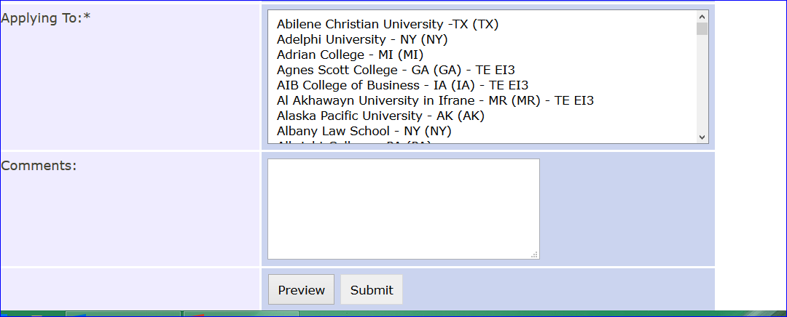
If you have the student’s complete shopping list of potential schools – you can select multiple. If you submit the record and the student wants to send the application to more – you will need to begin again.

Slide 3
Instructions
Scholarship Certification & Application Form - To be completed for each new student.
Fill in student name
Fill in last four digits of the student’s Social Security Number or another number that is unique to the student
Student e-mail
Telephone number
Permanent Address – first two lines are required
Parent/Guardian Name – important for tracking
Parent e-mail
Academic Years Use dates for the maximum number of years the TE sponsor is available to the student - example: 2014-2018 (four years)
Total number of semesters the student is eligible for: example 8 semesters would be for 4 years.
Application Status use pull down box
Class use pull down box
Applying To Use pull down box - hold down CTRL key to choose more than one school (you can choose as many schools as the student is applying to)
SUBMIT - this will send the application/certification to the respective school
This copied information is found inside the TELO portal on the right in the blue section under:
Instructions
Instructions for the Annual Report
Instructions for the Online Forms
Procedure for Withdrawal

